Slide 1
Learning Genie For Parents
WCCUSD EARLY LEARNING PROGRAM-
STATE PRESCHOOL

Slide 2
Welcome to Learning Genie for Parents
The information in these slides will….
Teach you how to download the app (slides 3-7)
Fill out the Daily Health card (slide 8)
Signing in (slides 9-13)
Signing out (slides 14-18)
Entering absence on Learning Genie app (slides 19-22)
Adding more than one child to an account (slide 23-25)

Slide 3
Download the Learning Genie app
You will receive a Learning Genie code from your teacher or the
preschool office. You will use this code when you download the app.
**Each person dropping off and picking up the child will need their
own code and will need to make their own account.
You can ask for as many codes as you need.
In the app store or on google play, search for
“Learning Genie for Parents”
** Make sure to download the app for parents and not educators.

Slide 4
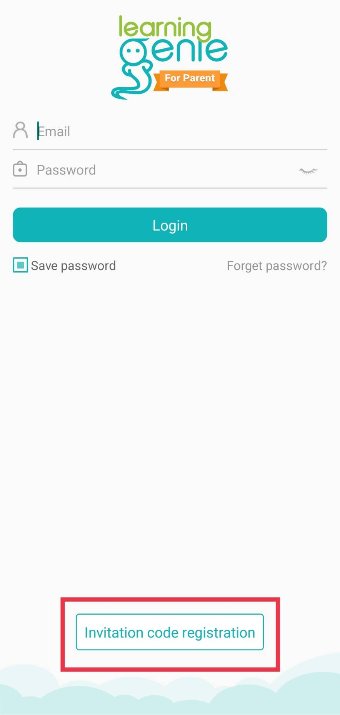
Getting Started
Step 1
Once the app is downloaded click on “invitation code”
at the bottom.

Slide 5
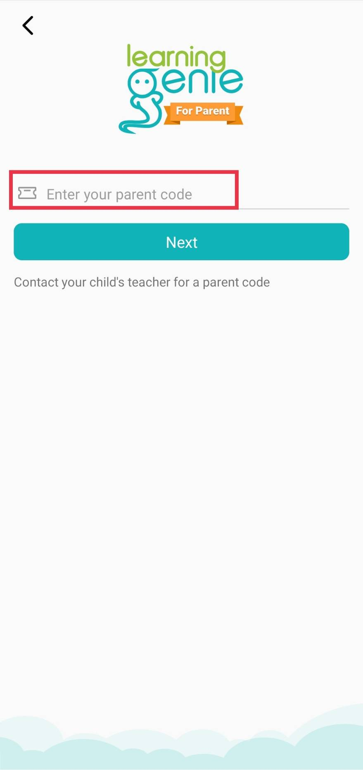
Getting Started (2)
Step 2
Enter the code you received
from your teacher or the
preschool office.

Slide 6
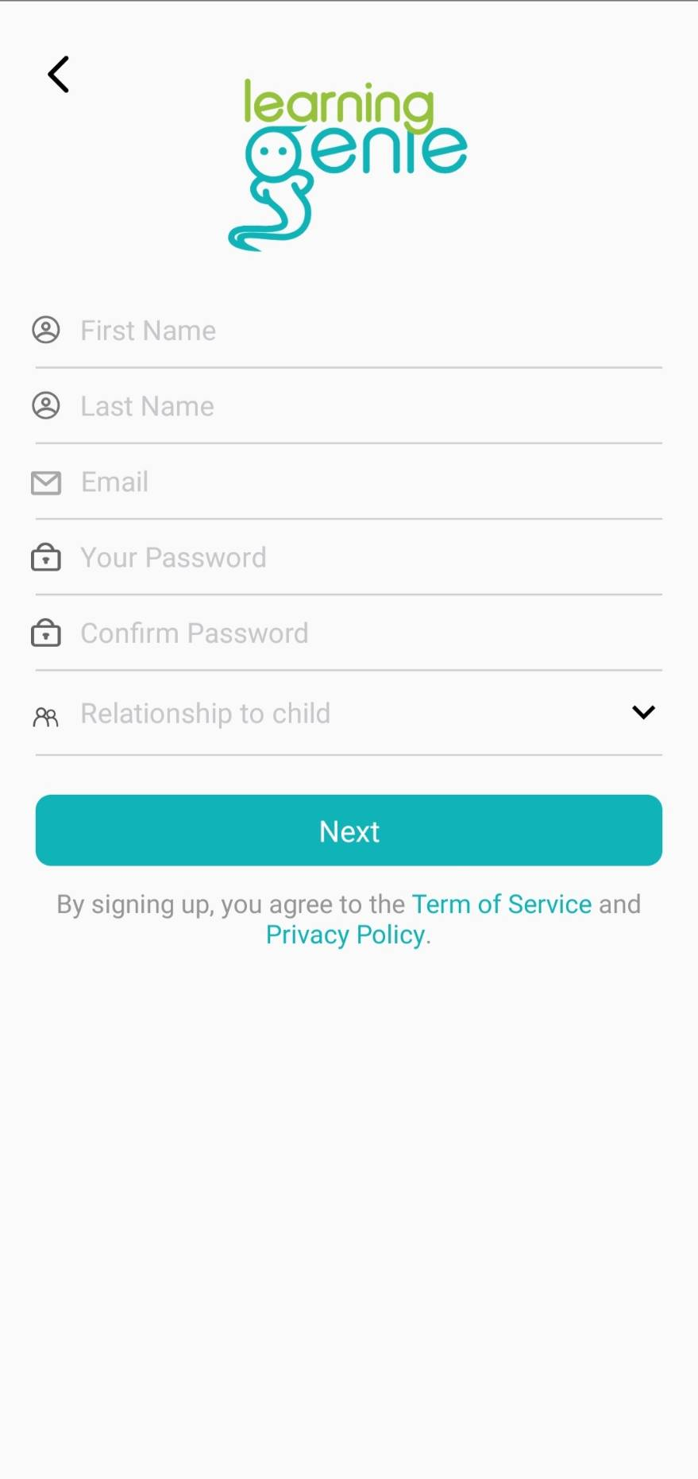
Getting Started (3)
Step 3
Create your account and click “Next”.

Slide 7
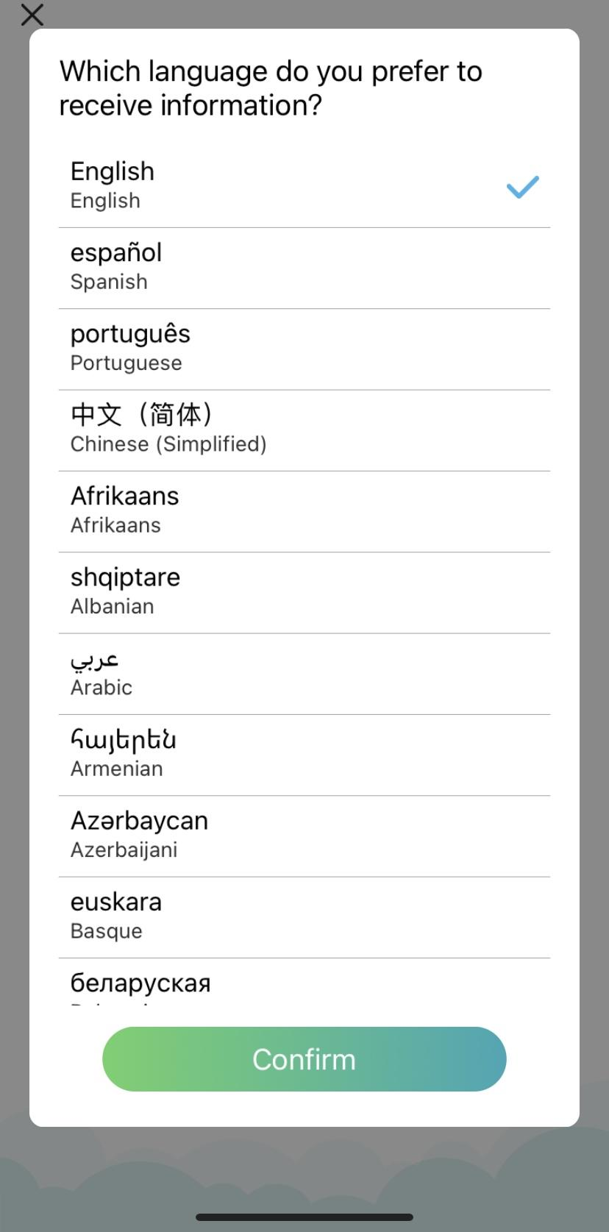
Getting started (4)
Step 4
Once you create your account you will be asked to
choose your preferred language.
All information you receive on the app
will be in the language you choose.

Slide 8
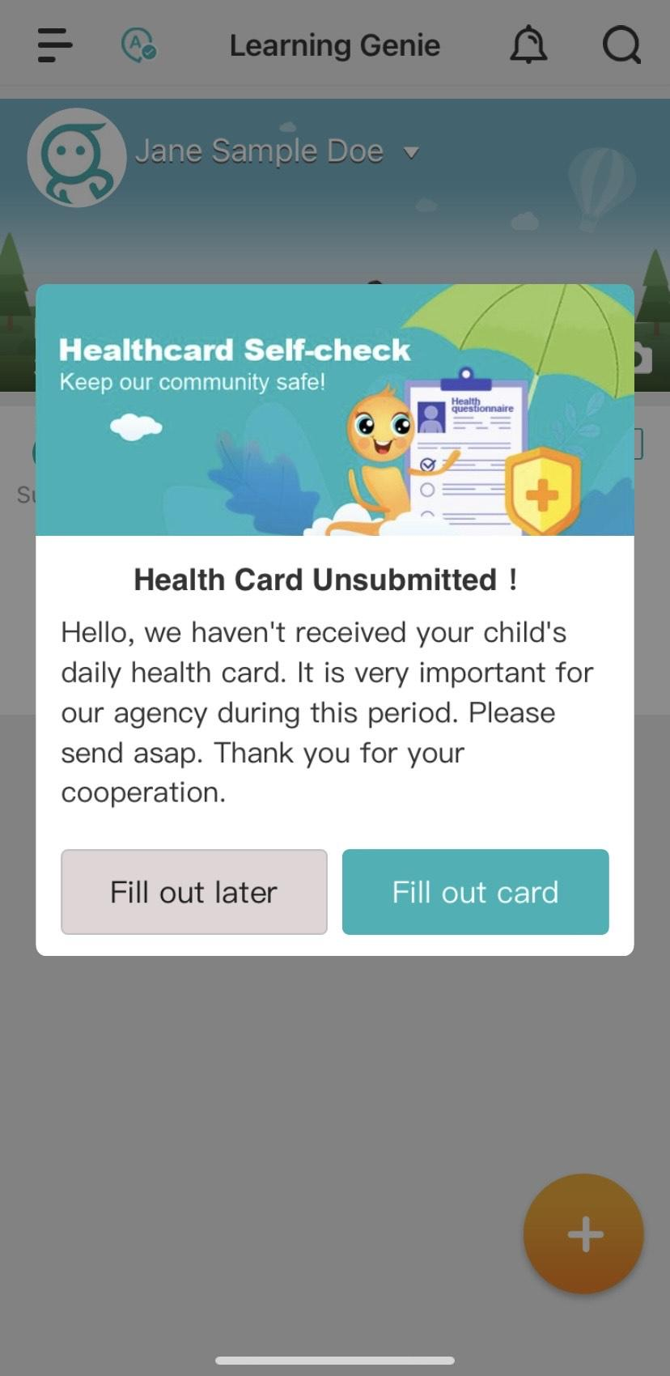
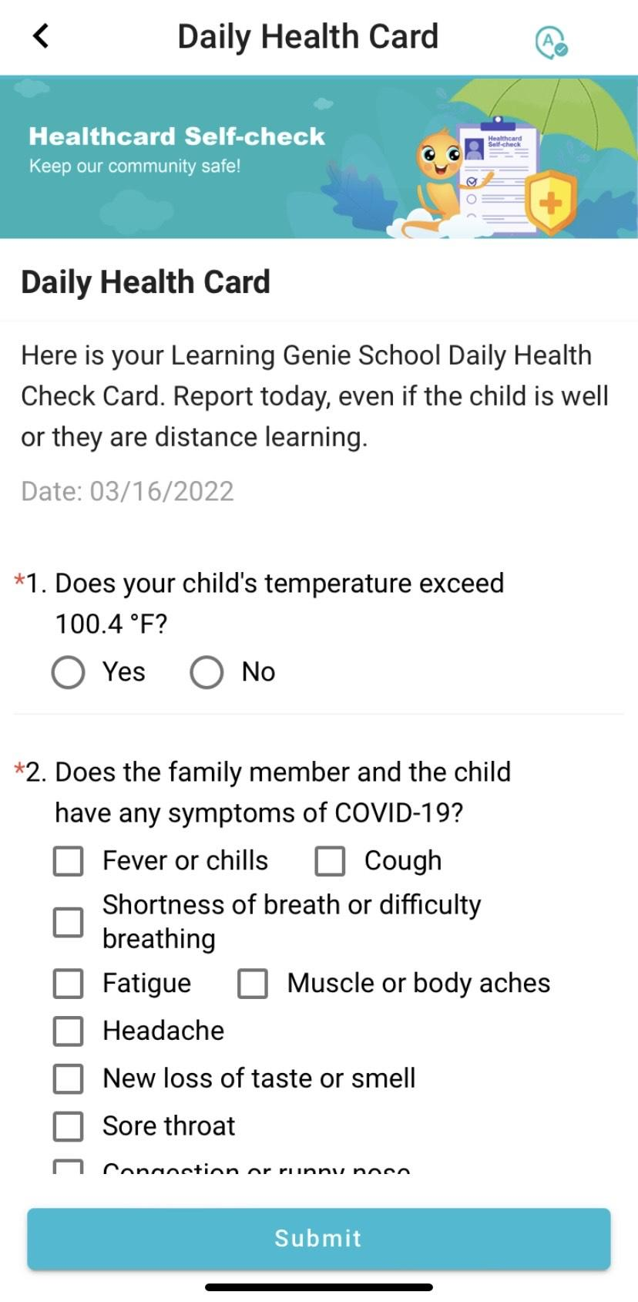
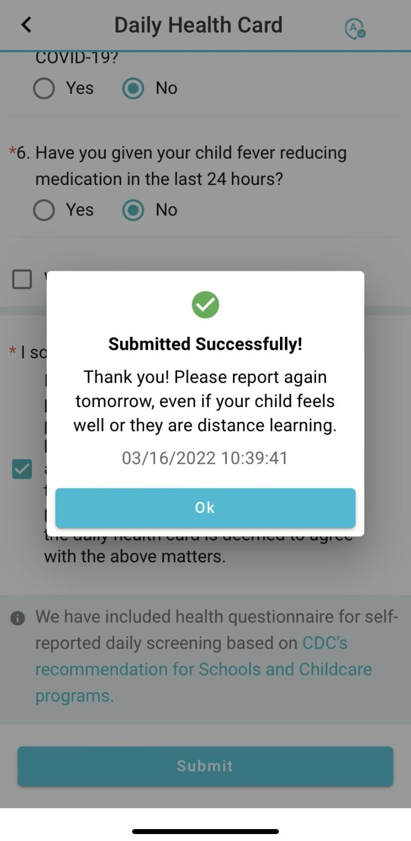
Daily Health Card
You will be asked to fill out a daily health card every day before coming to school.
The health card will pop up on the app every day when you log in.
Click on “Fill out card” and answer all questions. Then click submit at the bottom.

Slide 9
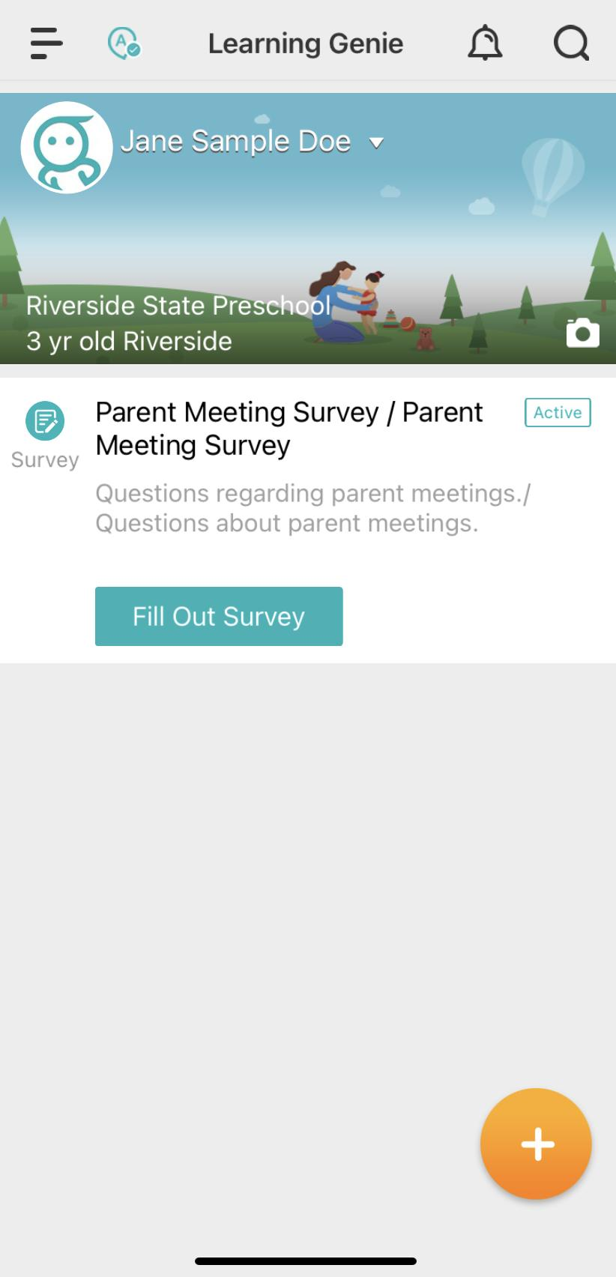
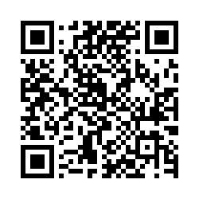
Signing in
During sign in at school the teacher will provide a
QR code for you to
sign your child in and out daily.
Step 1
Click on the orange circle at
the bottom of the page.

Slide 10
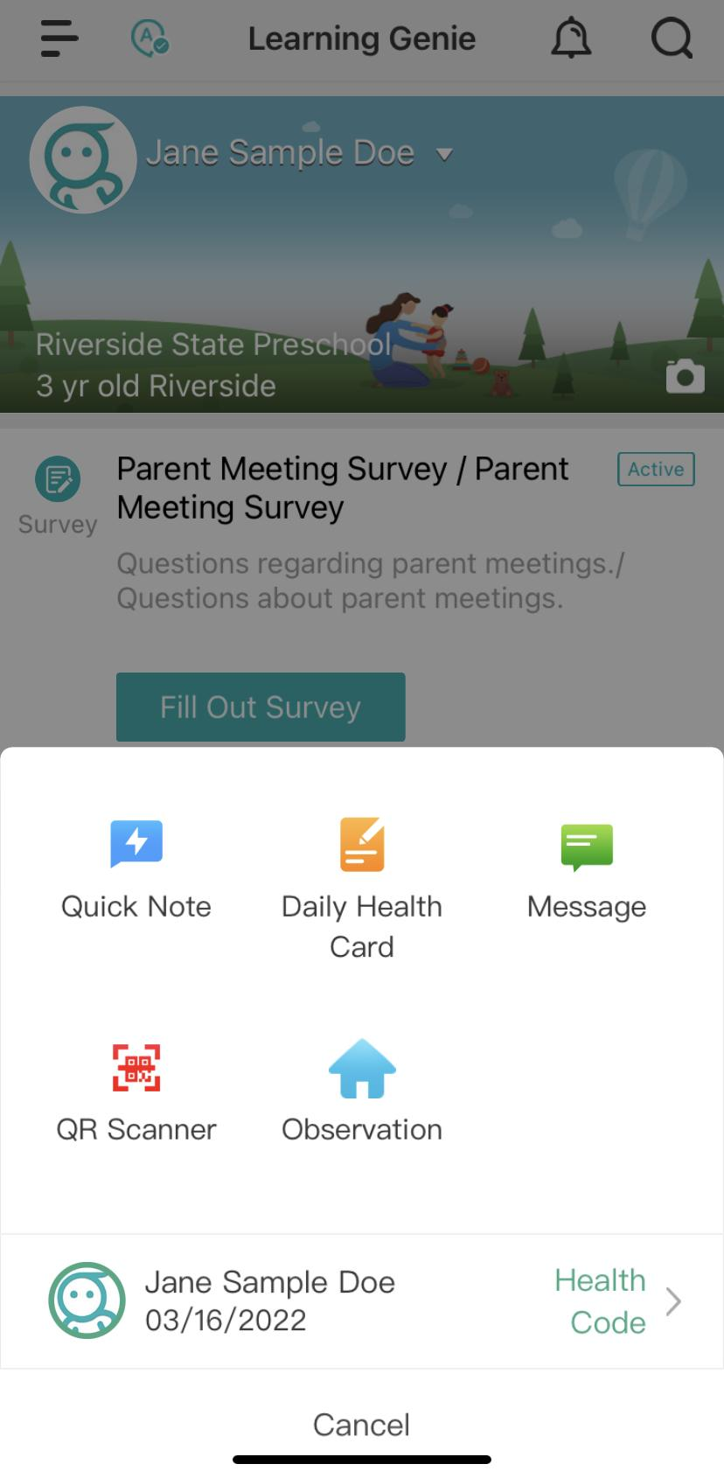
Signing in (2)
Step 2
Click on “QR Scanner”.
It will have a picture of a
red QR scanner above it.

Slide 11
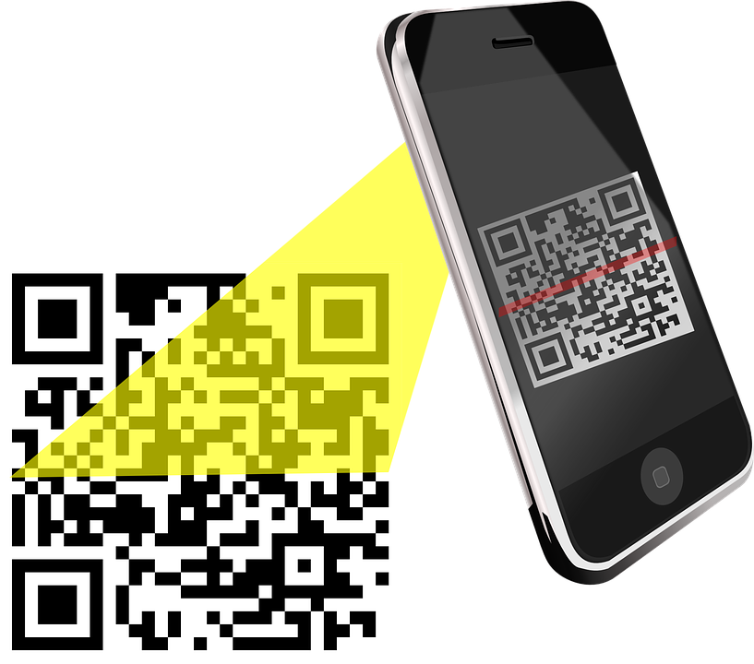
Signing in (3)
Step 3
After you click on the red QR Scanner
you will then be able to scan the QR code
provided by the teacher.

Slide 12
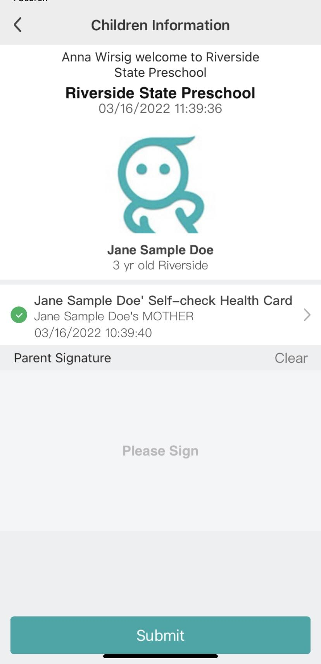
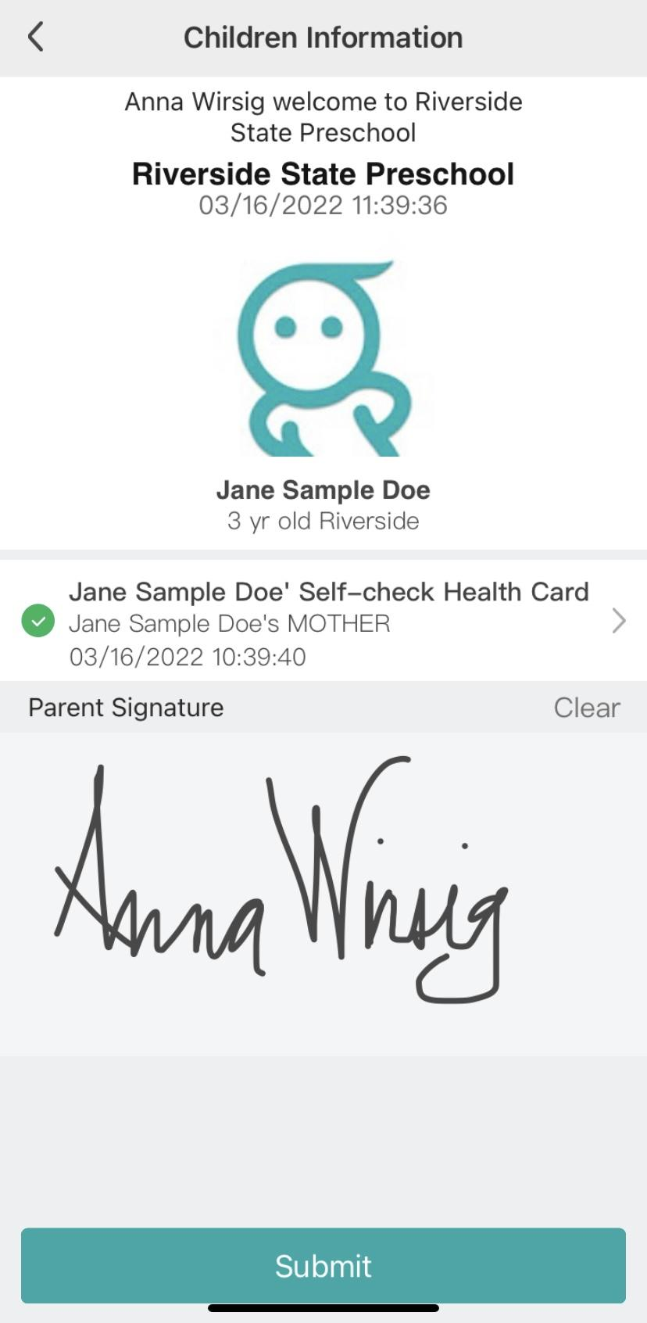
Singing in (4)
Step 4
After you scan, you will be asked
to sign your child in. Please sign
your FULL signature (first and
last name). Please no initials.
After you sign your name,
press “Submit”.

Slide 13
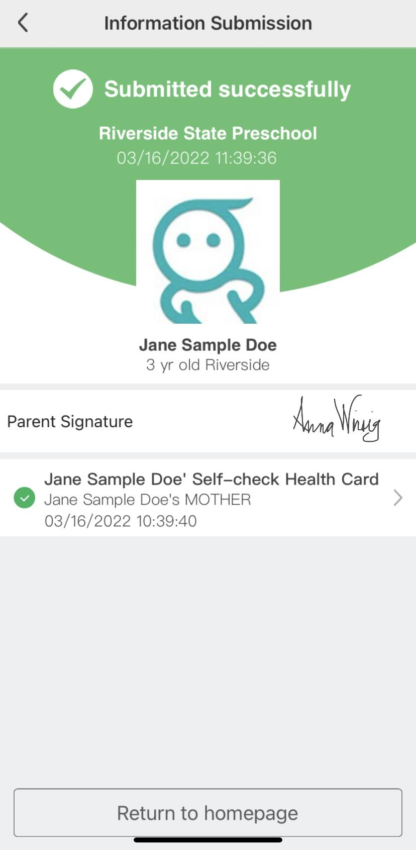
Signing in (5)
Step 5
After you press submit, please show your child’s
teacher this confirmation page.
….
Your child is now signed in!

Slide 14
Signing out
Step 1
To sign your child out at the end
of the school day, you will need to log
back into the learning genie app and
click on the orange circle.

Slide 15
Signing out (2)
Step 2
Click on QR scanner.

Slide 16
Signing out (3)
Scan the teacher provided QR code.

Slide 17
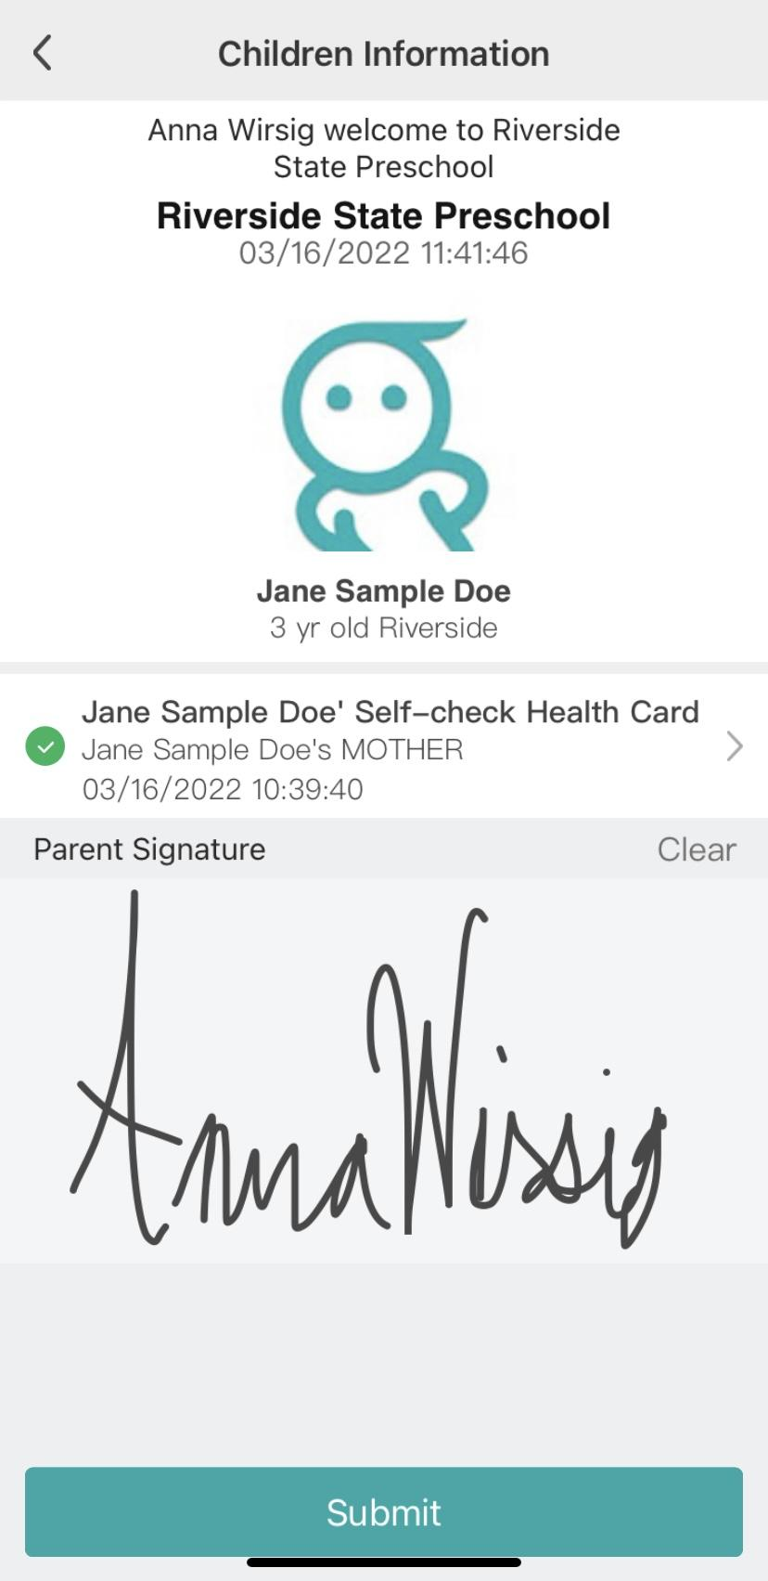
Sign out (4)
Step 4
Sign your FULL signature
and click “Submit”.

Slide 18
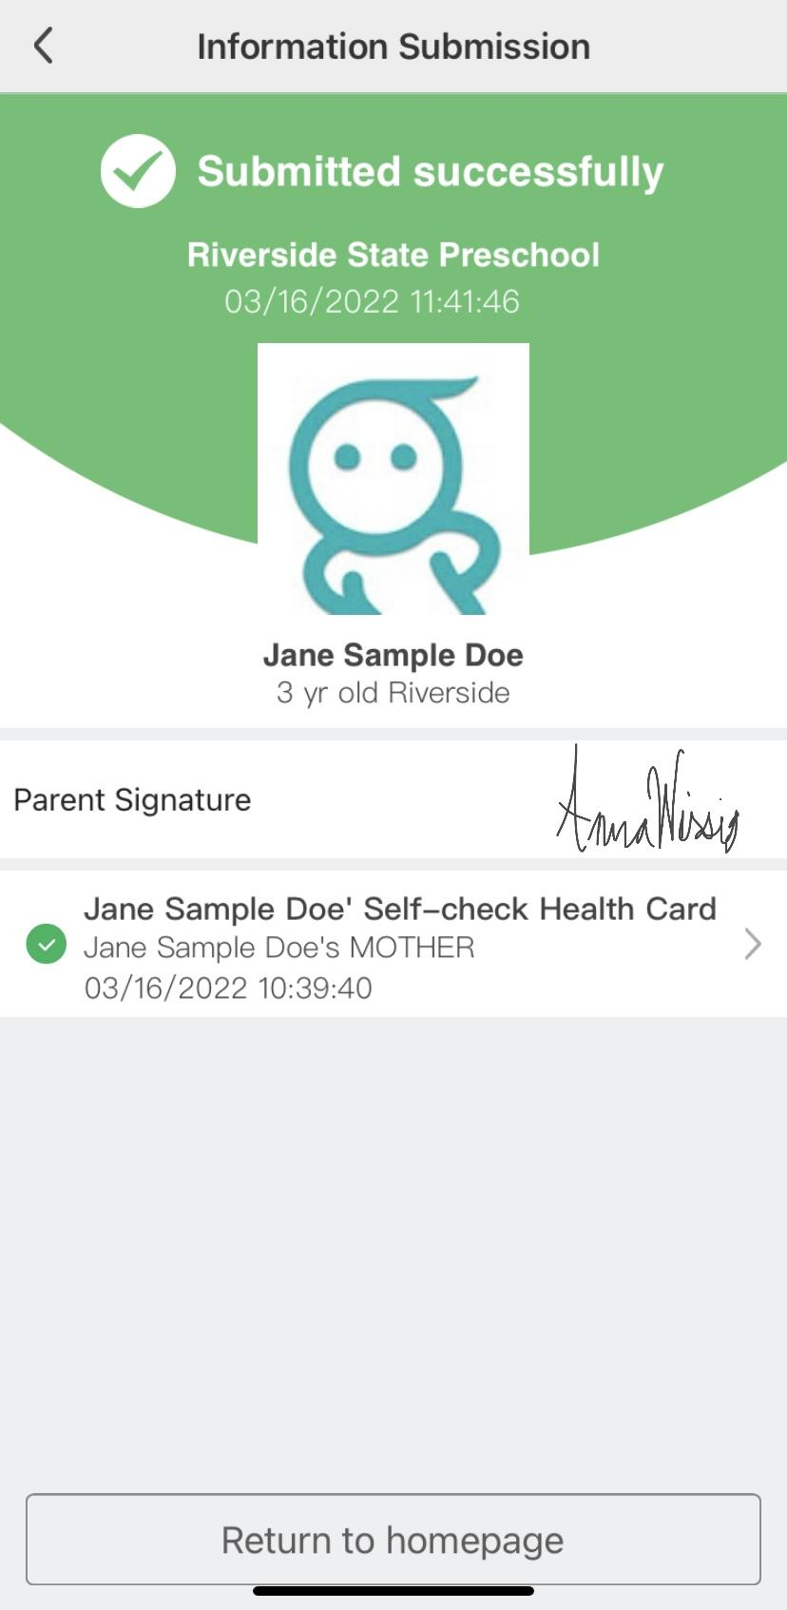
Sign out (5)
Step 5
After you press submit, please show your child’s
teacher this confirmation page.
….
Your child is now signed out!

Slide 19
Entering Absence on Learning Genie app
Step 1
Log into your learning genie app
And click on the orange button
at the bottom.
Then click on
“Daily Health Card”.

Slide 20
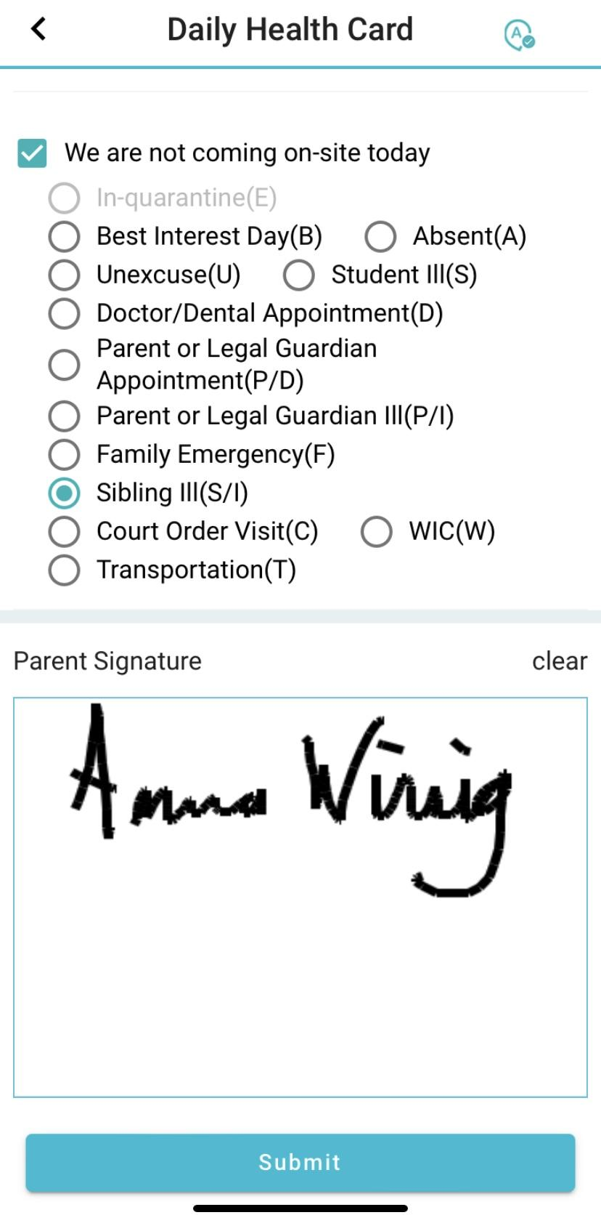
Entering Absence on Learning Genie app (2)
Step 2
Click on your child’s name and fill
out the health card.
Click the box
at the bottom that says “We are not coming
on site today” and choose a reason.
**If none of the reasons are stated on the form, please refer
to the parent handbook.

Slide 21
Entering Absence on Learning Genie app (3)
Step 3
After you choose the reason, sign
your full signature and click
“submit”.

Slide 22
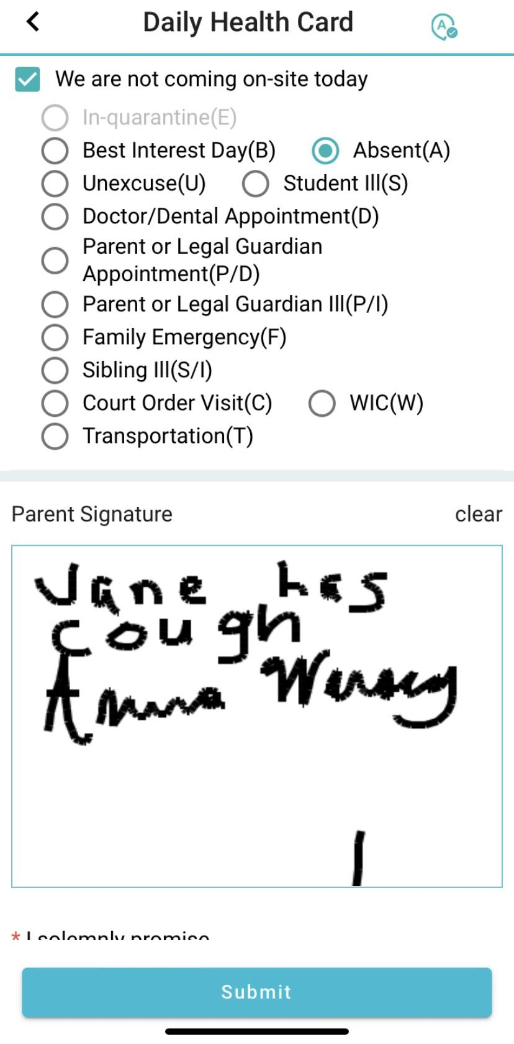
Entering Absence on Learning Genie app (4)
If you choose “Absent”
Please write a specific reason.
“Who and why”. (See Example)
Then sign and click “Submit”.

Slide 23
Adding More than one Child to an Account
Step 1
To add another child to your
account , click on the three bars
at the top of the page.

Slide 24
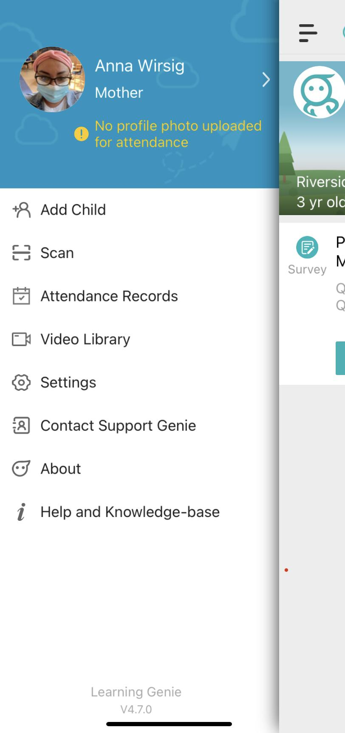
Adding More than one Child to an Account (2)
Step 2
Click on “Add Child”.

Slide 25
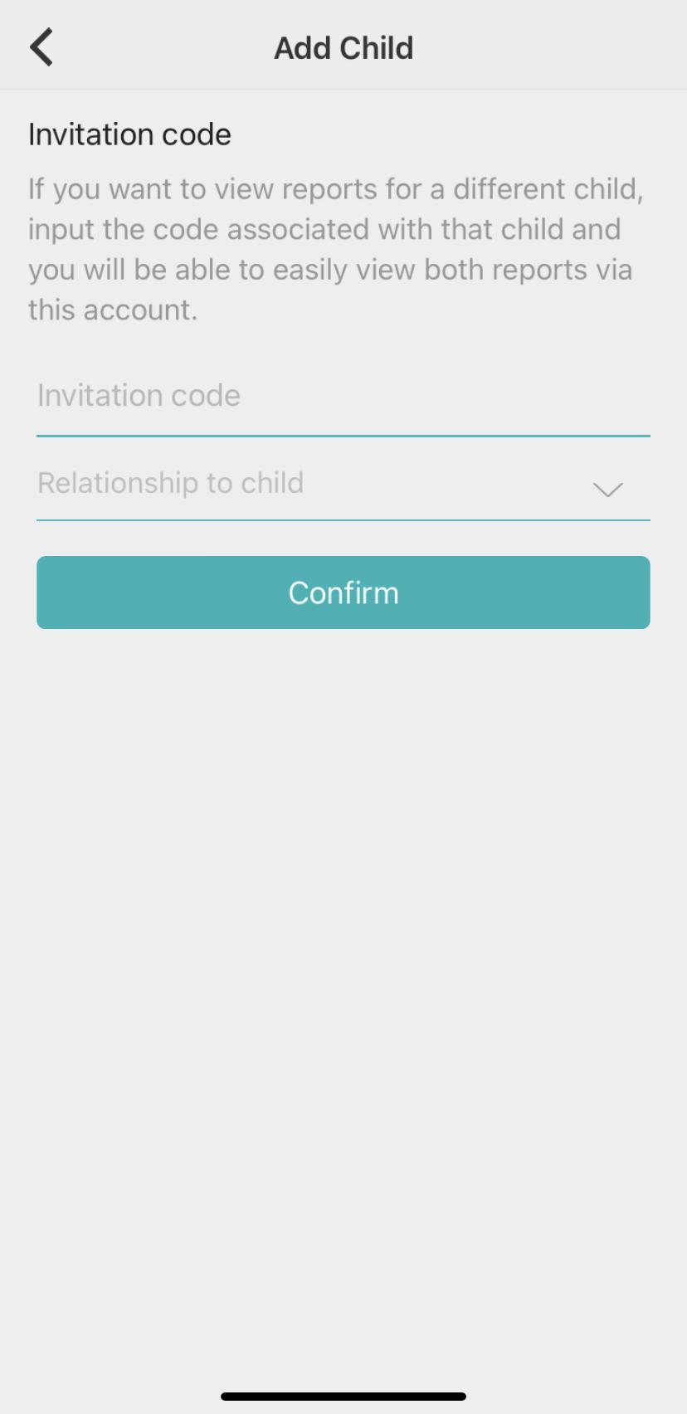
Adding More than one Child to an Account (3)
Step 3
Add the invitation code
of the child you are adding.
Add your relationship to the child
and click “Confirm”.
Your child is now added!
** Every child has their own
personal invitation codes.

Slide 26
Thank you!
This Concludes our presentation.

