Slide 1
8th Grade Social Science Review part 2
The 8th Grade portion is 48% of the 8th Grade Test

Slide 2
The 8th grade portion is divided into 2 sections:
  U.S. Constitution and the Early Republic - 30%
    Part 1 = 8.1-8.3 – 11 questions
    Part 2 = 8.4-8.8 – 18 questions
  Civil War and its Aftermath - 18%
    Part 3 = 8.9-8.12 -

Slide 3
U.S. History Standards
8.1 - Revolution
8.2 – Forming a New Nation
8.3 – American Political System
8.4 – A new Republic
8.5 – Expanding the Nation
8.6 – Americans in Mid-1800’s
8.7 – The South 1800-1850
8.8 – The West 1800 - 1850

Slide 4
U.S. History
Standards
8.9 – The Union Challenged
8.10 – The Civil War
8.11 – The Reconstruction
8. 12 – The Industrial Revolution

Slide 5
8.4 – A new Republic
Chapter 11 Political Developments in the Early Republic
1. inauguration (p. 146)
2. Executive departments (p. 146)
3. French Revolution
4. Alexander Hamilton
5. Thomas Jefferson
6. John Adams (p. 155)
7. the Alien & Sedition Acts (p 155)
8. sedition (p. 155)
9. aliens (p. 155)
10. States rights (p. 156
11. resolution (p.156)
12. nullify (p. 156)
13. Election of 1800 157
14. 12th Amendment158
15. deadlock (p. 158)

Slide 6
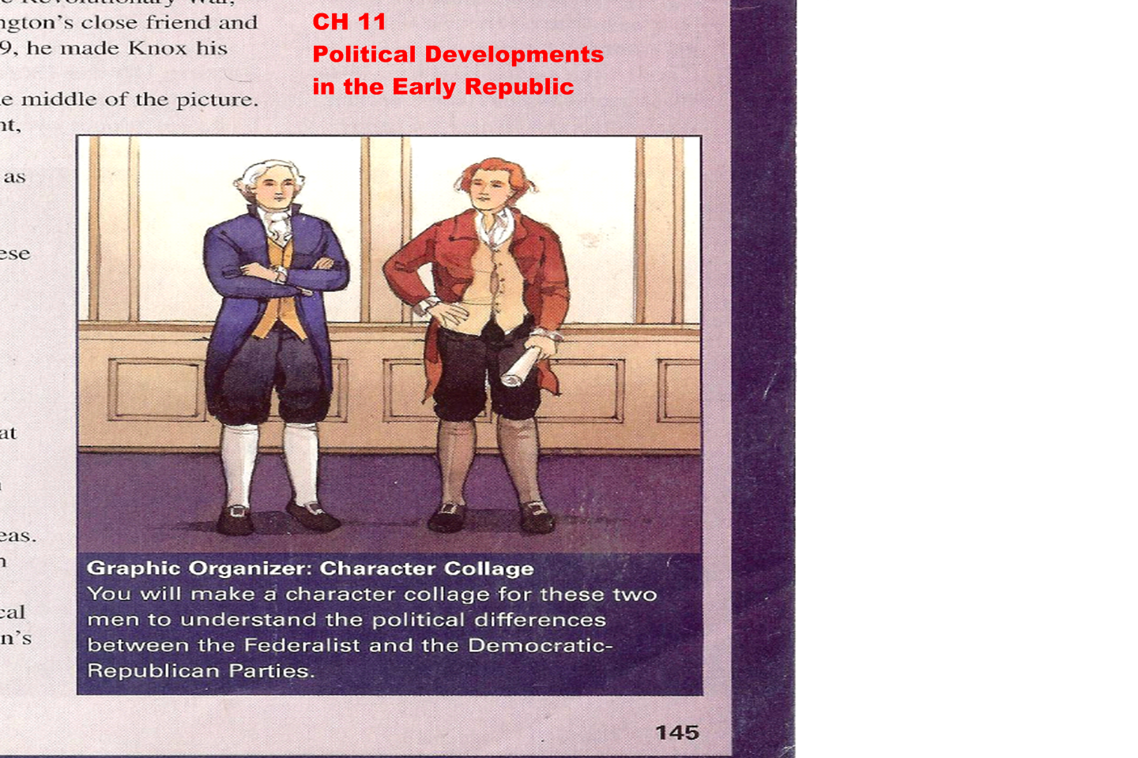

Slide 7
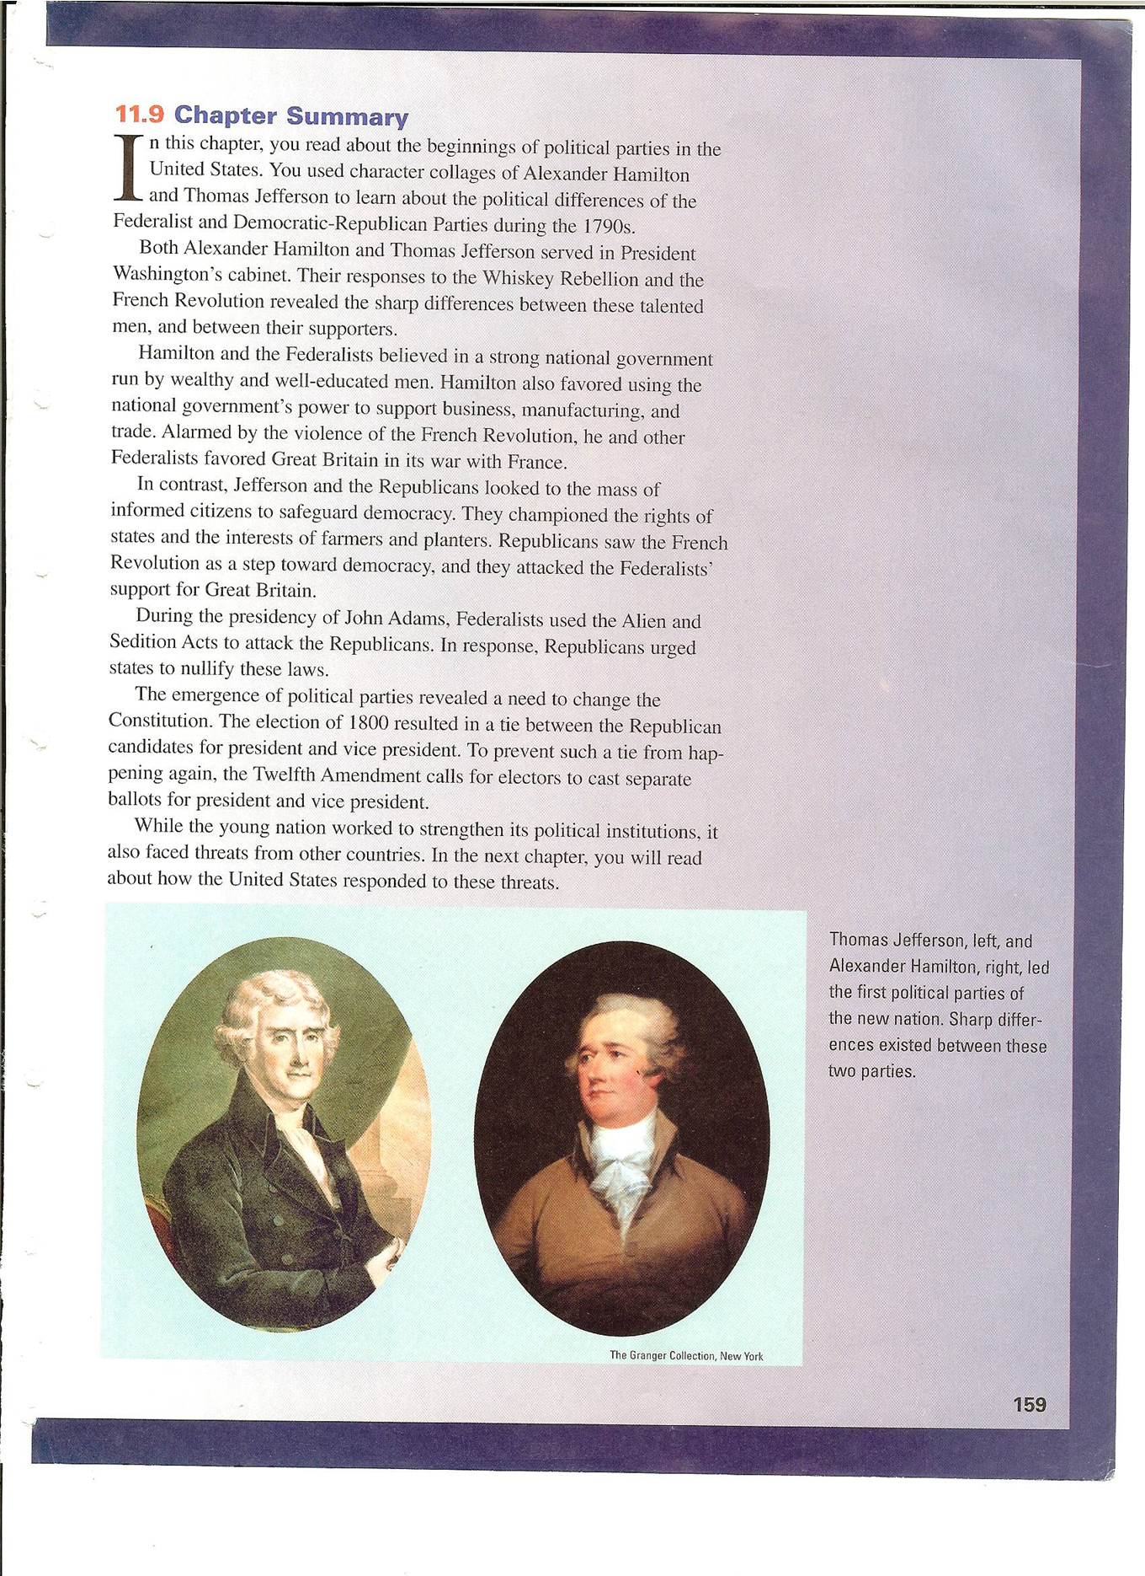

Slide 8
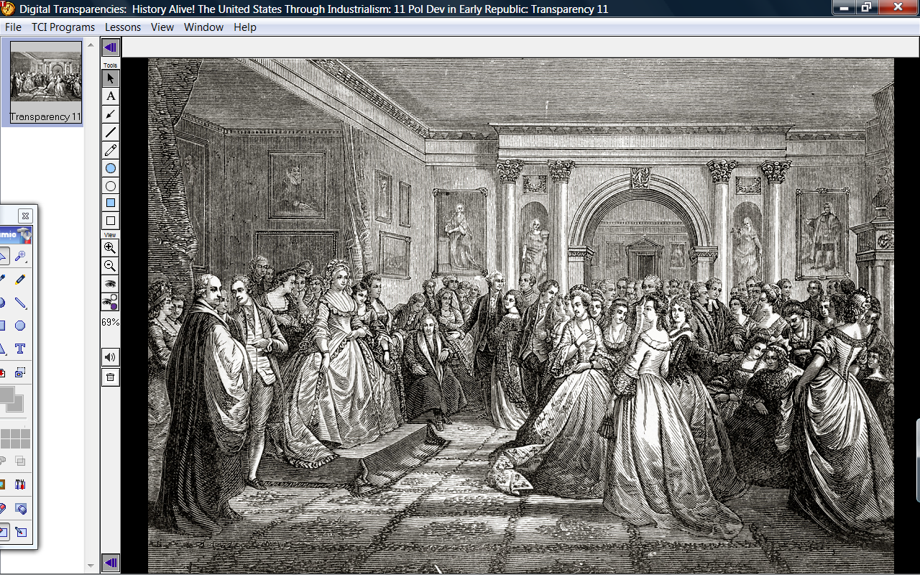
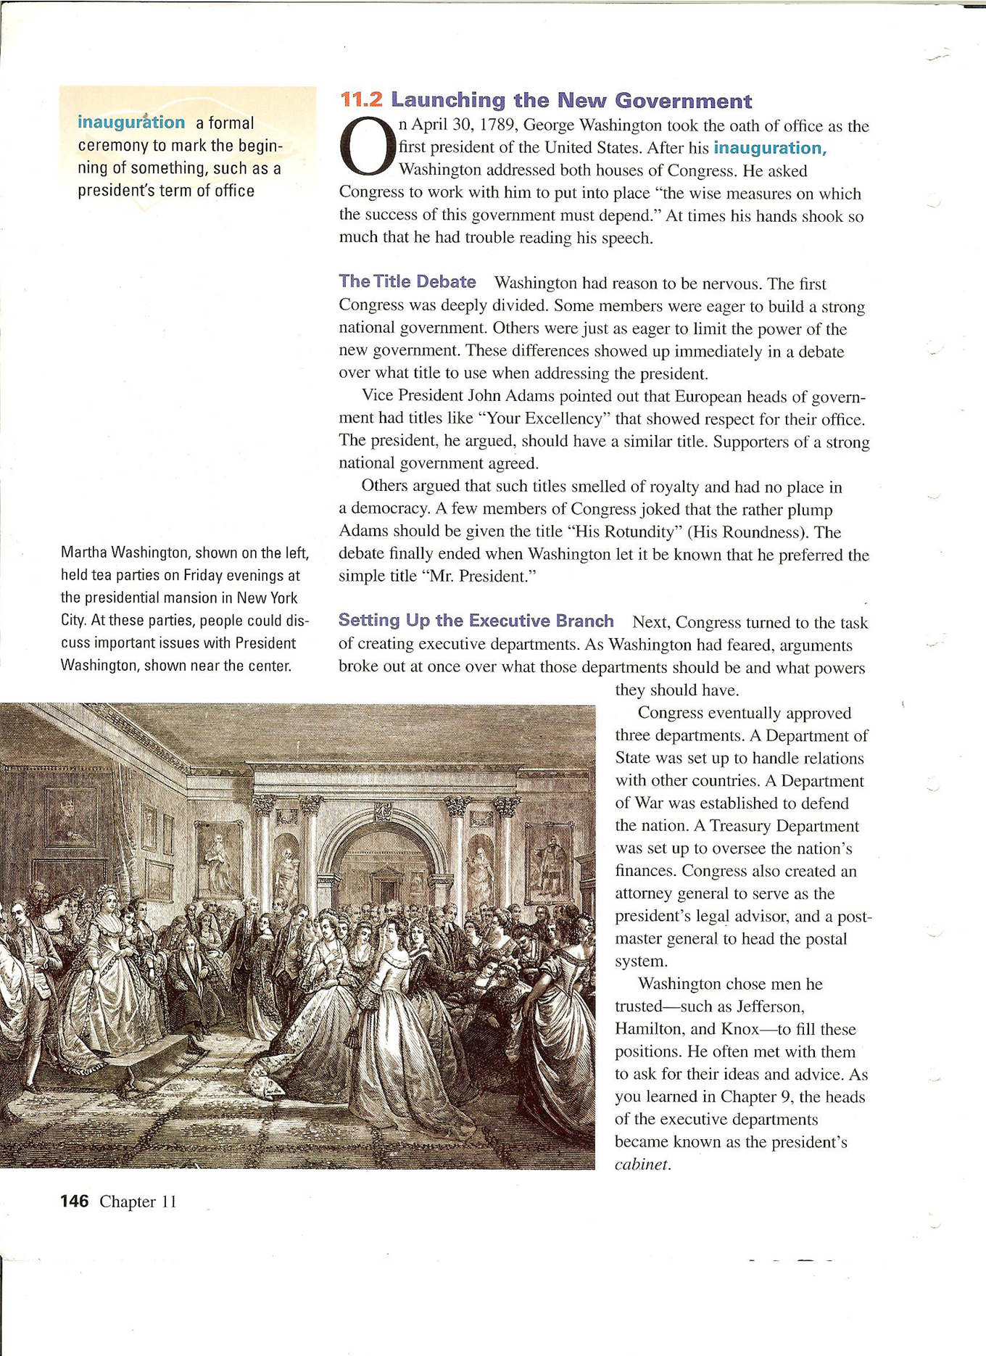

Slide 9
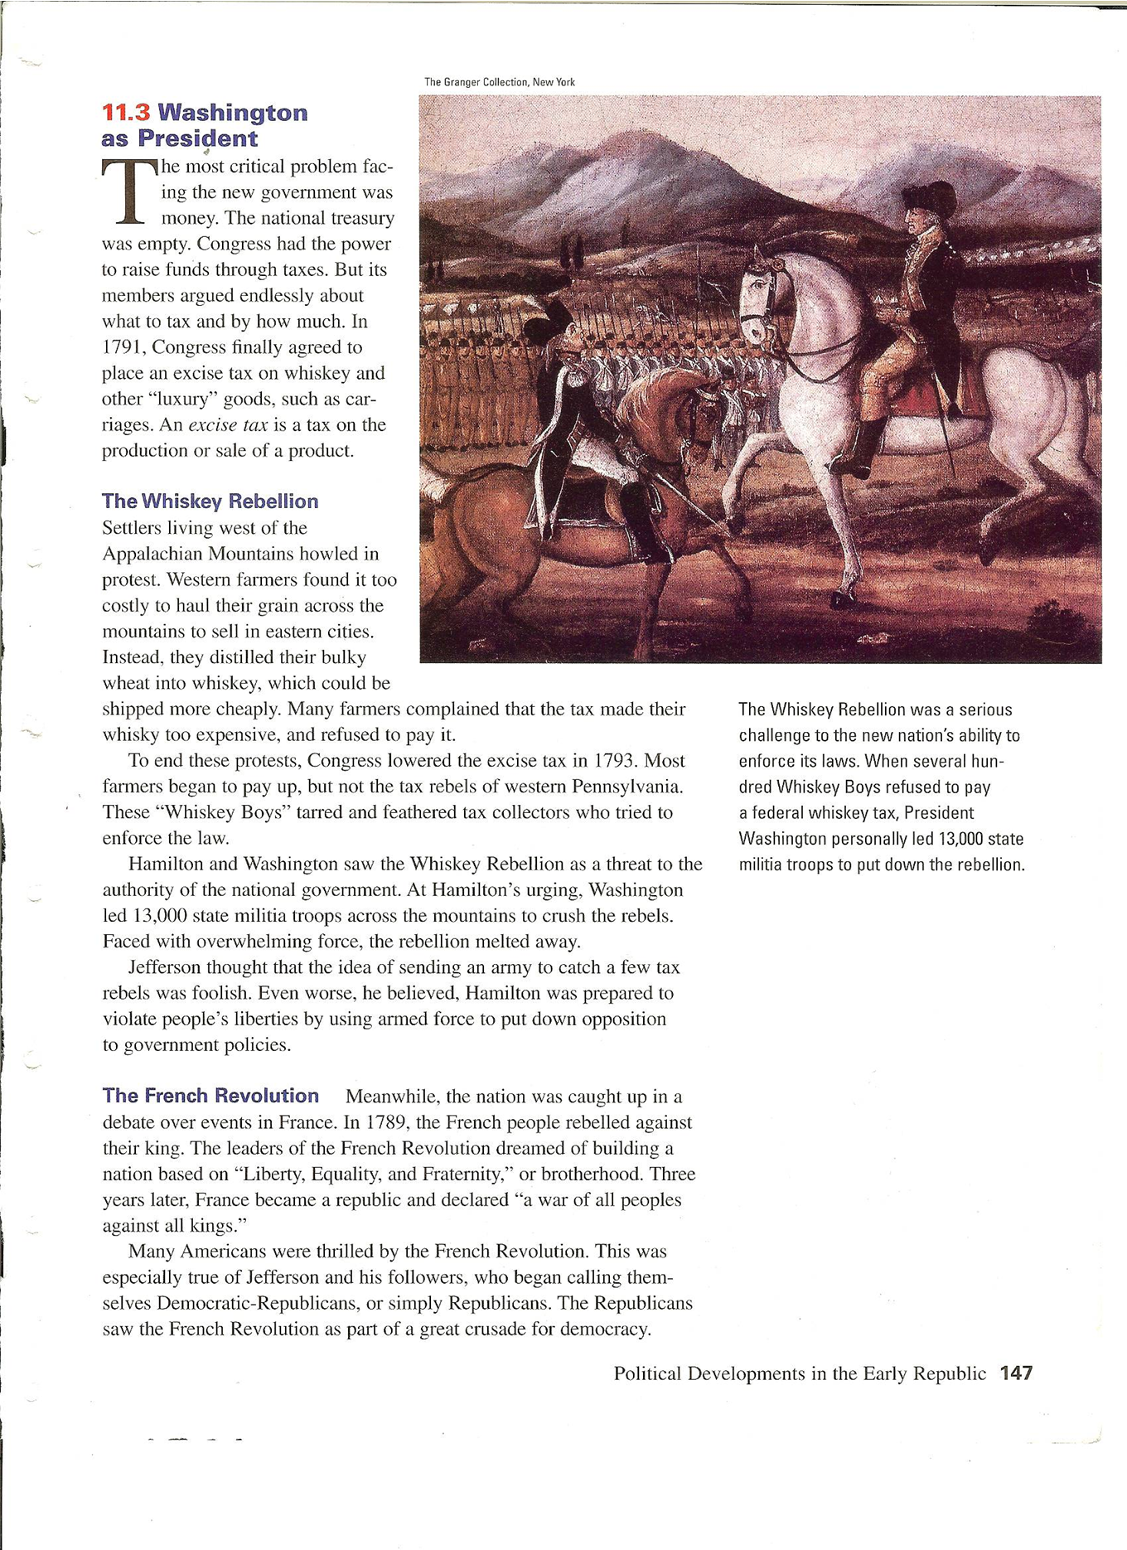

Slide 10
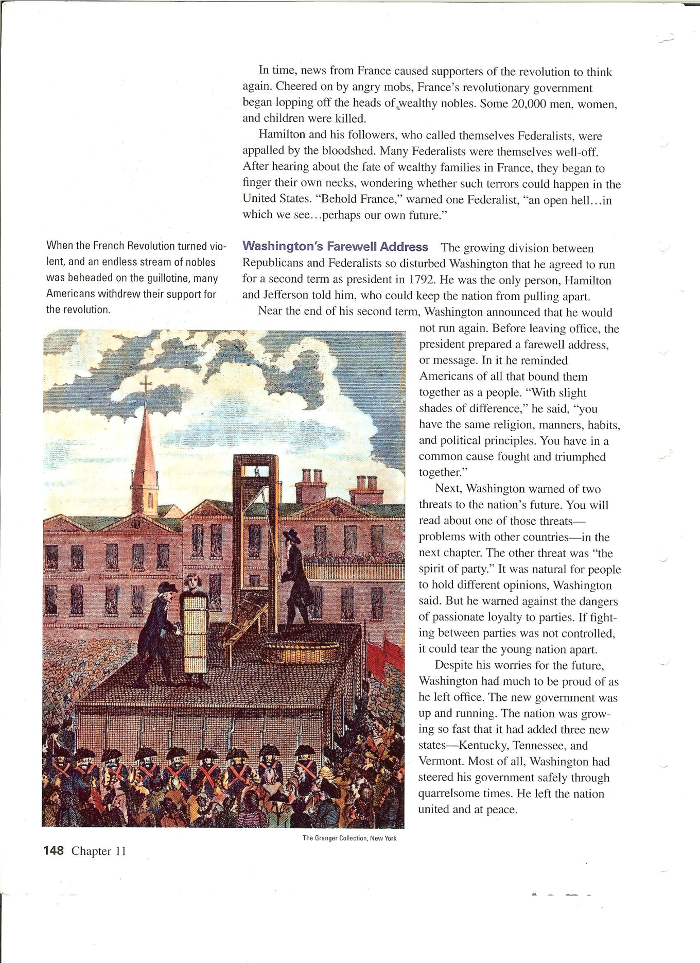

Slide 11
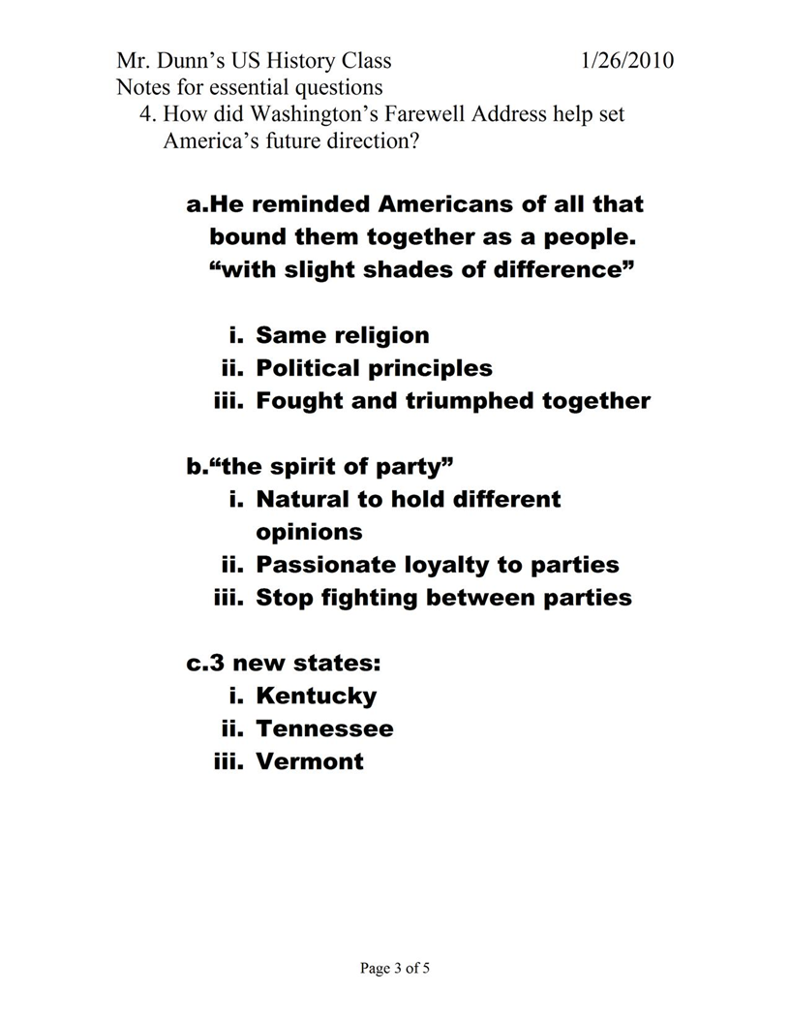

Slide 12
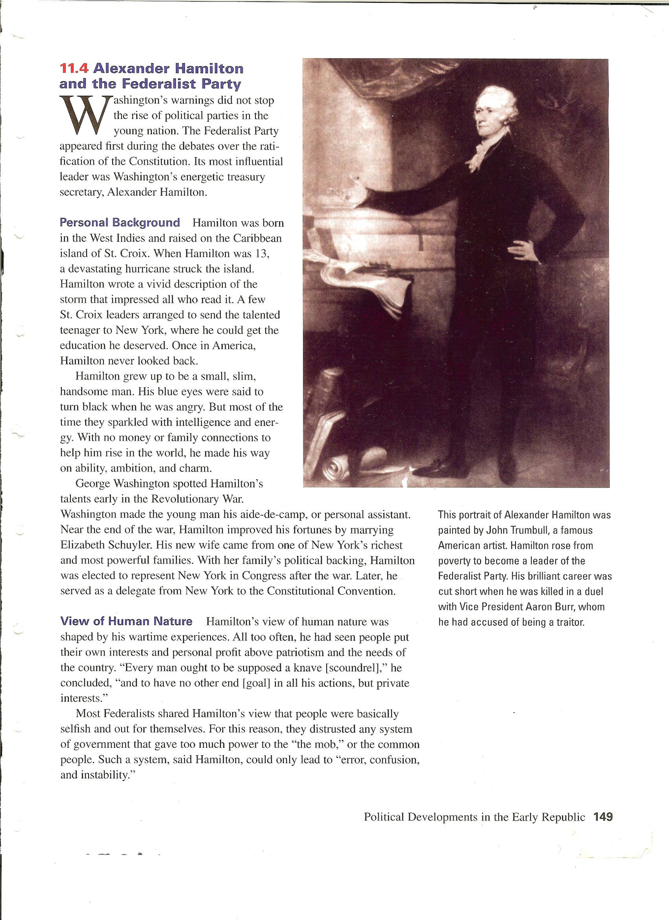

Slide 13
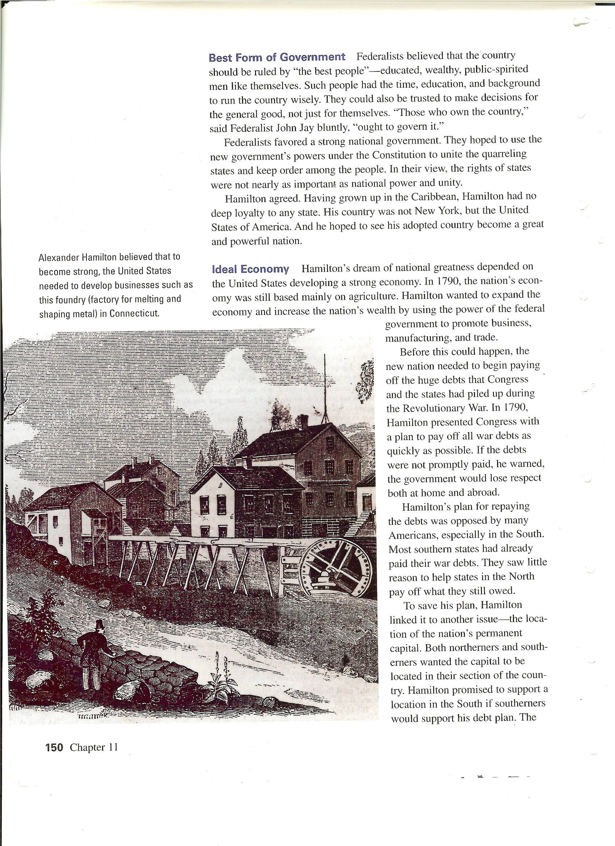

Slide 14
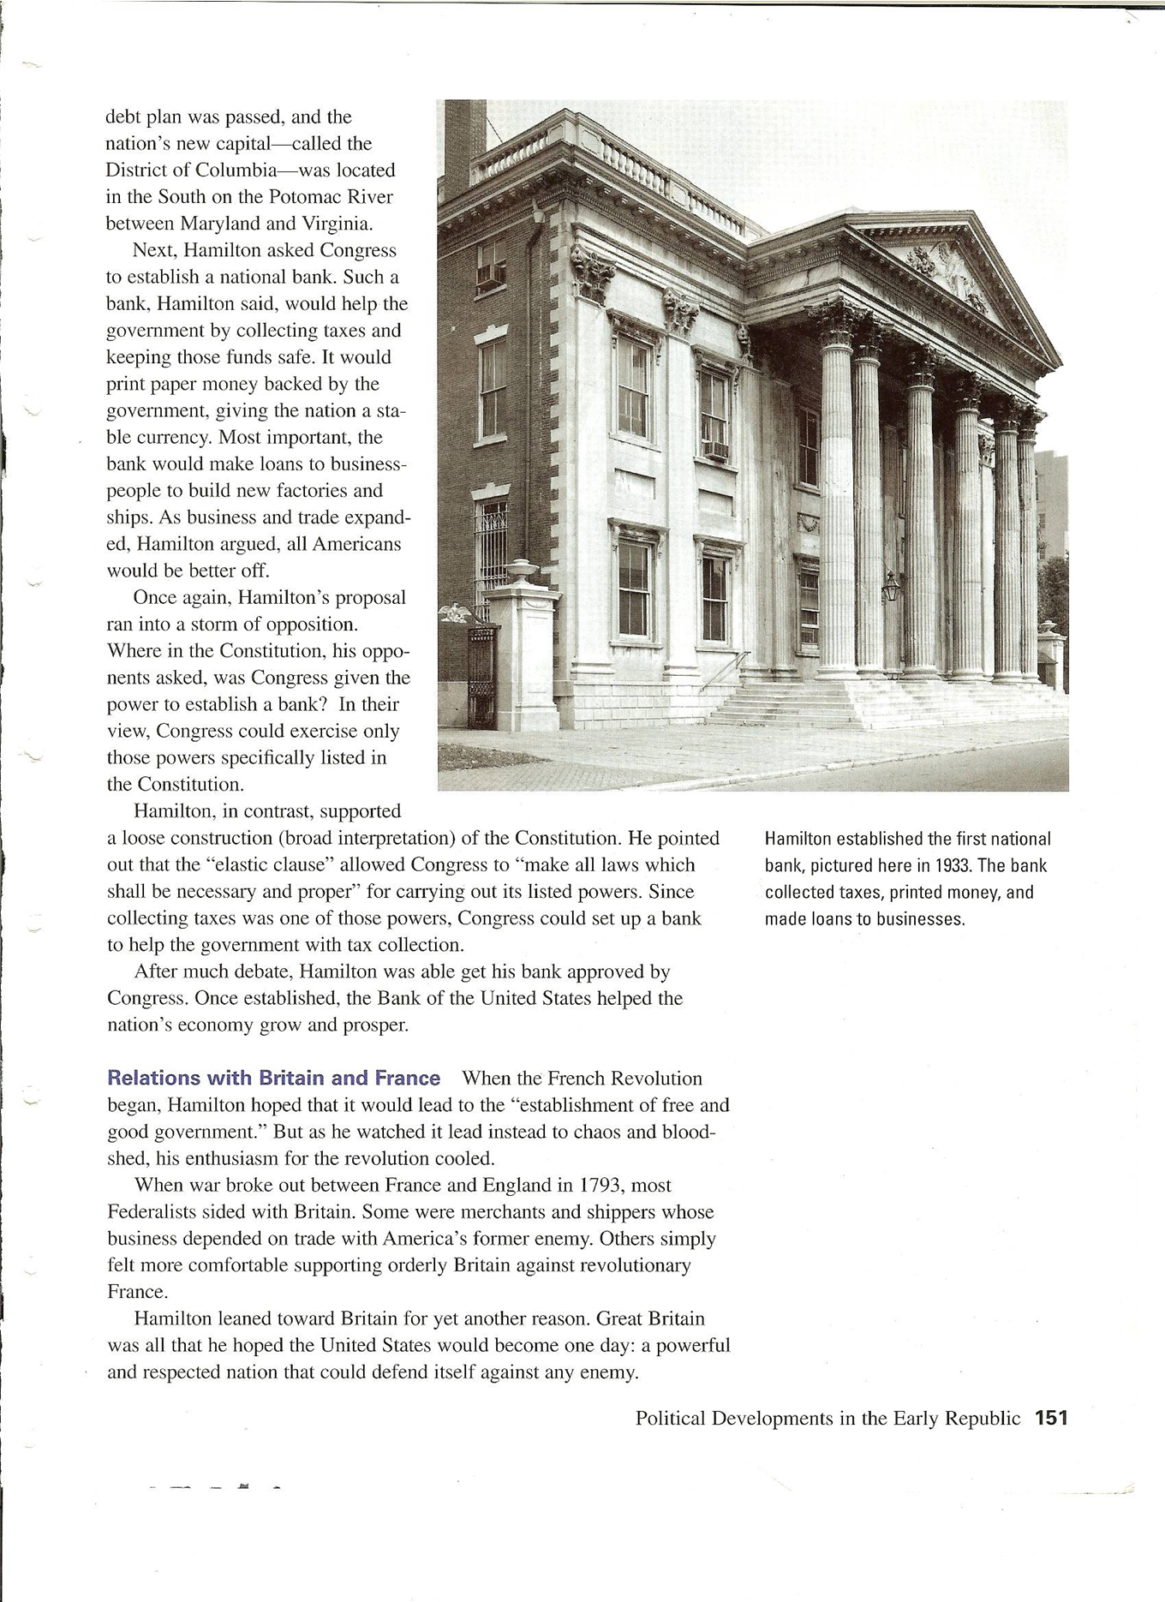

Slide 15
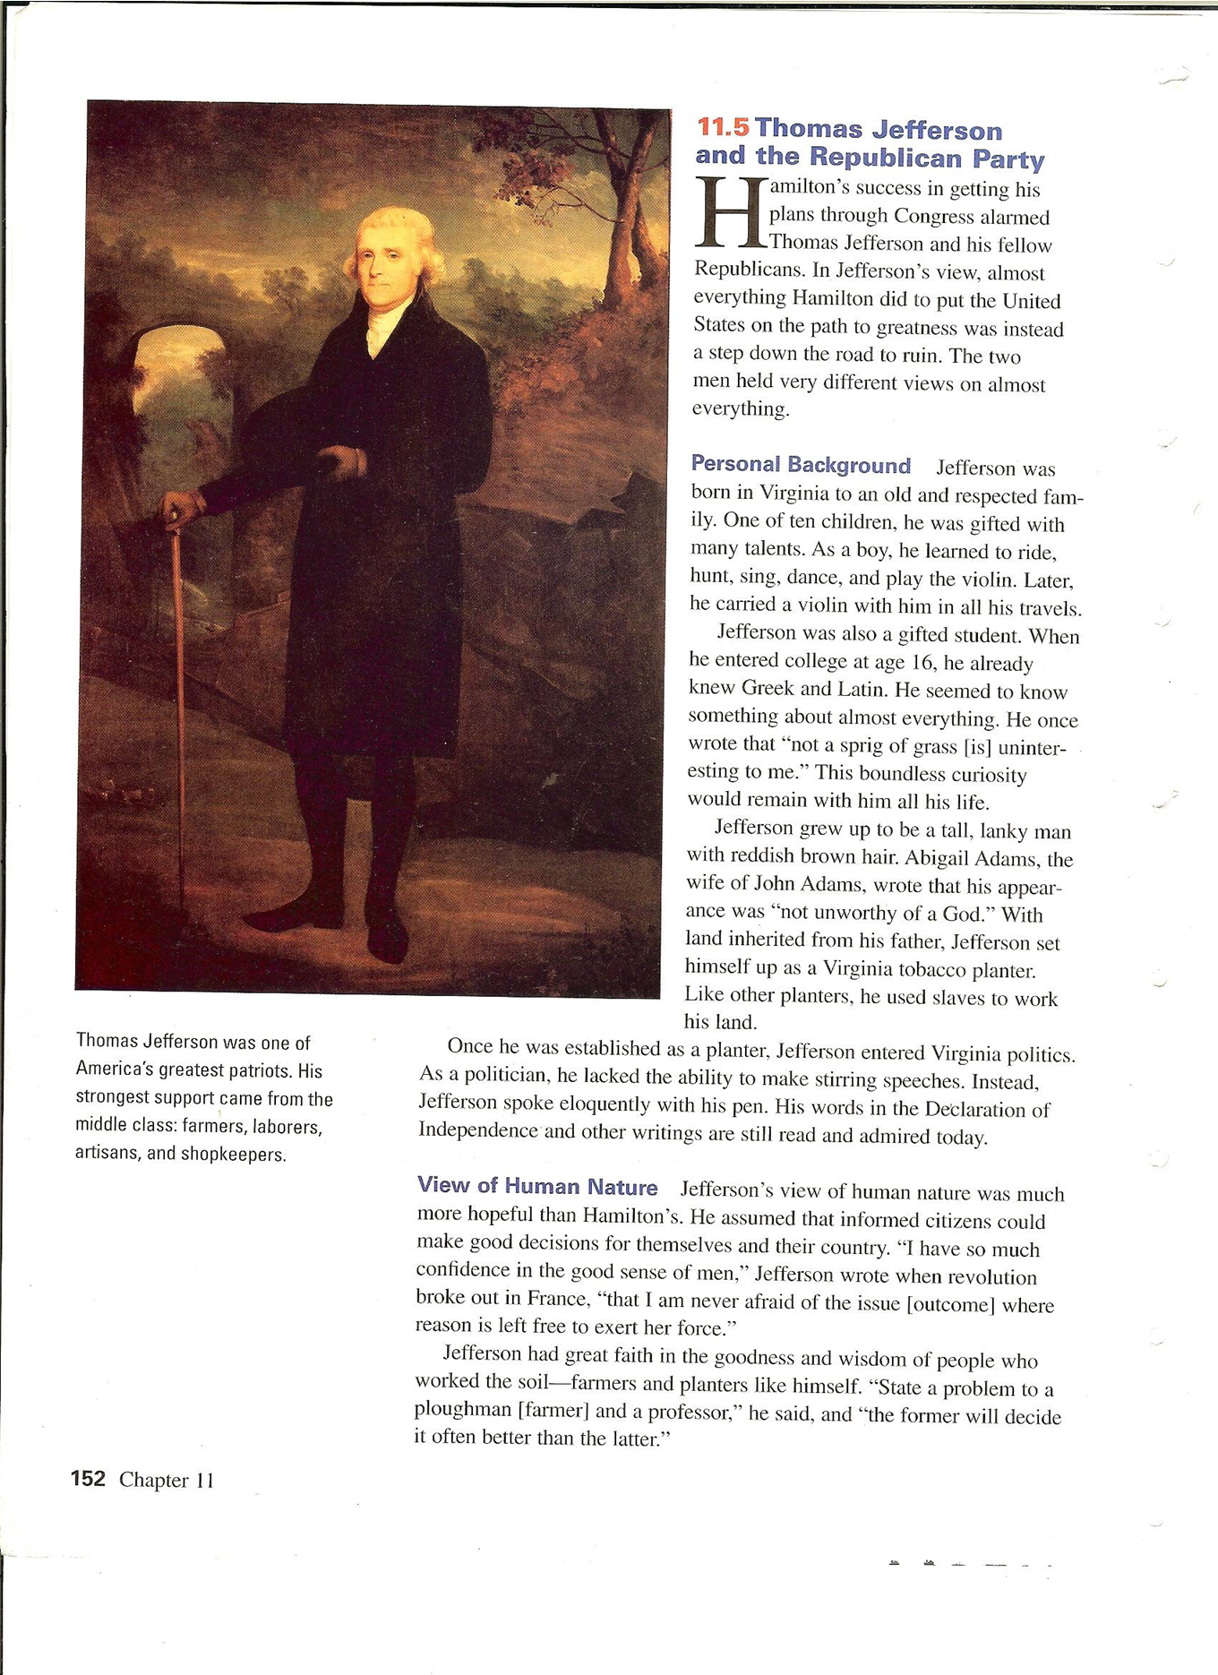

Slide 16
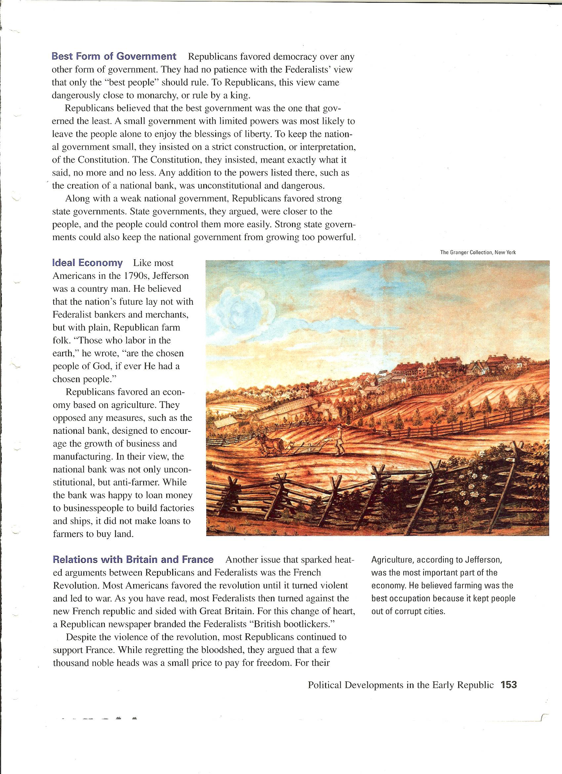

Slide 17
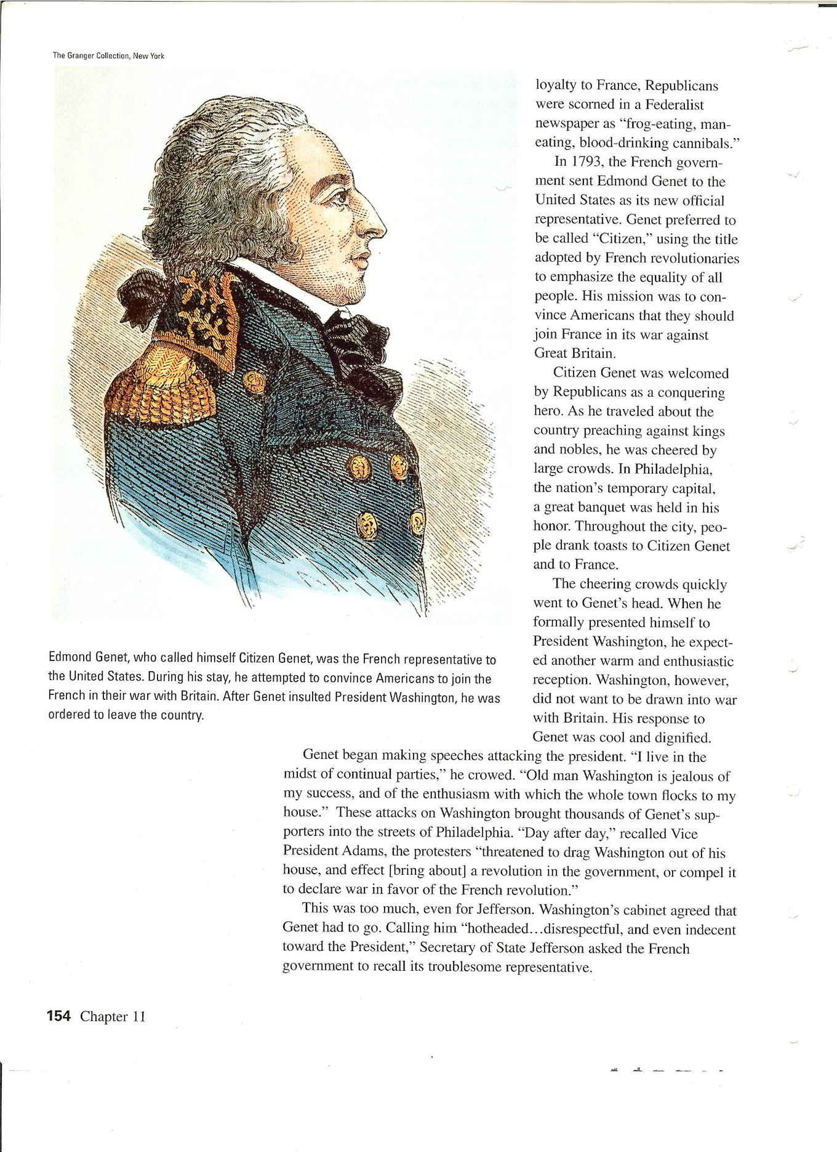

Slide 20
Charles Pinckney Left and Aaron Burr Right, were vice presidential candidates in the election of 1800

Slide 21
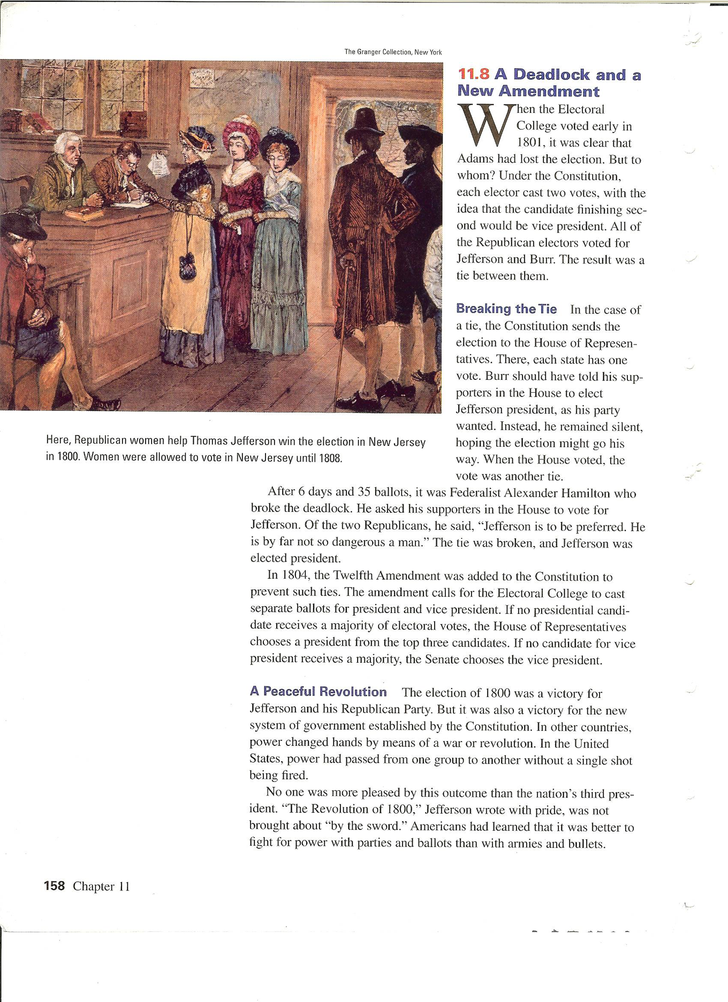

Slide 22
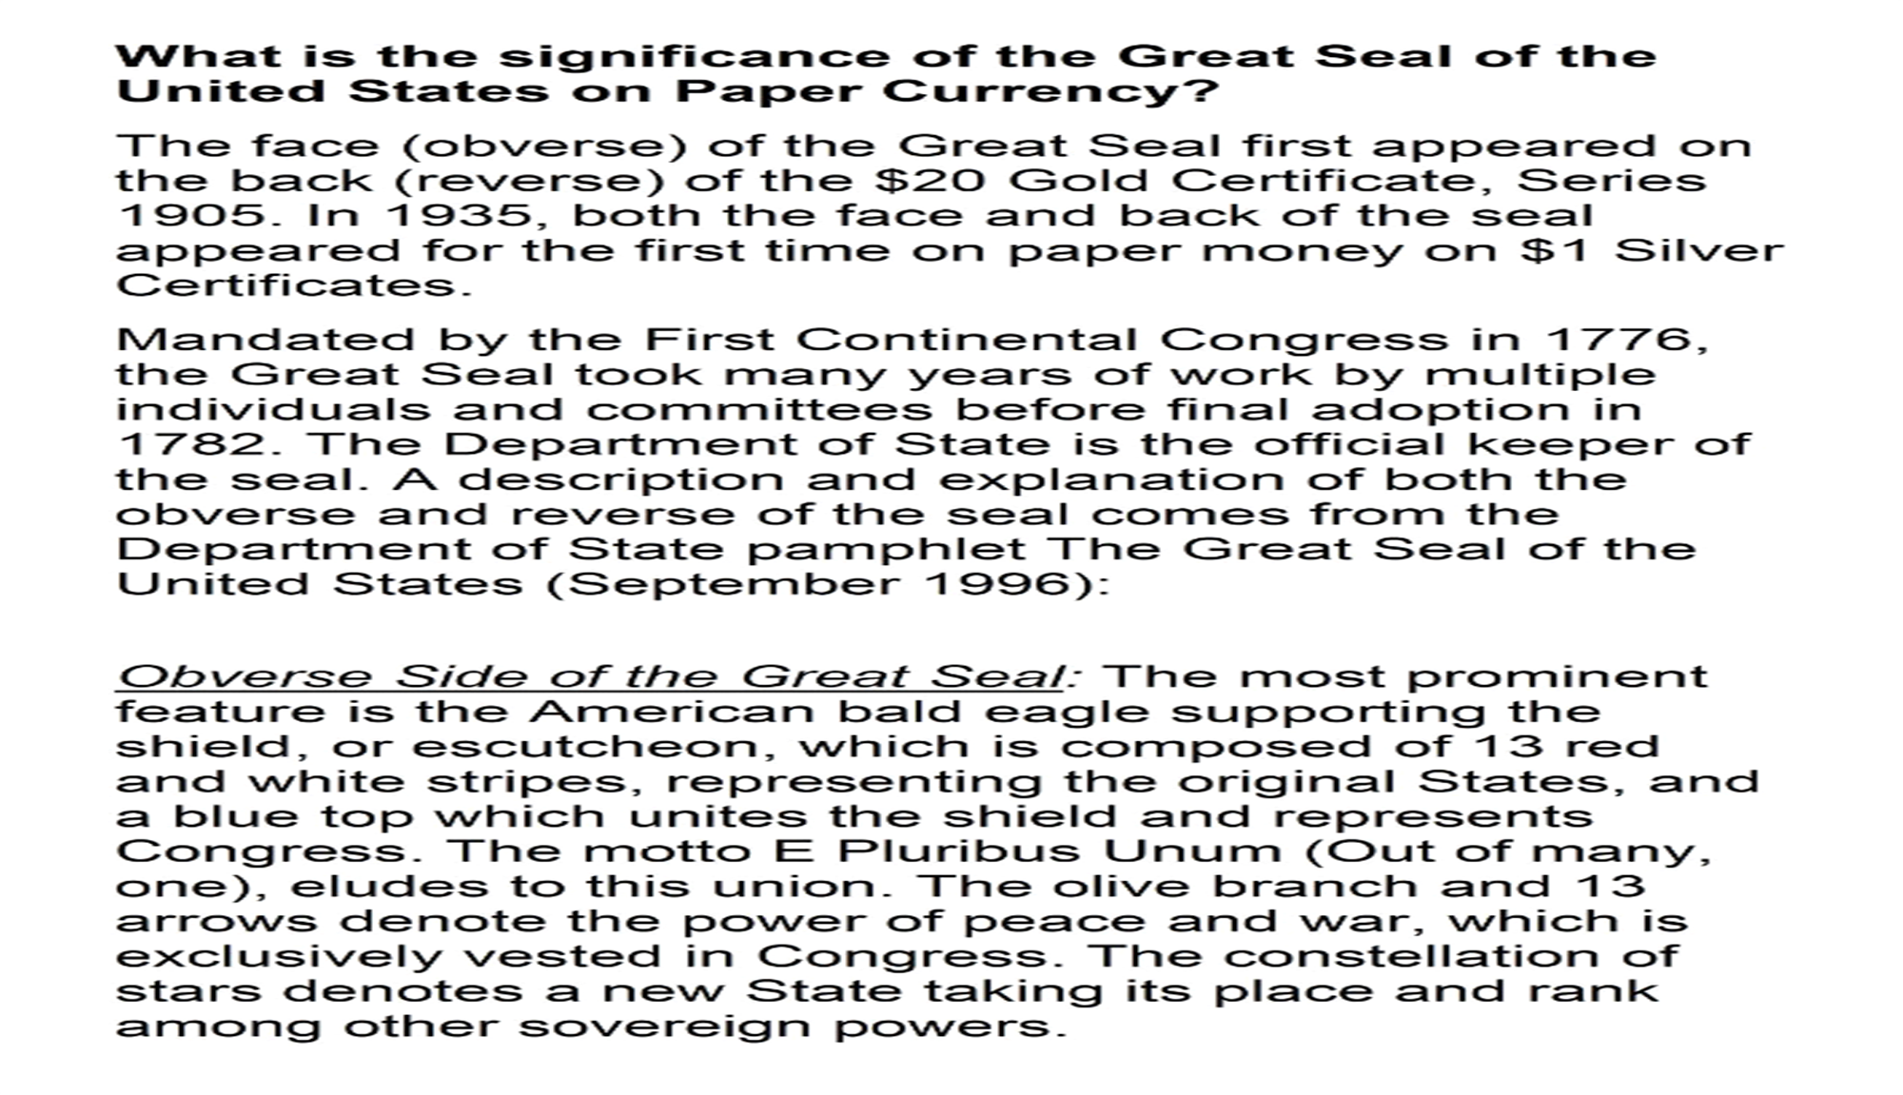

Slide 23


Slide 24
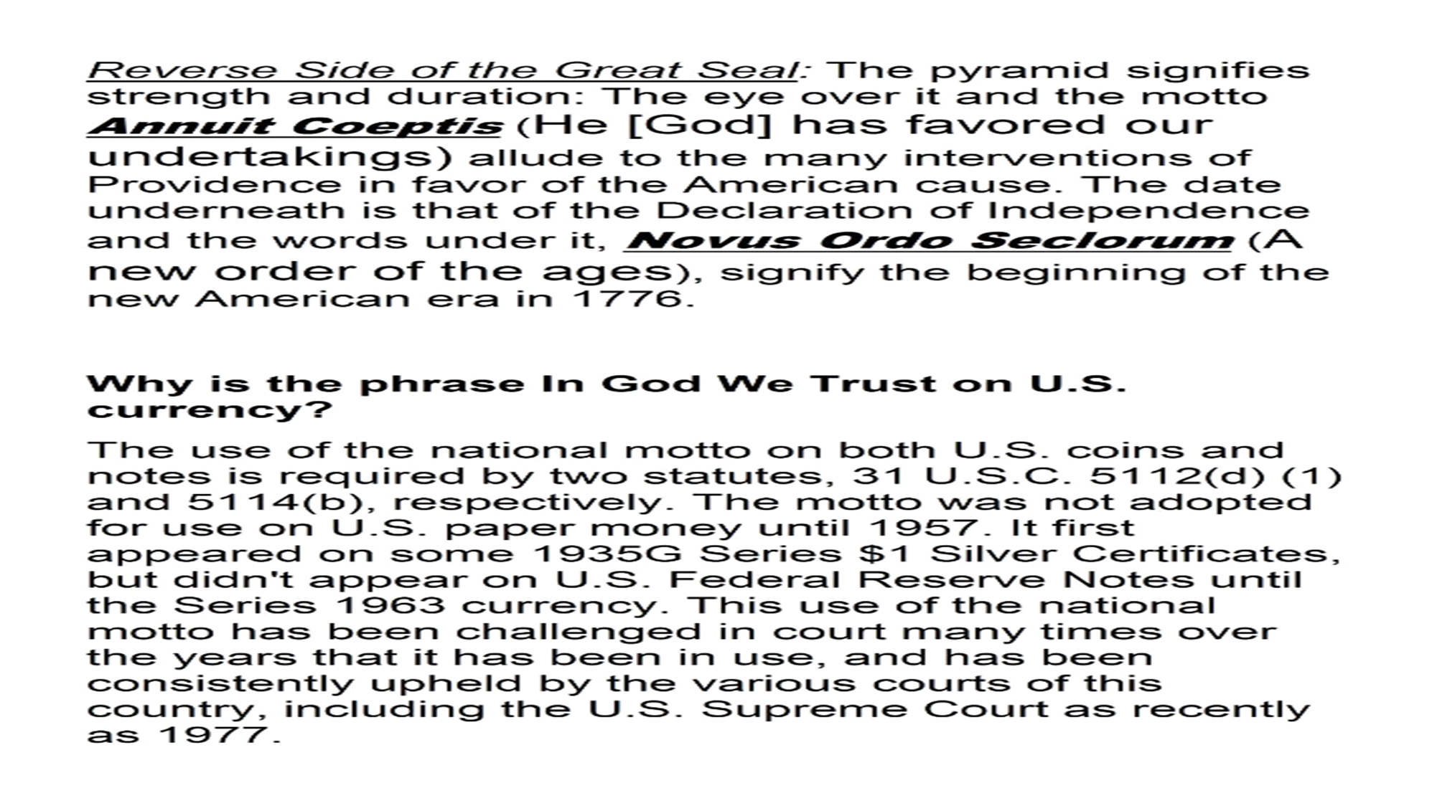

Slide 26
8.4 – A new Republic
Chapter 12 Foreign Affairs in the New Nation
1. neutrality (p. 163)
2. isolationism (p. 163)
3. The XYZ Affair p.164
4. The Jay Treaty p164
5. tribute (p. 164)
6. Privateers (p. 164)
7. impressment p. 166)
8. Barbary States p166
9. embargo (p. 167)
10. blockade (p. 168)
11. War Hawks (p. 169)
12. Francis Scott Key
13. Battle of New Orleans (p. 170)
14. Secretary of State
15. Monroe Doctrine

Slide 27


Slide 28
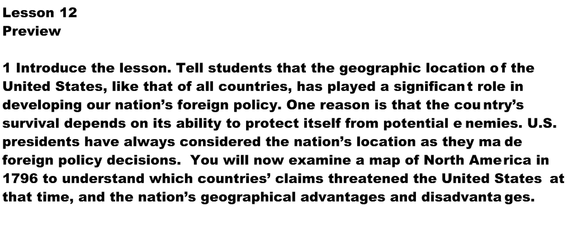

Slide 29
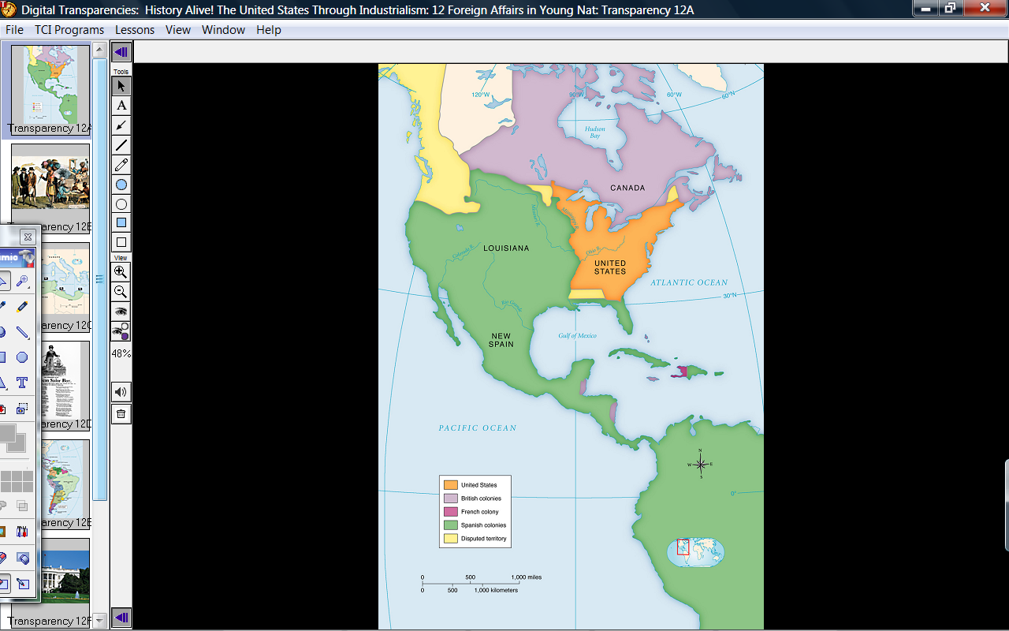
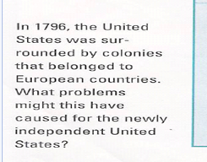

Slide 30
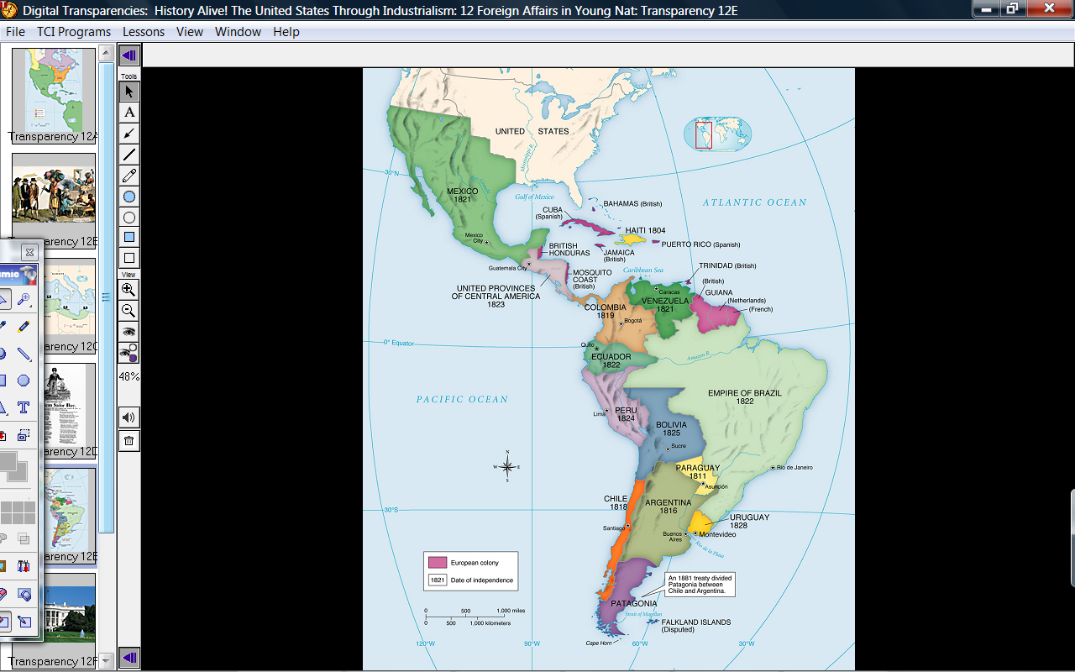

Slide 31
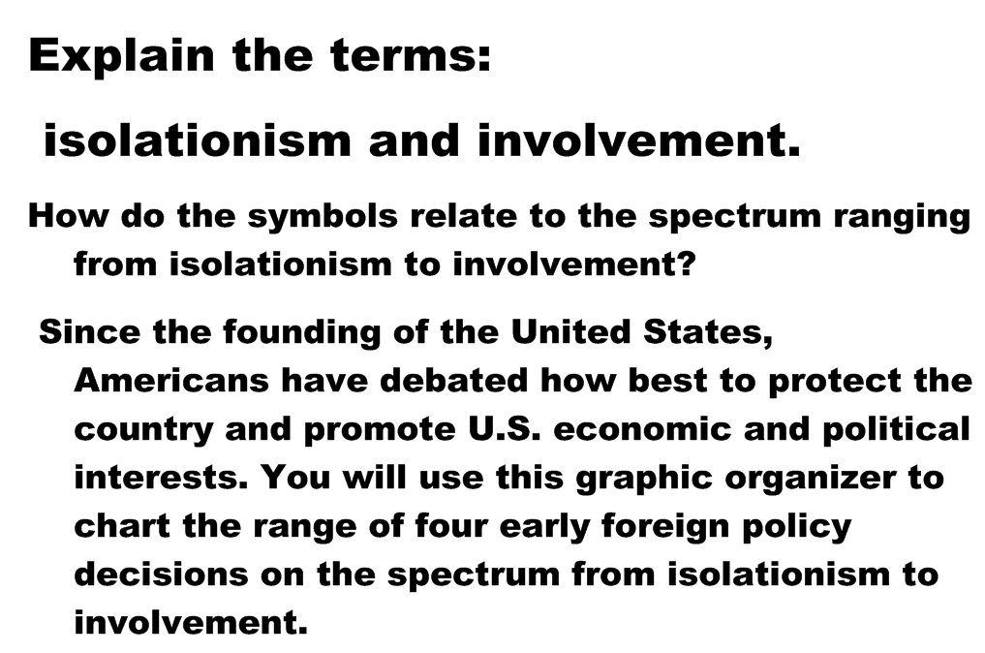

Slide 32
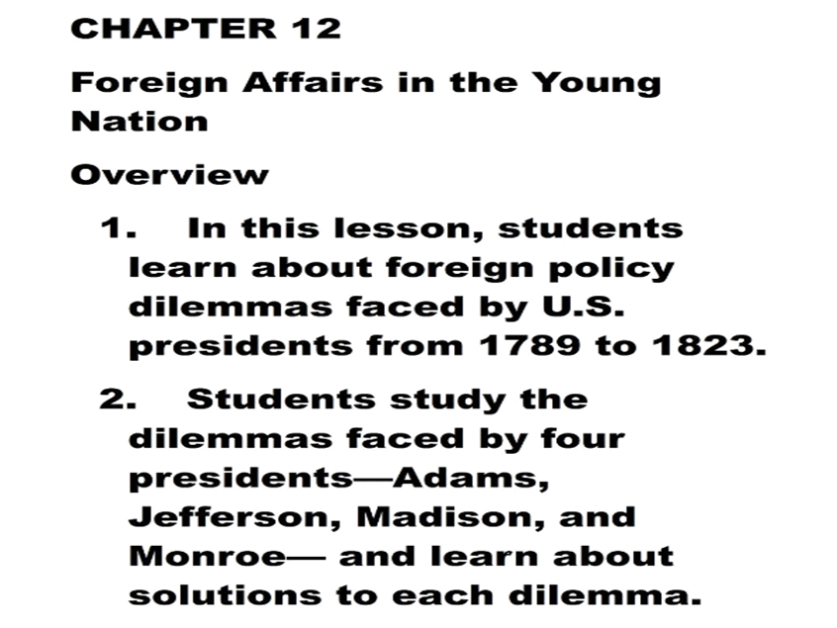

Slide 33
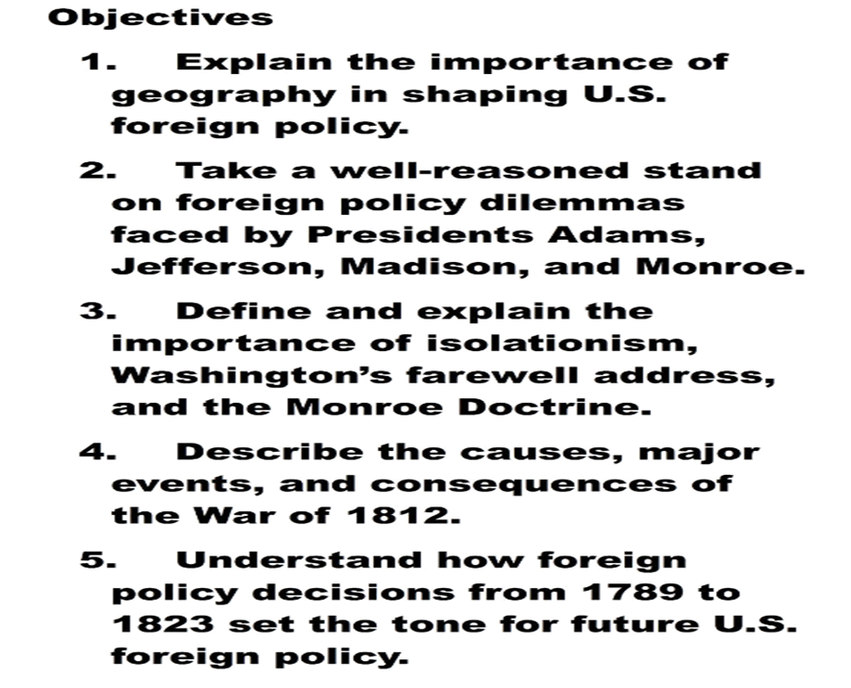

Slide 34
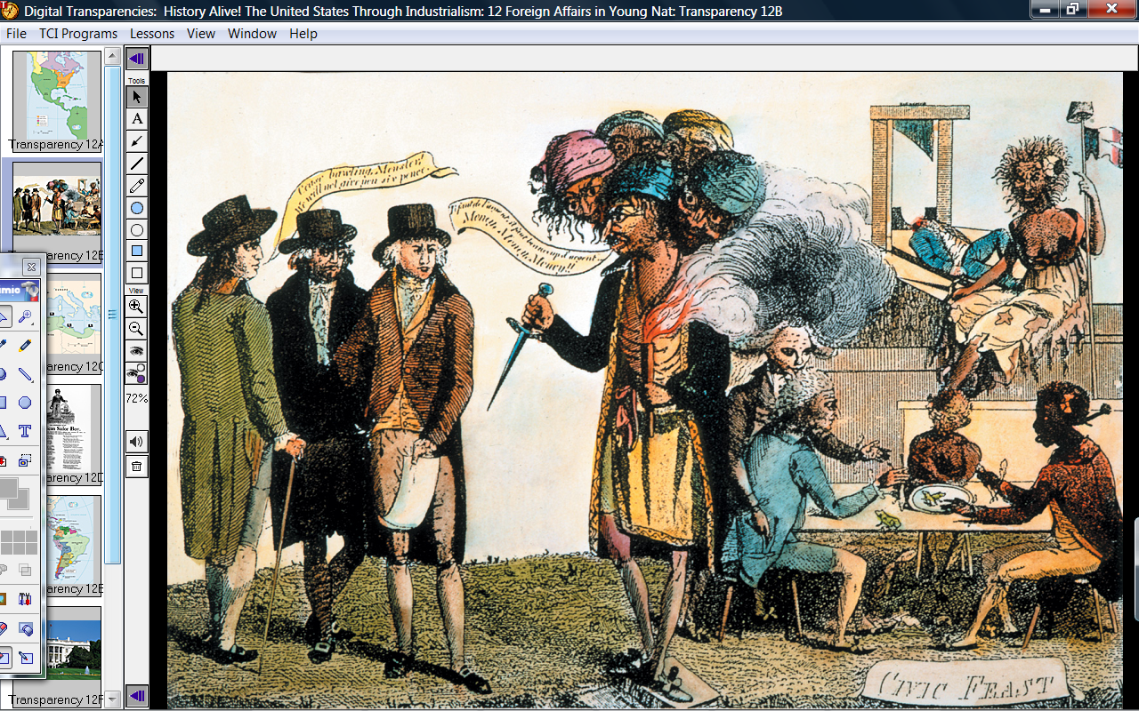
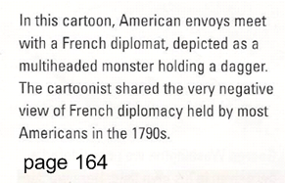

Slide 35
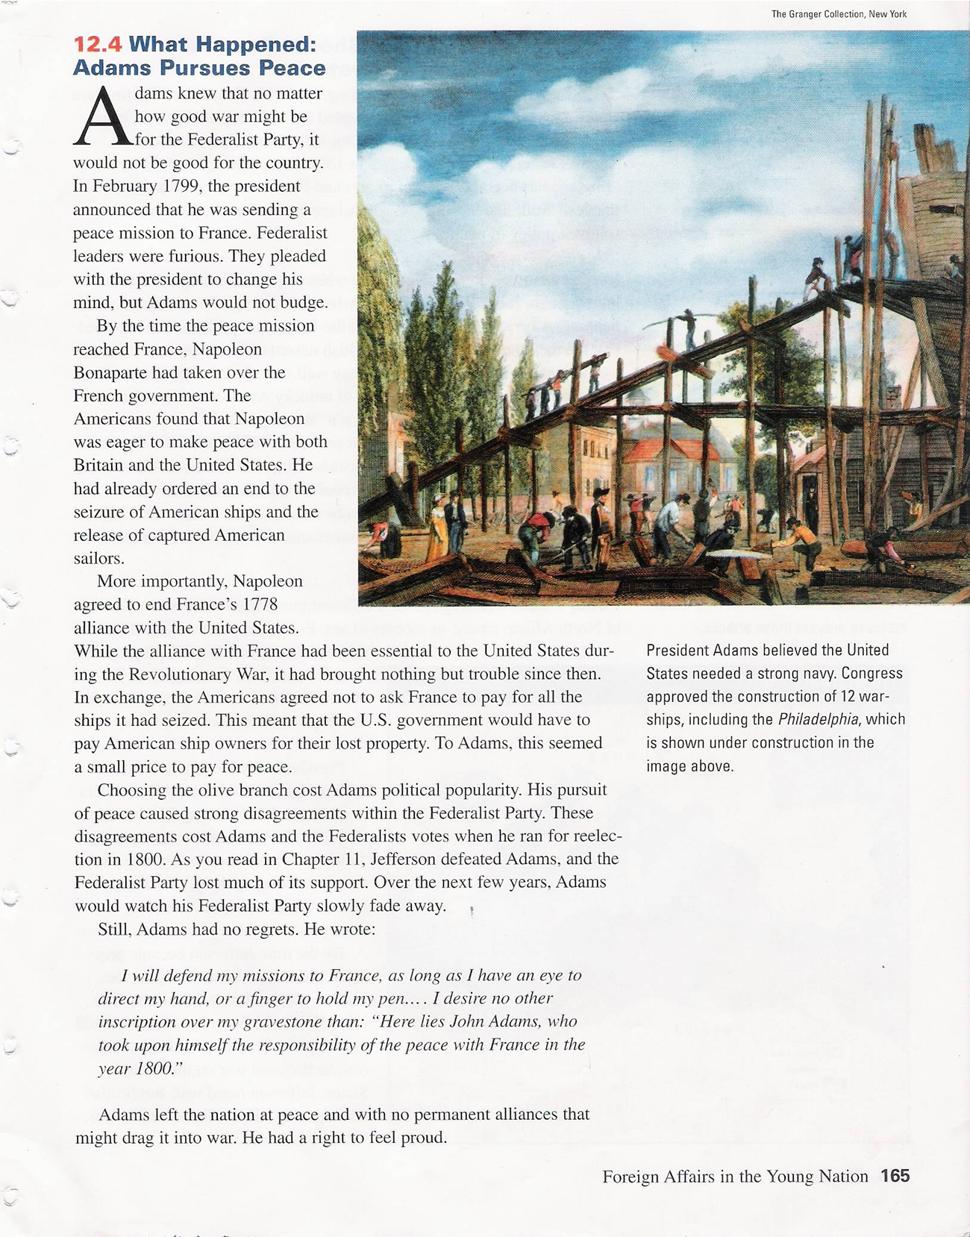

Slide 36
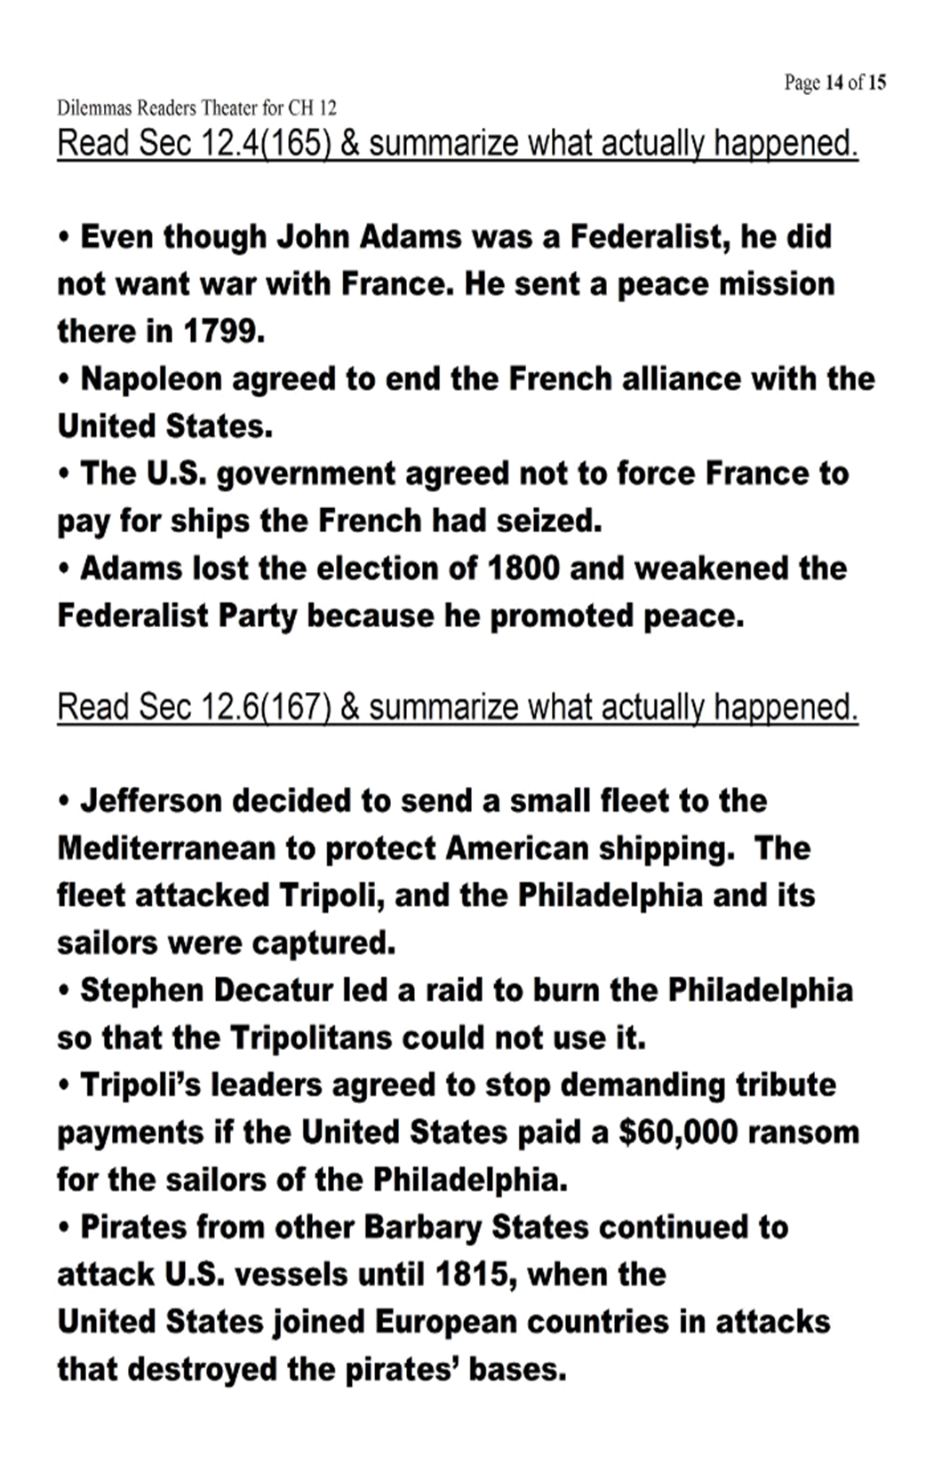

Slide 37
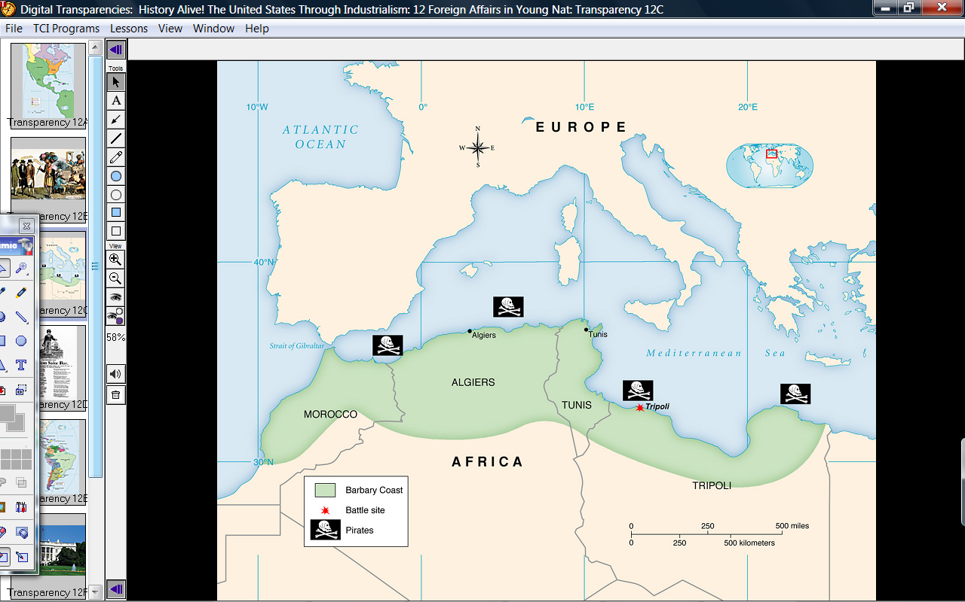
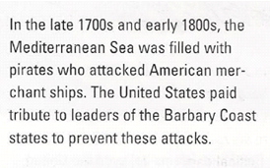

Slide 38
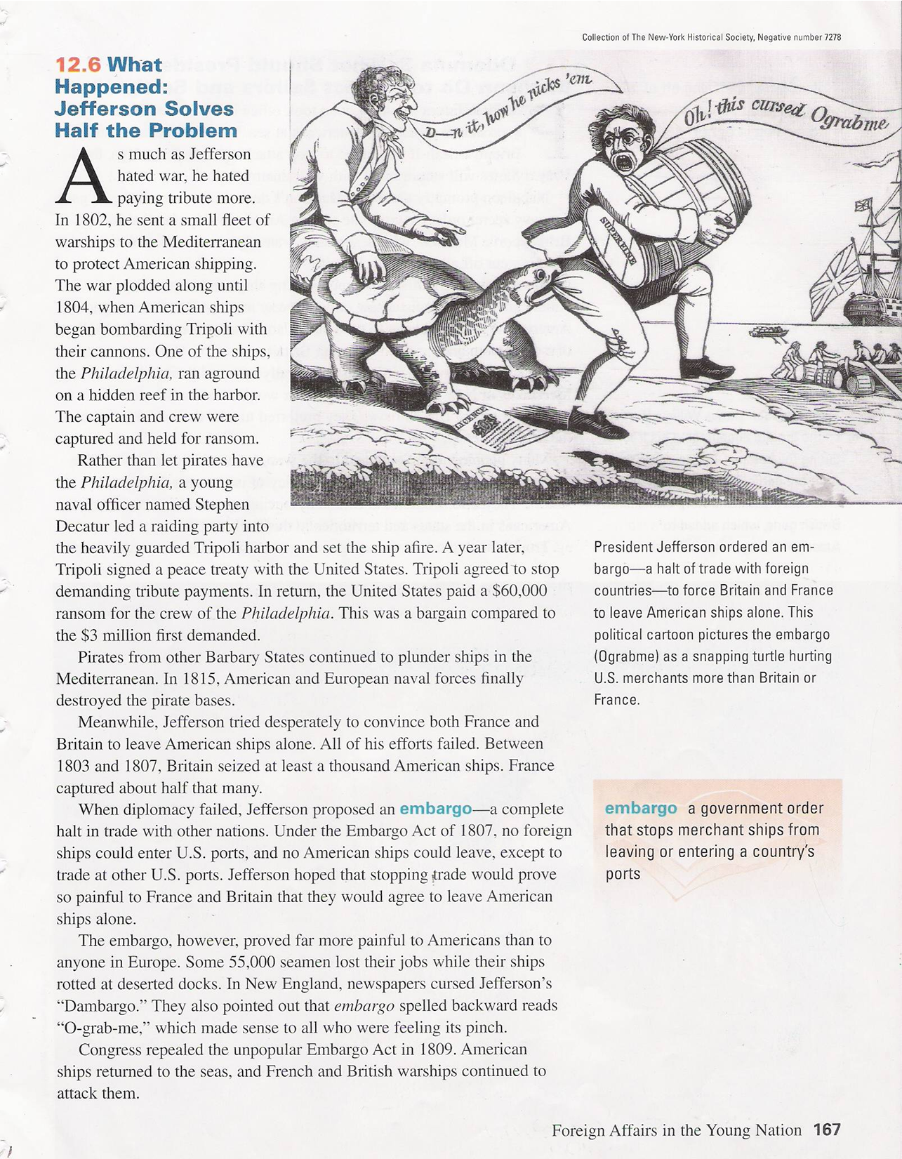
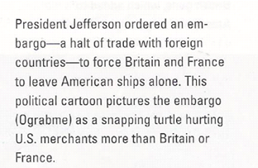

Slide 40
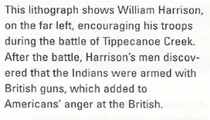
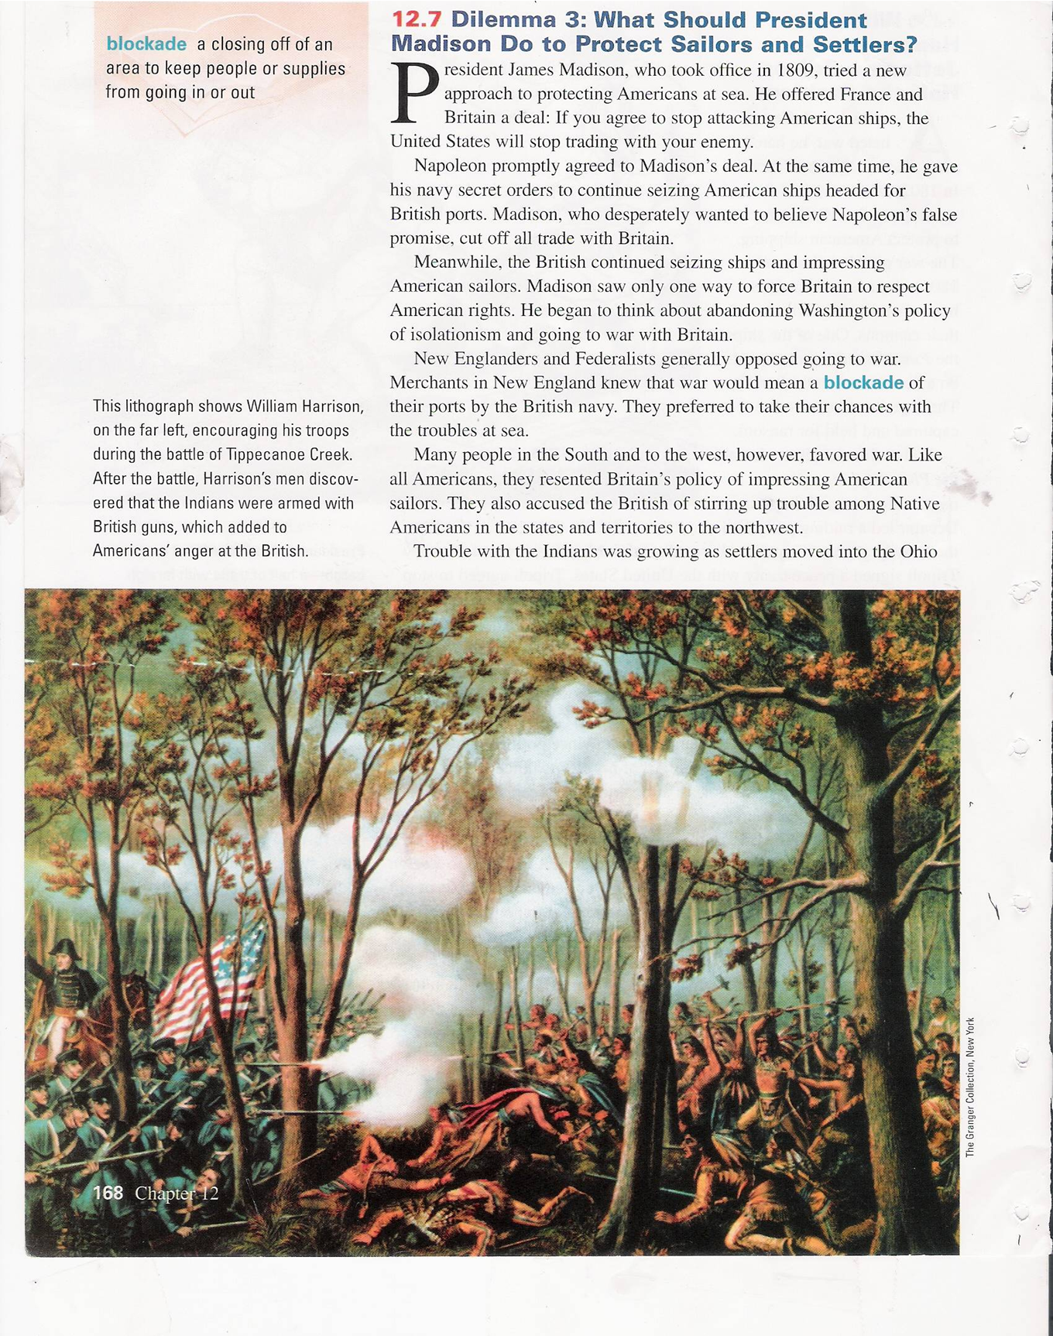

Slide 41
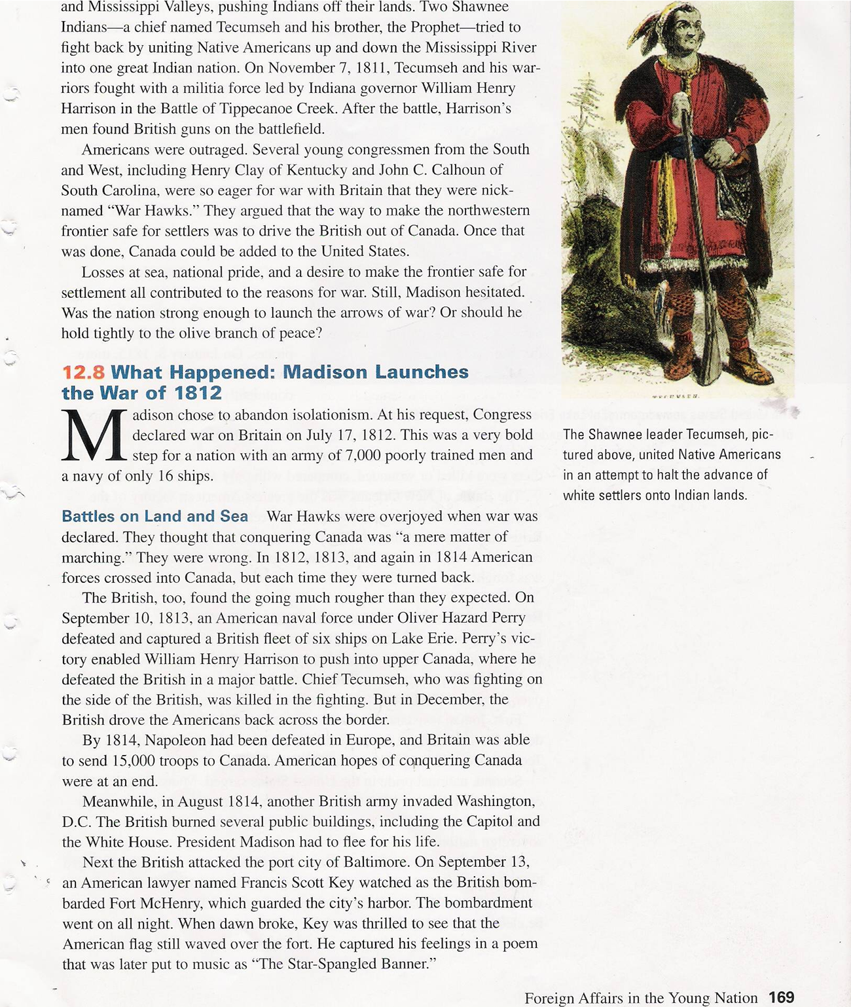
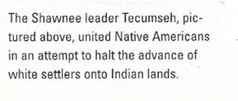

Slide 42
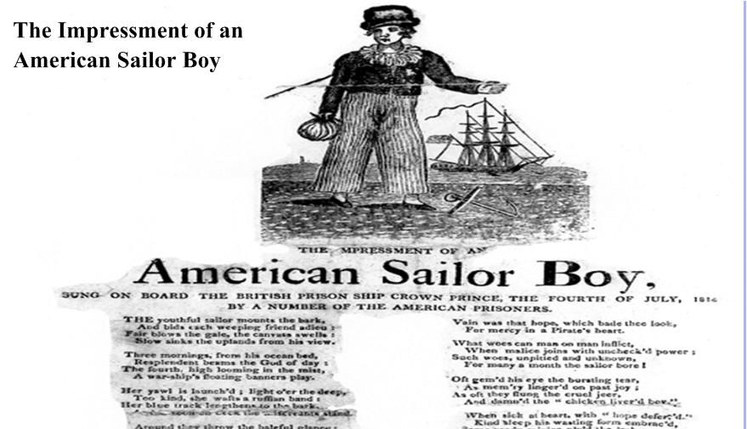

Slide 43
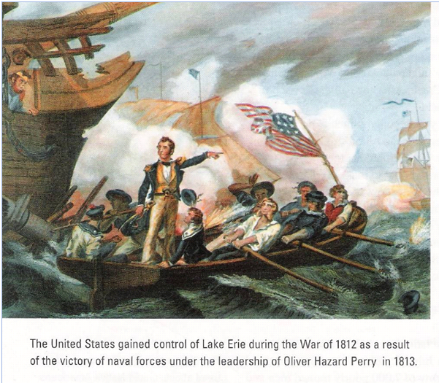

Slide 44
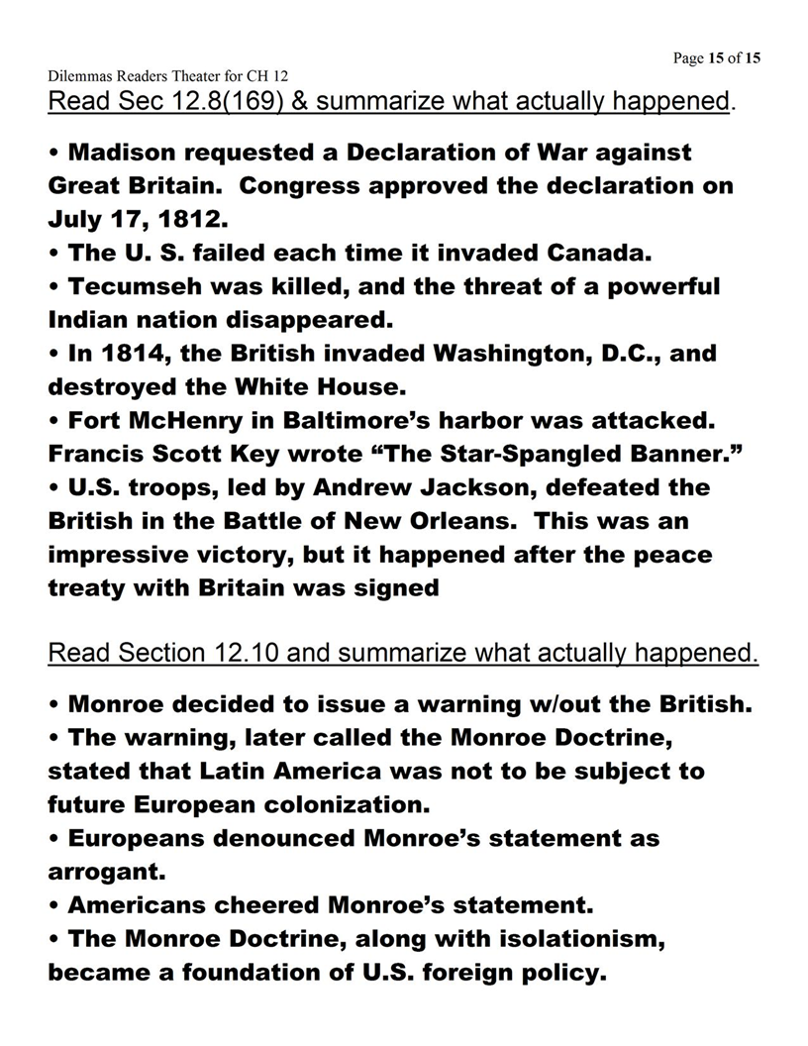

Slide 45
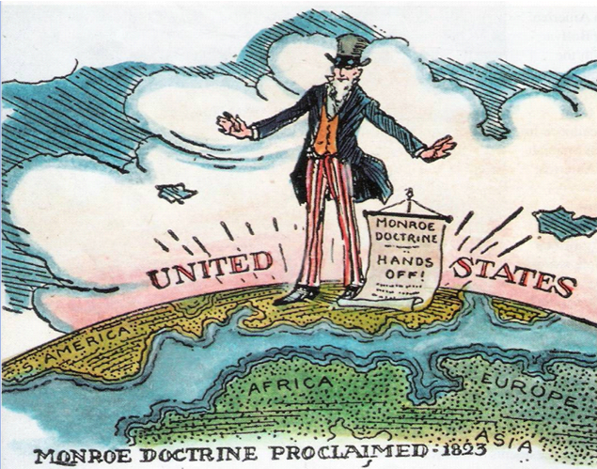

Slide 47
8.5 – Expanding the Nation
Chapter 13 A Growing Sense of Nationhood
Appalachian Mountains
Uncle Sam (p. 177)
capitalism (p. 178)
Bank of the United States (p. 178)
McCulloch v. Maryland (p. 179)
Era of Good Feelings (p. 179)
folk art (p. 180)
Hudson River School (p. 180)
spirituals (p. 181)
minstrel shows (p181)
Washington Irving (pp. 182, 438)
James Fennimore Cooper (pp. 182, 438)
Henry Wadsworth Longfellow (p. 182)

Slide 48
8.5 – Expanding the Nation
Chapter 14 Andrew Jackson and the Growth of American Democracy
1. mudslinging (p. 185) 2. “Old Hickory” p. 185
3. self-made man (187)
4. Jacksonian democracy (p. 188)
5. the Kitchen Cabinet (p.189)
6. Spoils system p. 189
7. civil servant (p. 189)
8. nullification(p. 190)
9. secede (p. 190)
10. Bank of the United States (191)
11. Five Civilized Tribe
12. tariff (p. 190)
13. Indian Removal Act
14. Trail of Tears 193,
15. refuge (p. 193)

Slide 49
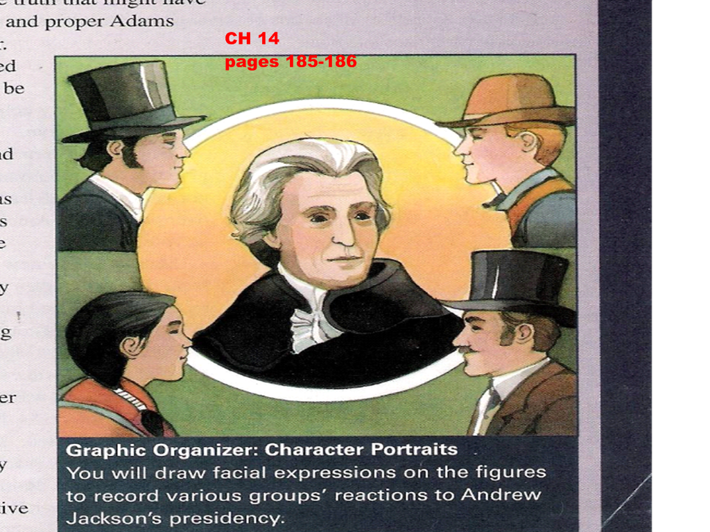
CHAPTER 14

Slide 50
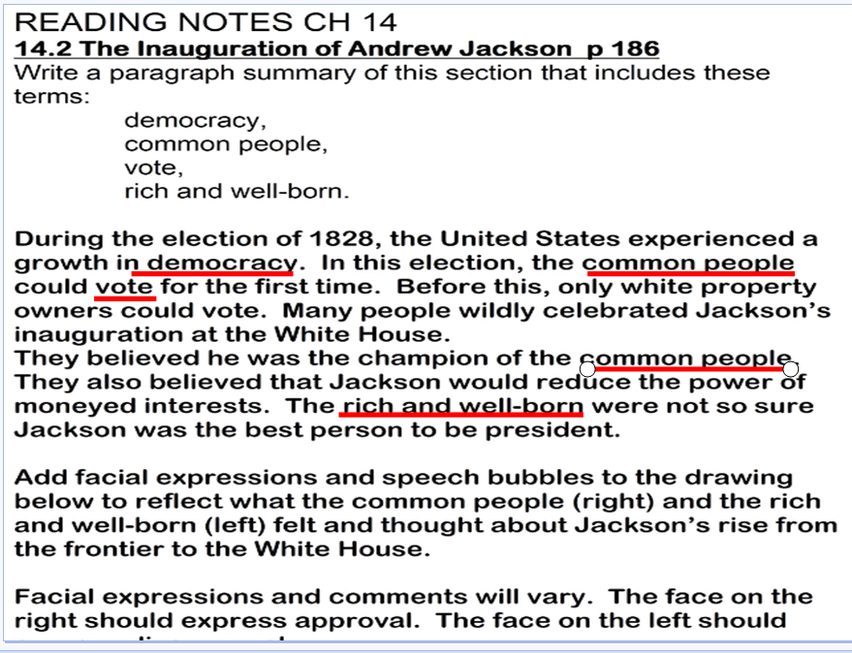

Slide 55
8.5 – Expanding the Nation
Chapter 15 Manifest Destiny and the Growing Nation
Manifest Destiny 197
Louisiana Purchase 198
Noble Bargain (199)
diplomacy (p. 200)
Tejano (p. 201)
diplomacy (p. 200)
Texas War for Independence (p.202)
the Alamo (p. 202)
annex (p. 203)
converts (p. 205)
Oregon Fever (205)
Mexican-American War (206–208)
Bear Flag Republic
Cession (p. 208)
Treaty of Guadalupe Hidalgo (208)

Slide 57
8.5 – Expanding the Nation
Chapter 16 Life in the West
1. Zebulon Pike 213
2. John C. Fremont
3. pathfinder(p. 213)
4. Californios (p. 216)
5. missions (p. 216)
6. rancho (p. 216)
7. trappers (p. 217)
8. Oregon Trail 219
9. Homestead (220)
10. Wagon trains (213)
11. Annie Bidwell (222)
12. Mormons (p. 220)
13. Forty-niners (224)
14. sluice (p. 225)
15. queues (p. 226)

Slide 59
8.6 – Americans in Mid-1800’s
Chapter 18 An Era of Reform
1. Second Great Awakening (p. 242)
2. transcendentalism
3. Dorothea Dix (244)
4. Horace Mann (245)
5. public schools 245
6. abolitionists (246)
7. Frederick Douglass
8. Sojourner Truth 247
9. Elizabeth Cady Stanton (248,446)
10. Lucretia Mott (pp. 248, 446–447)
11. Elizabeth Blackwell (p. 249)
12. Seneca Falls Convention (p. 249)
13. Declaration of Sentiments (p249)
14. Susan B. Anthony 250,445–6
15. Margaret Fuller 447

