Slide 1
8th Grade Social Science Review Part 1
The 8th Grade portion is 48% of the 8th Grade Test

Slide 2
The 8th grade portion is divided into 2 sections:
  U.S. Constitution and the Early Republic - 30%
    Part 1 = 8.1-8.3 – 11 questions
    Part 2 = 8.4-8.8 – 18 questions
  Civil War and its Aftermath - 18%
    Part 3 = 8.9-8.12 -

Slide 3
U.S. History Standards
8.1 - Revolution
8.2 – Forming a New Nation
8.3 – American Political System
8.4 – A new Republic (3 Questions)
8.5 – Expanding the Nation(2 Questions)
8.6 – Americans in Mid-1800’s
8.7 – The South 1800-1850 (2 Quest)
8.8 – The West 1800 - 1850

Slide 4
U.S. History
Standards
8.9 – The Union Challenged
8.10 – The Civil War
8.11 – The Reconstruction (3 Questions)
8. 12 – The Industrial Revolution

Slide 5
8.1 – Revolution
Chapter 3 the English colonies in America
indentured servant (p. 35)
cash crops (p. 38)
assembly (p. 38)
democratic (p. 38)
Puritans (p. 39)
Mayflower Compact (p. 39)
slave trade (p. 40)
Fundamental Orders (p. 41)

Slide 6
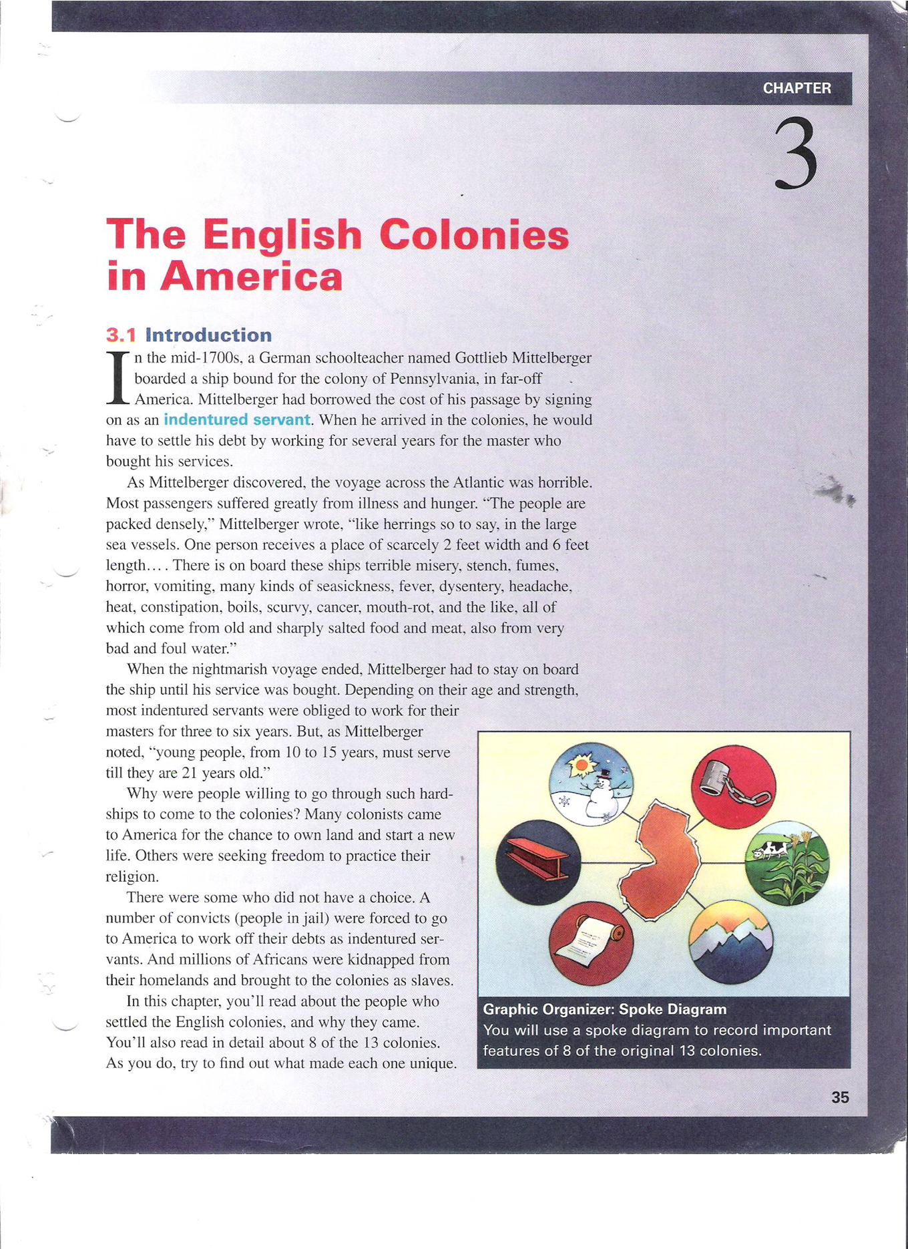
The Early Colonies

Slide 7
Essential Questions
How were the New England, Middle, and Southern colonies different from each other? How were they similar? (2 parts)
What events, ideas, and social patterns from the colonial period helped to shape American democracy?(3 parts)
In what way was the Mayflower Compact important to the development of democracy in America?
How and why did the practice of slavery begin and grow in colonial America?

Slide 8
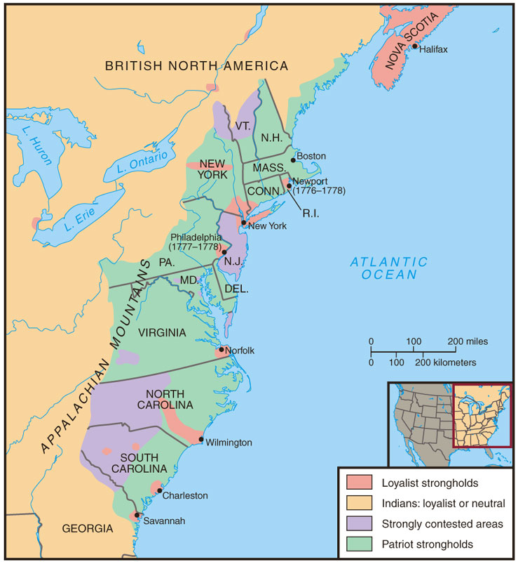
Loyalist
Strongholds

Slide 9
8.1 – Revolution
Chapter 4 Life in the Colonies
1. economy (p. 50)
2. Magna Carta (p. 52)
3. Parliament (p. 52)
4. petition (p. 52)
5. English Bill of Rights
6. blue laws (p. 53)
7. social class (p. 54)
8. the Middle Passage p. 55
9. First Great Awakening pp. 56, 429

Slide 10
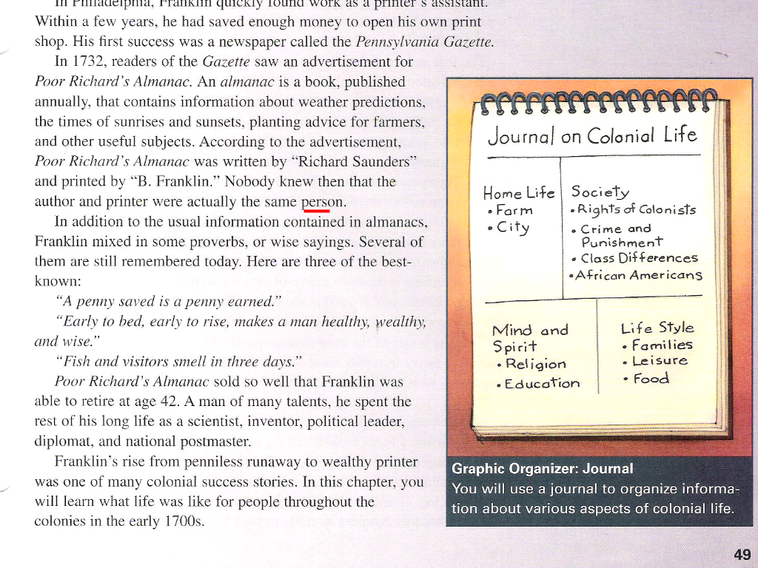
8.1 – Revolution
Chapter 4 The English colonies in America

Slide 11
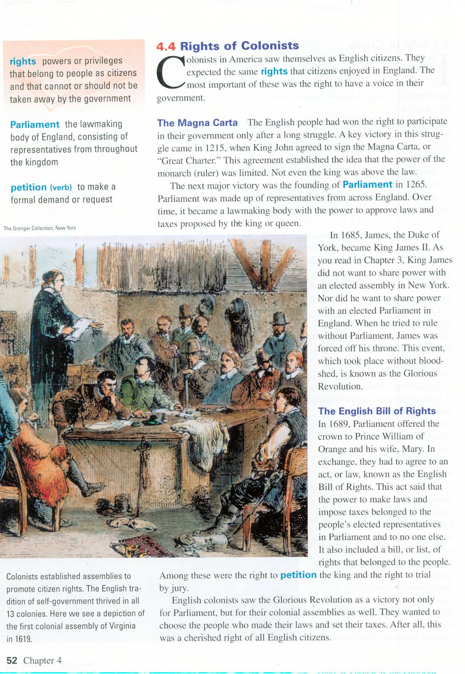

Slide 12
8.2 – Forming a New Nation
Chapter 5 Toward Independence
Patriots (page. 63)
Loyalists (page. 63)
Neutralists (p. 63)
French & Indian War (page. 65)
Proclamation of 1763 (page. 66)
Stamp Act (page 67)
Quartering Act (p68)
Townshend Acts -68
Boston Massacre 68
Boston Tea Party 70
Tea Act (page 71)
Intolerable Acts -72
First Continental Congress (page 73)
Lexington & Concord (page 74)

Slide 13
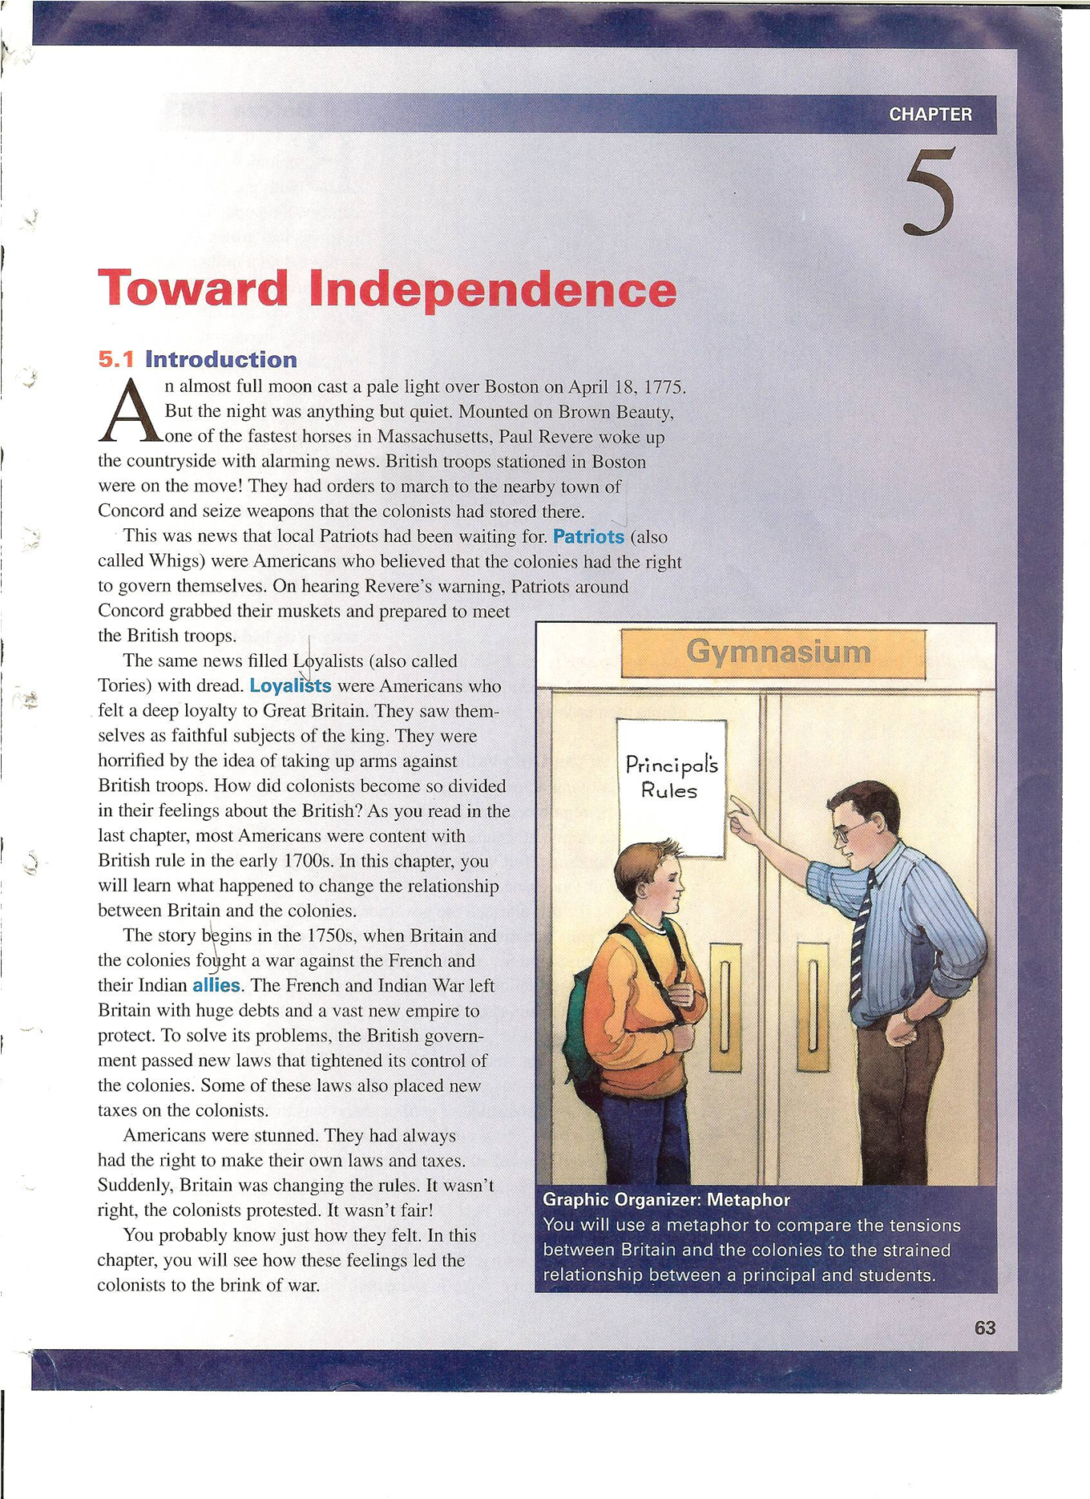

Slide 14
Overview
In this lesson, students learn about the growing tensions between the colonists and Great Britain from 1763 to 1775.
First, students experience the injustice of “taxation without representation” when they are told that they need to pay for photocopies.
Students then read about key events that caused tension between the colonists and Britain and compare these events to a strained relationship between students and a school principal.
Afterward, in an Experiential Exercise, students assume historical roles at a town meeting to debate colonial independence.
Finally, students apply their learning in a Processing assignment.

Slide 15
Objectives
empathize with colonists who were taxed without representation.
use a metaphor of students and a school principal to describe the strained relationship that developed between the colonies and Britain after the French and Indian War.
assume the roles of historical figures during a colonial town meeting and participate in a debate on independence.
write a dialogue between a Loyalist and a Patriot that includes the key arguments on colonial independence.

Slide 16
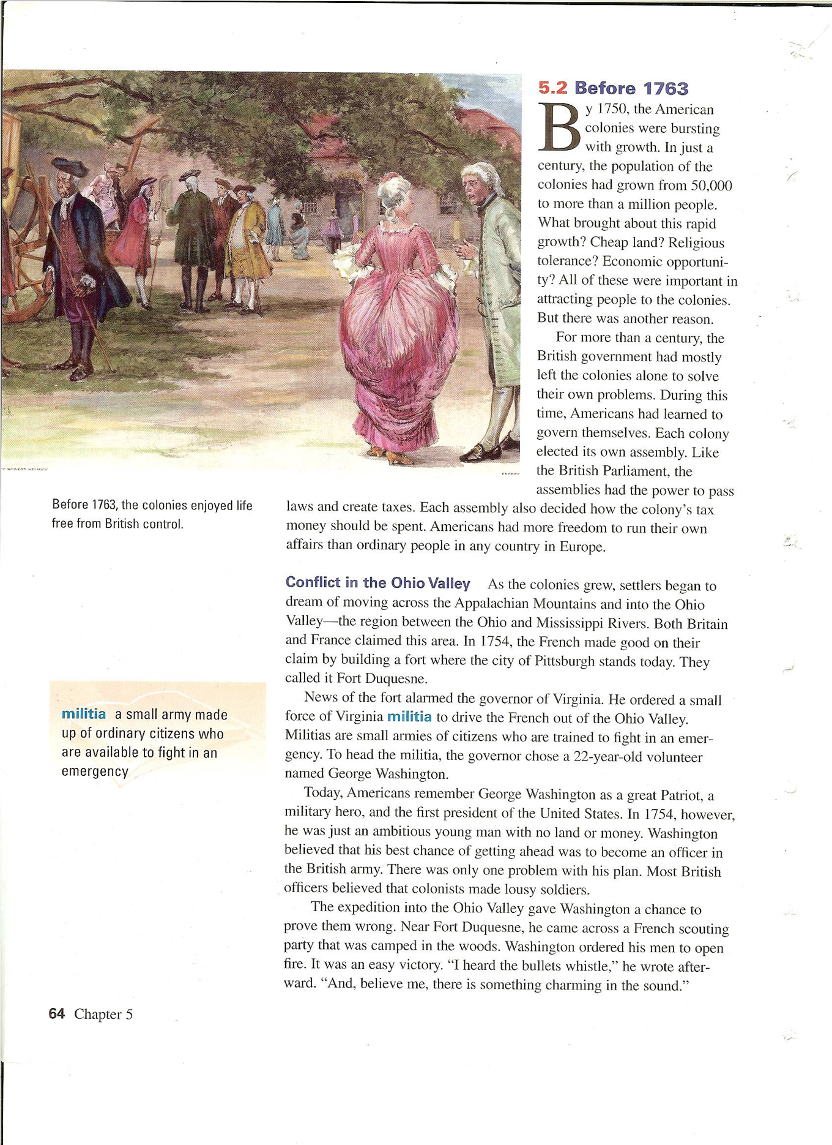
Main ideas of CH 5

Slide 17
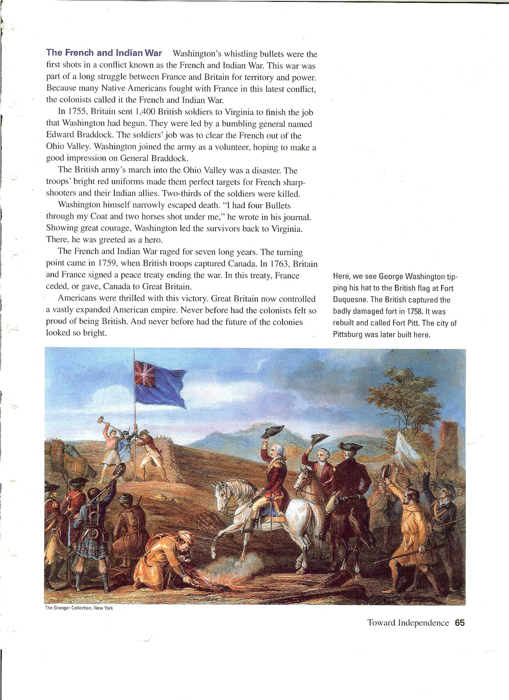
Main ideas of CH 5

Slide 18
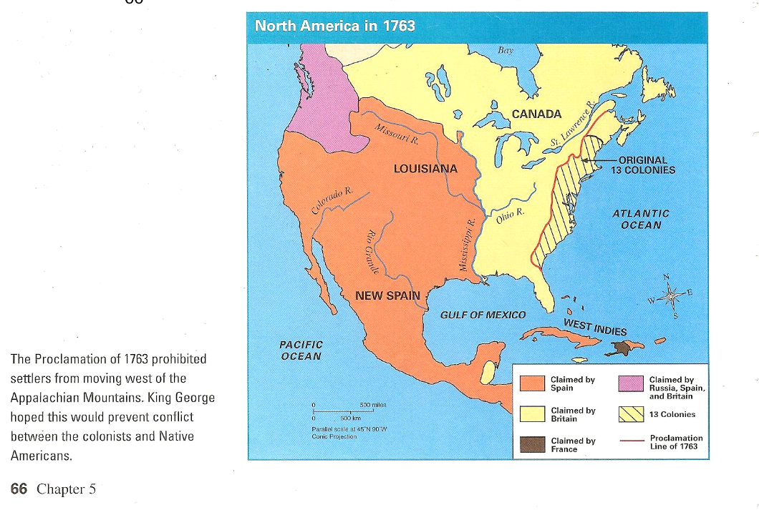
Main ideas of CH 5

Slide 19
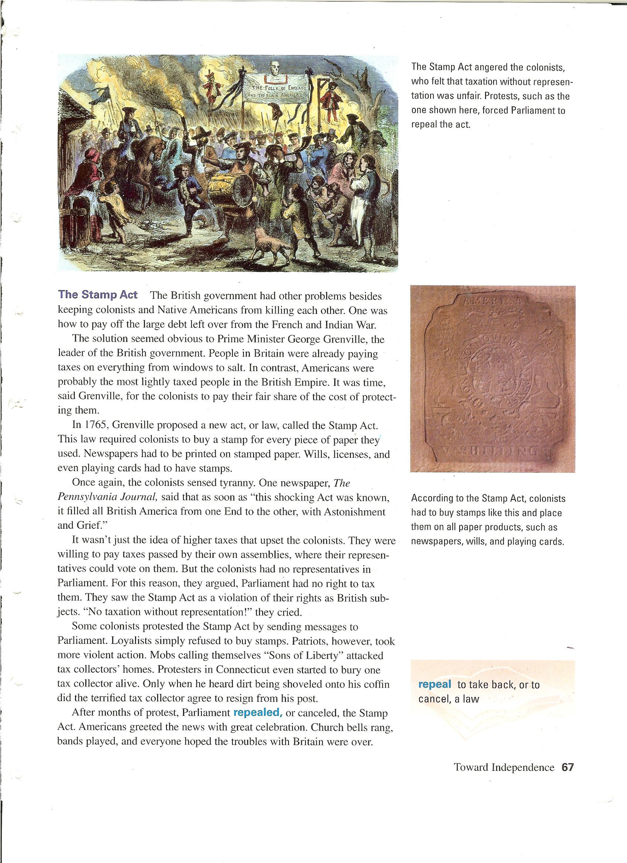
Main ideas of CH 5

Slide 20
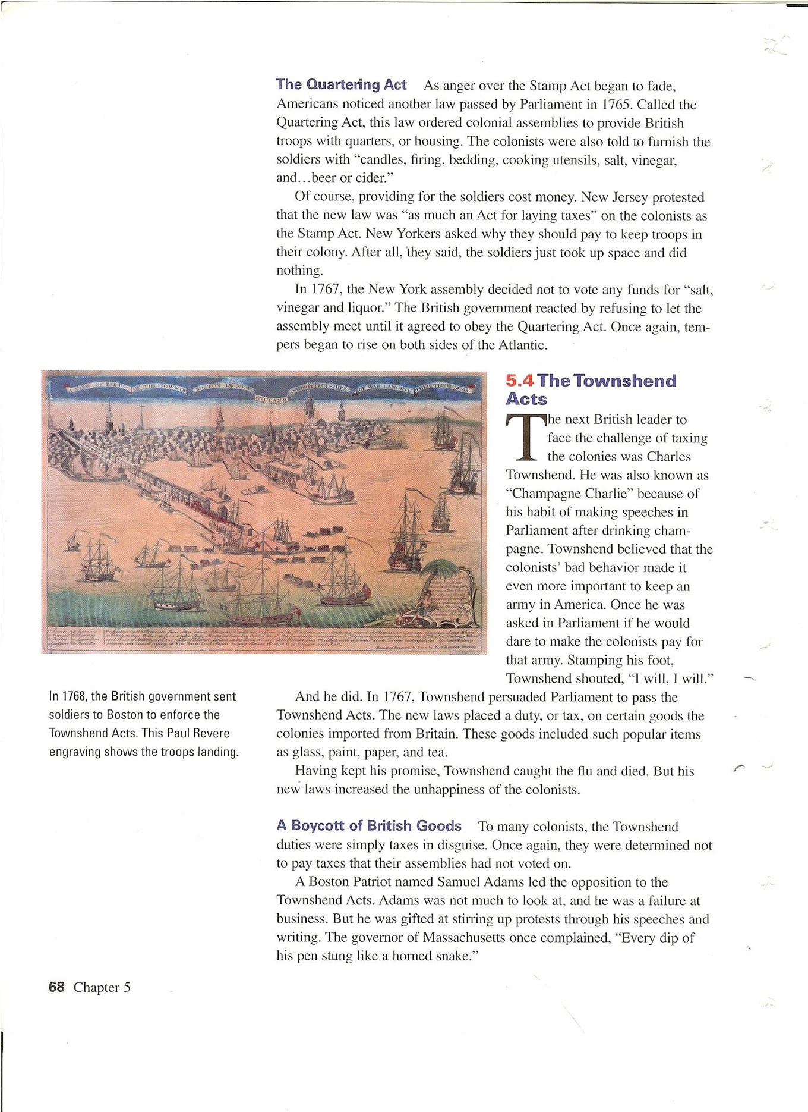
Main ideas of CH 5

Slide 21
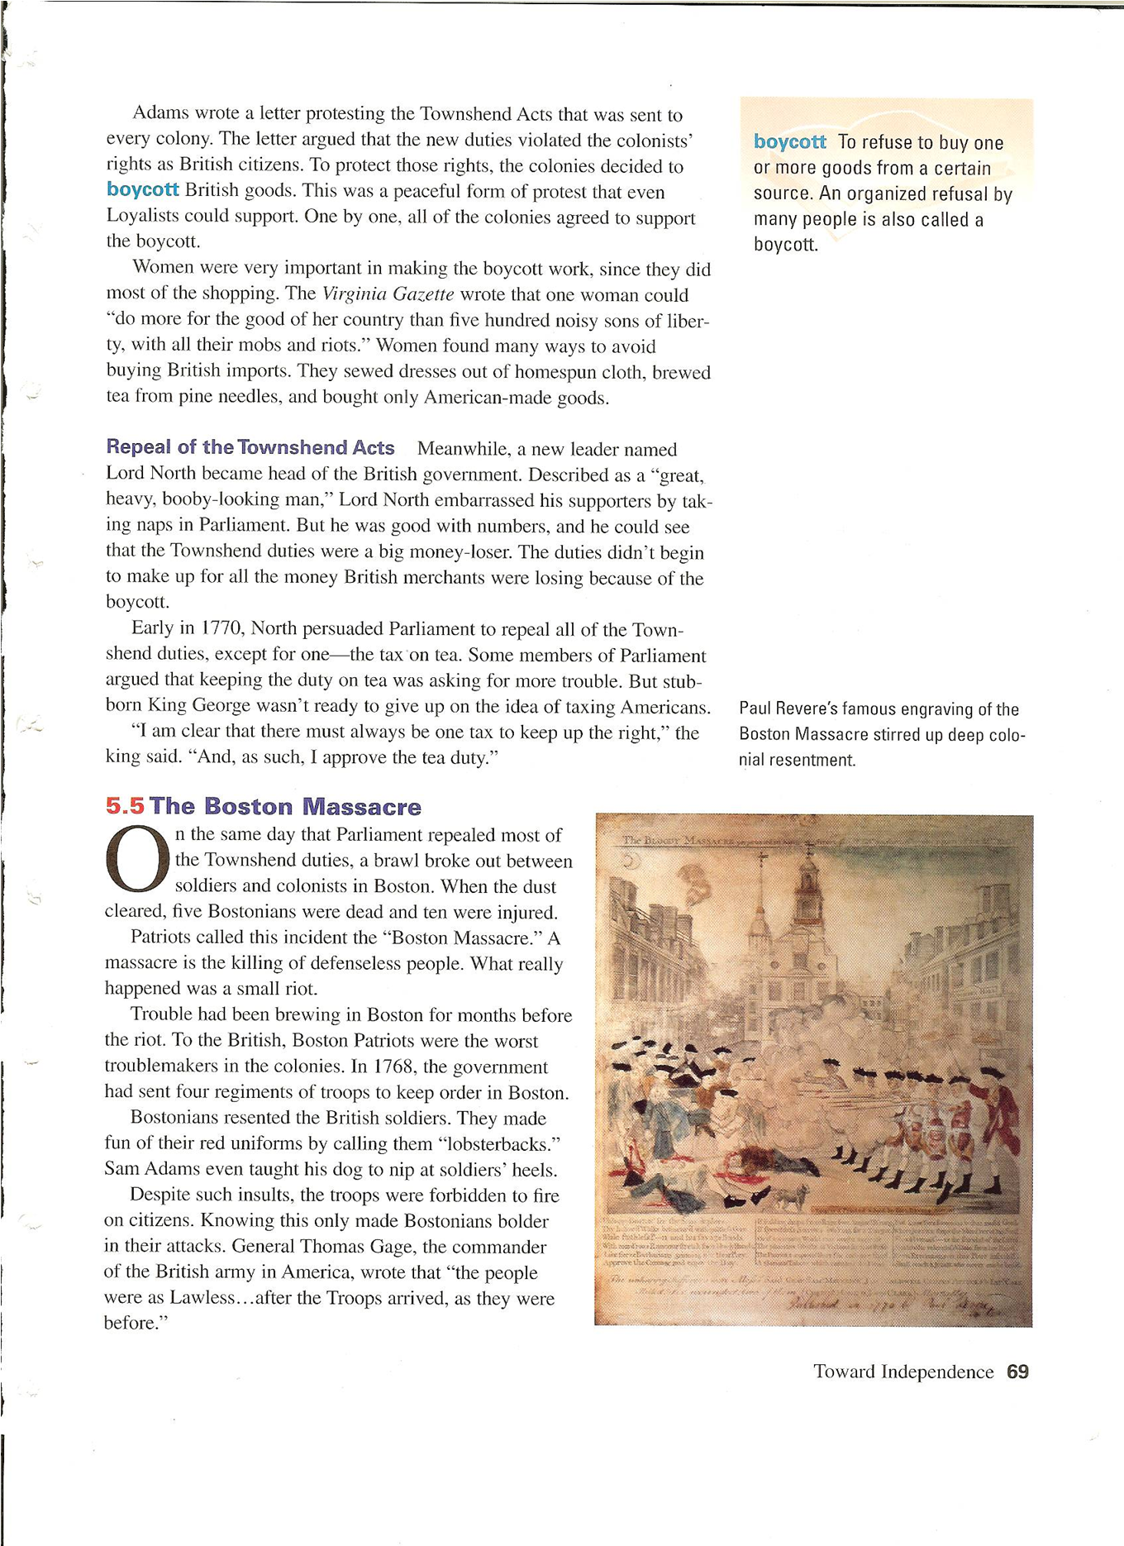
Main ideas of CH 5

Slide 22
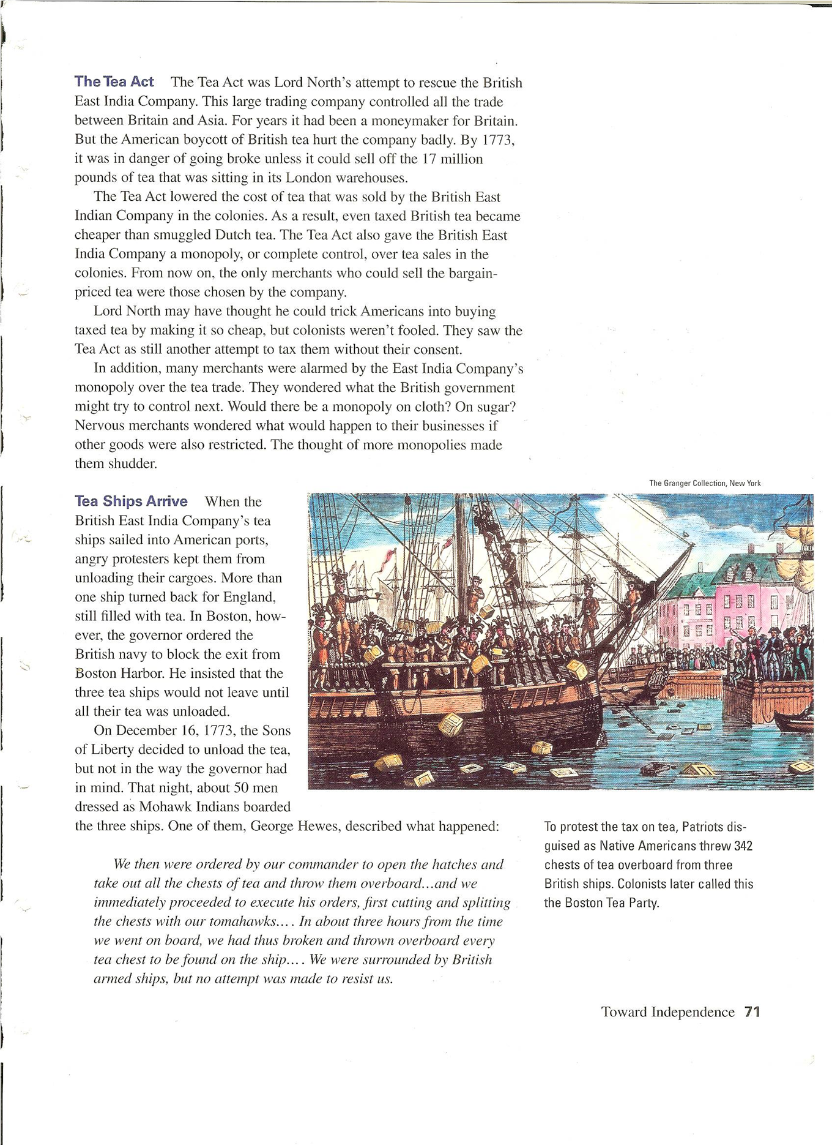
Main ideas of CH 5

Slide 23
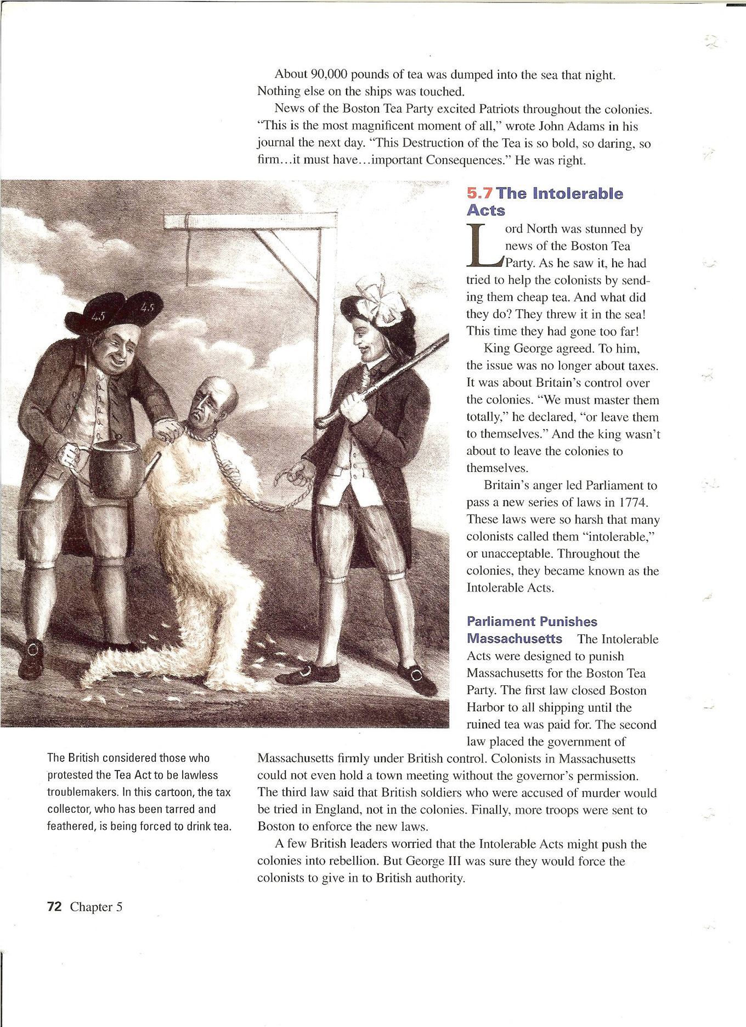
Main ideas of CH 5

Slide 24
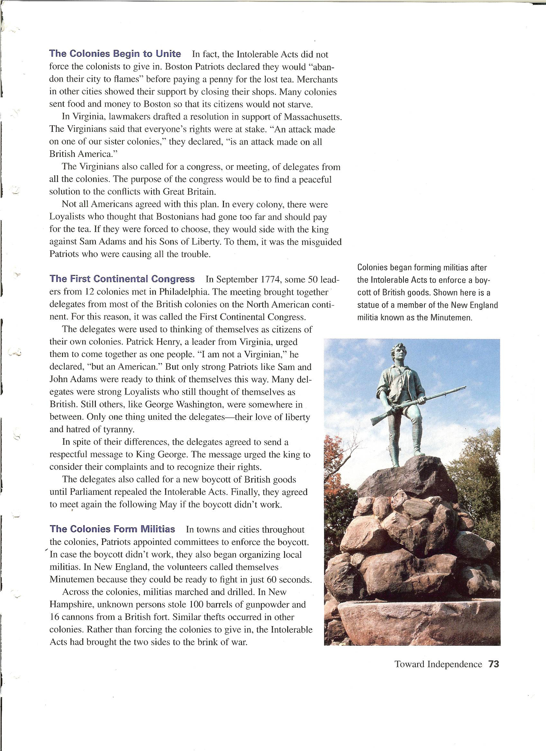
Main ideas of CH 5

Slide 25
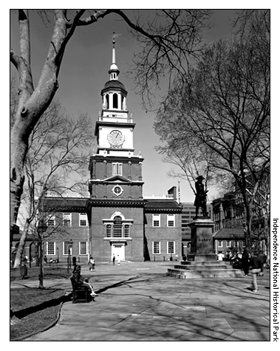
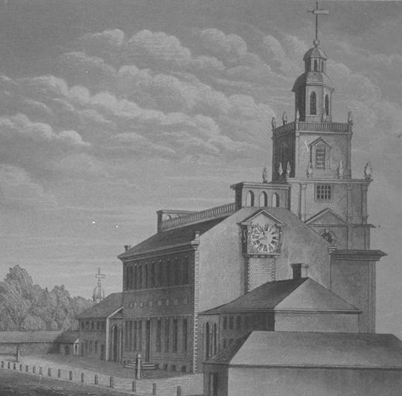
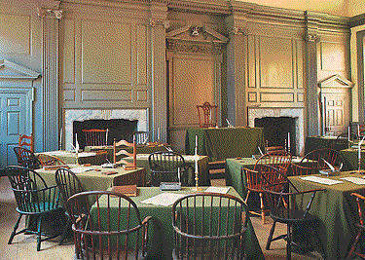
First Continental Congress meets in Philadelphia

Slide 26
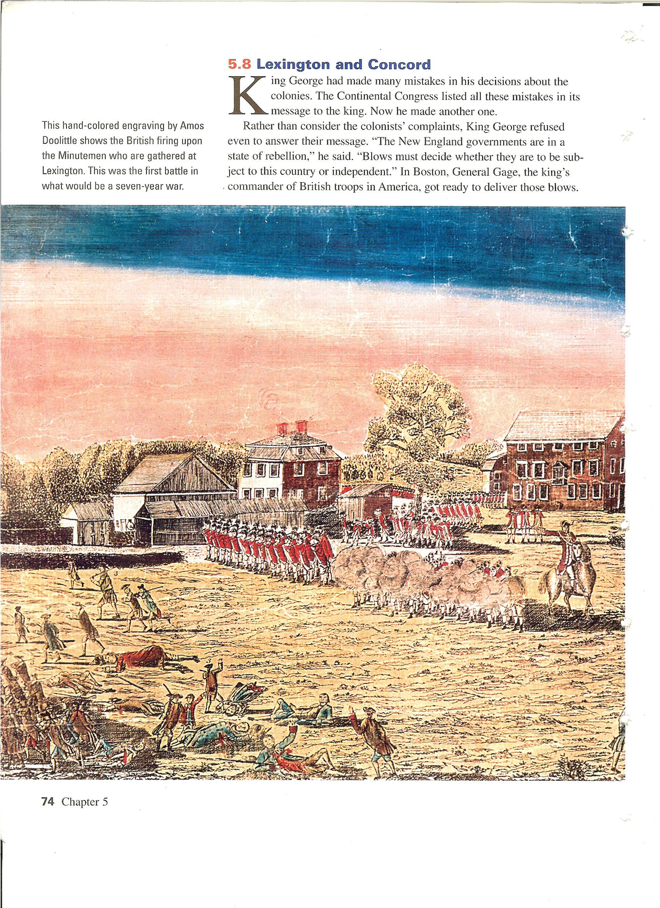
Main ideas of CH 5

Slide 27
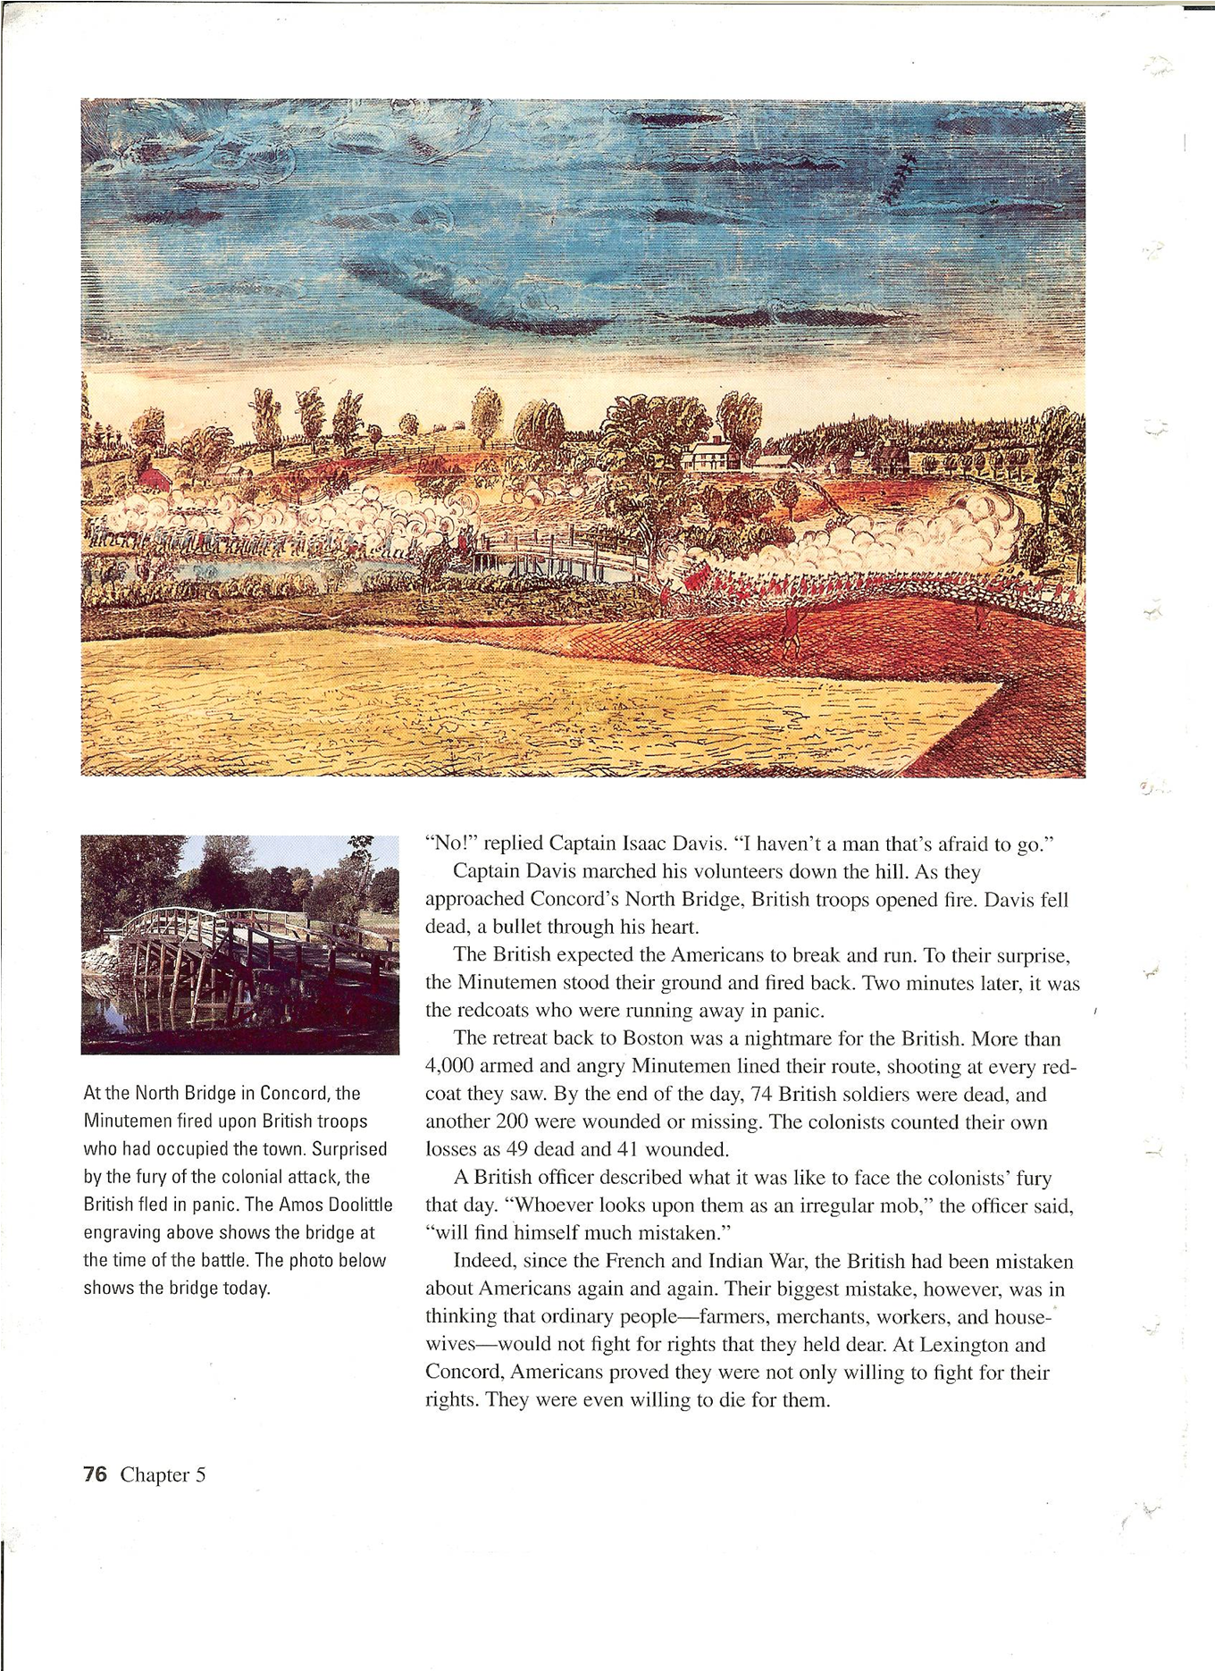
Main ideas of CH 5

Slide 28
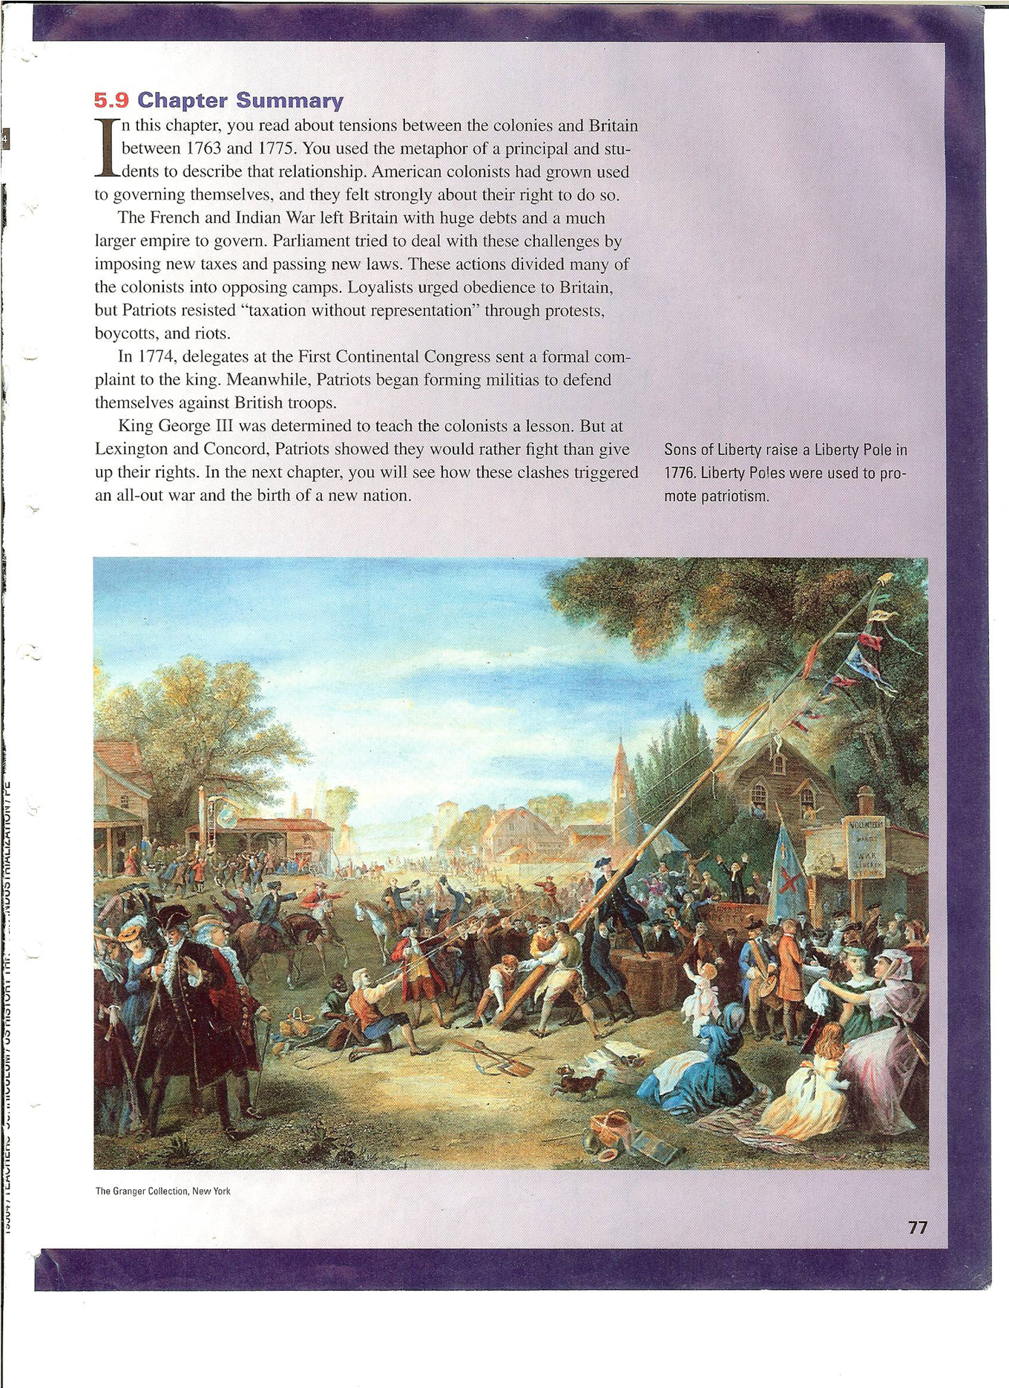
Main ideas of CH 5

Slide 29
8.2 – Forming a New Nation
Chapter 6 The Declaration of Independence
petitions (p. 79)
independence (p. 79)
Bunker Hill (p. 80)
George Washington (p. 80)
Continental Army 80
Ticonderoga (p. 81)
Traitor (p. 82)
Olive Branch Petition (p.82)
Natural Rights (p.83)
Thomas Jefferson
Declaration of Independence (p. 83
King George III (83)

Slide 31
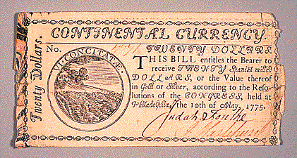
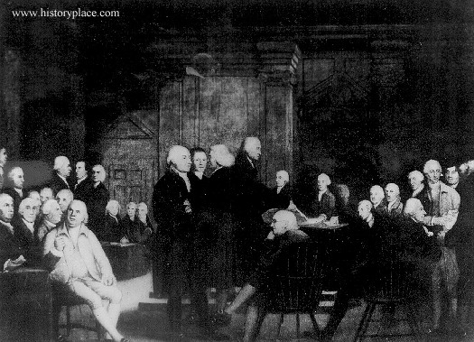
Second Continental Congress
Representatives brought money to help establish…
the Continental Army
(i.e. pay soldiers, buy guns, bullets, food, and uniforms

Slide 32
independence : (n)
declaration : (n)
an official statement
the freedom to govern on one’s own.

Slide 33
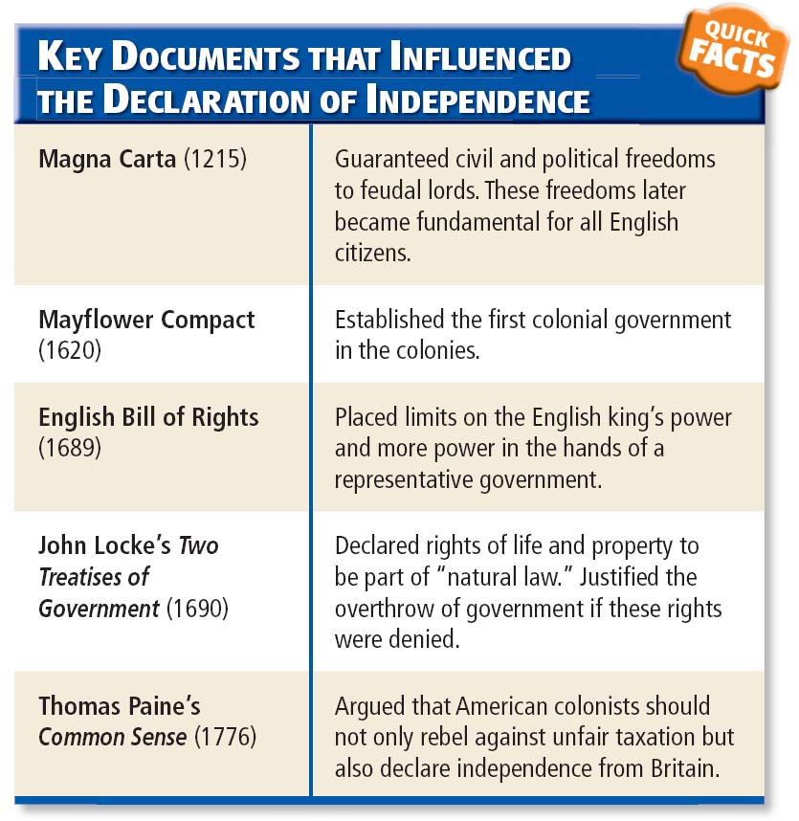

Slide 34
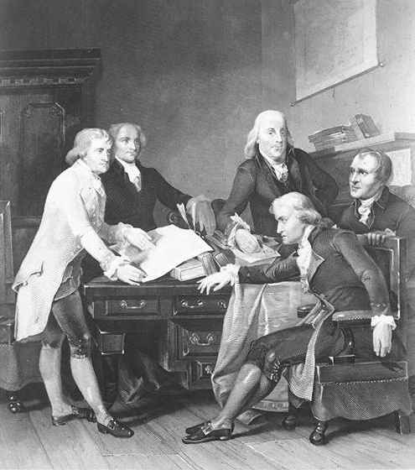
Who was involved?
Benjamin Franklin
John Adams
Robert R. Livingston
Roger Sherman
Thomas Jefferson

Slide 35
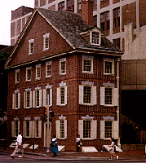
Where did it all take place?
This is a replica of the Graff house where Jefferson wrote the majority of the 1st draft of the Declaration of Independence. The original building (at this location) was destroyed in 1888.

Slide 36
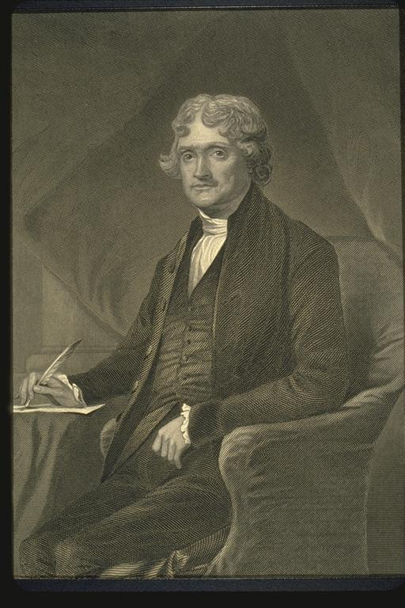
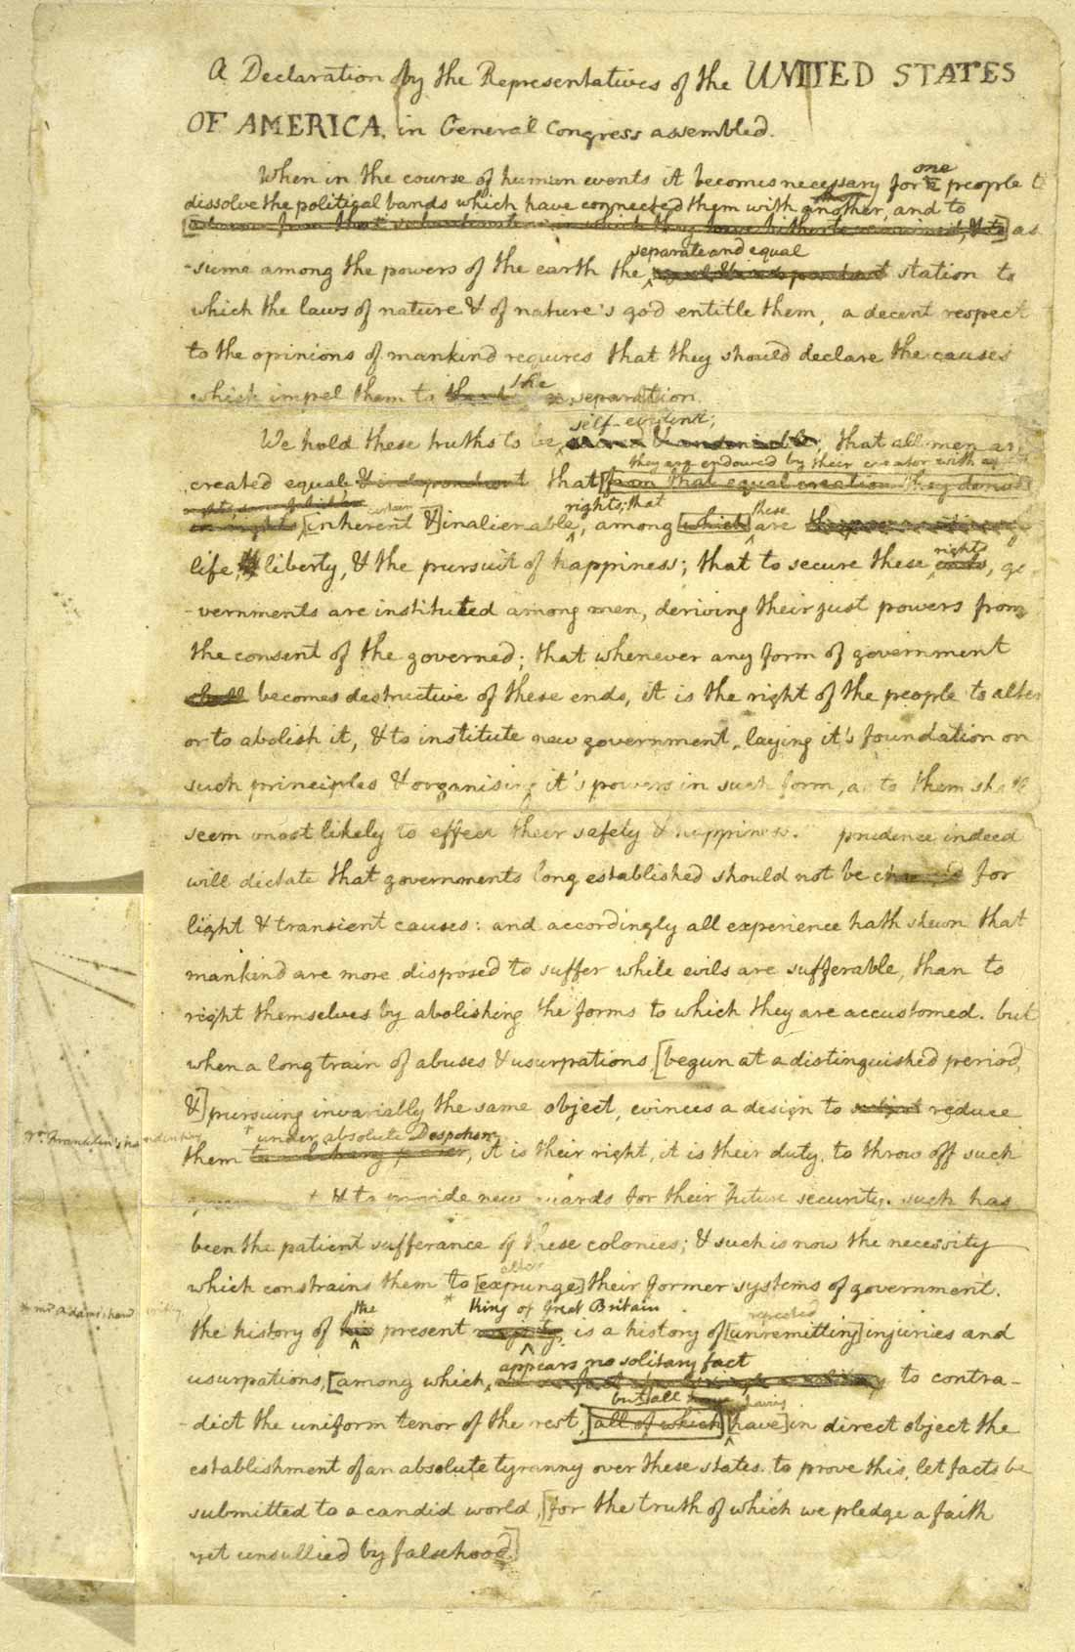
What did it look like?
Who wrote the first draft?

Slide 37
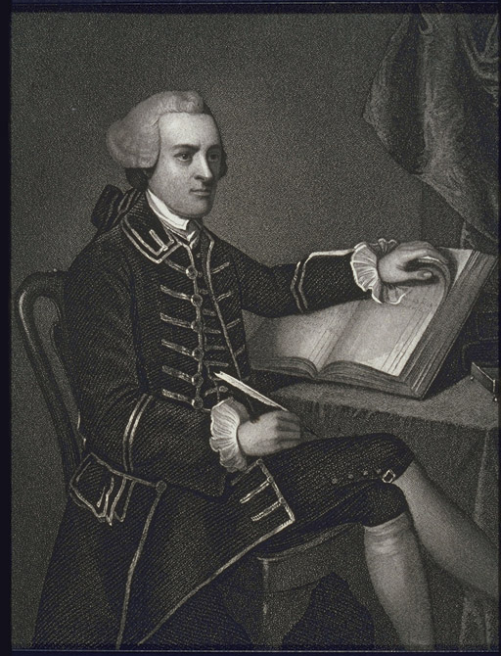
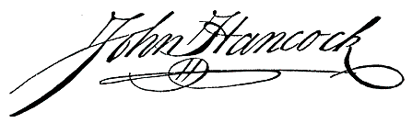
Who signed it first?

Slide 38
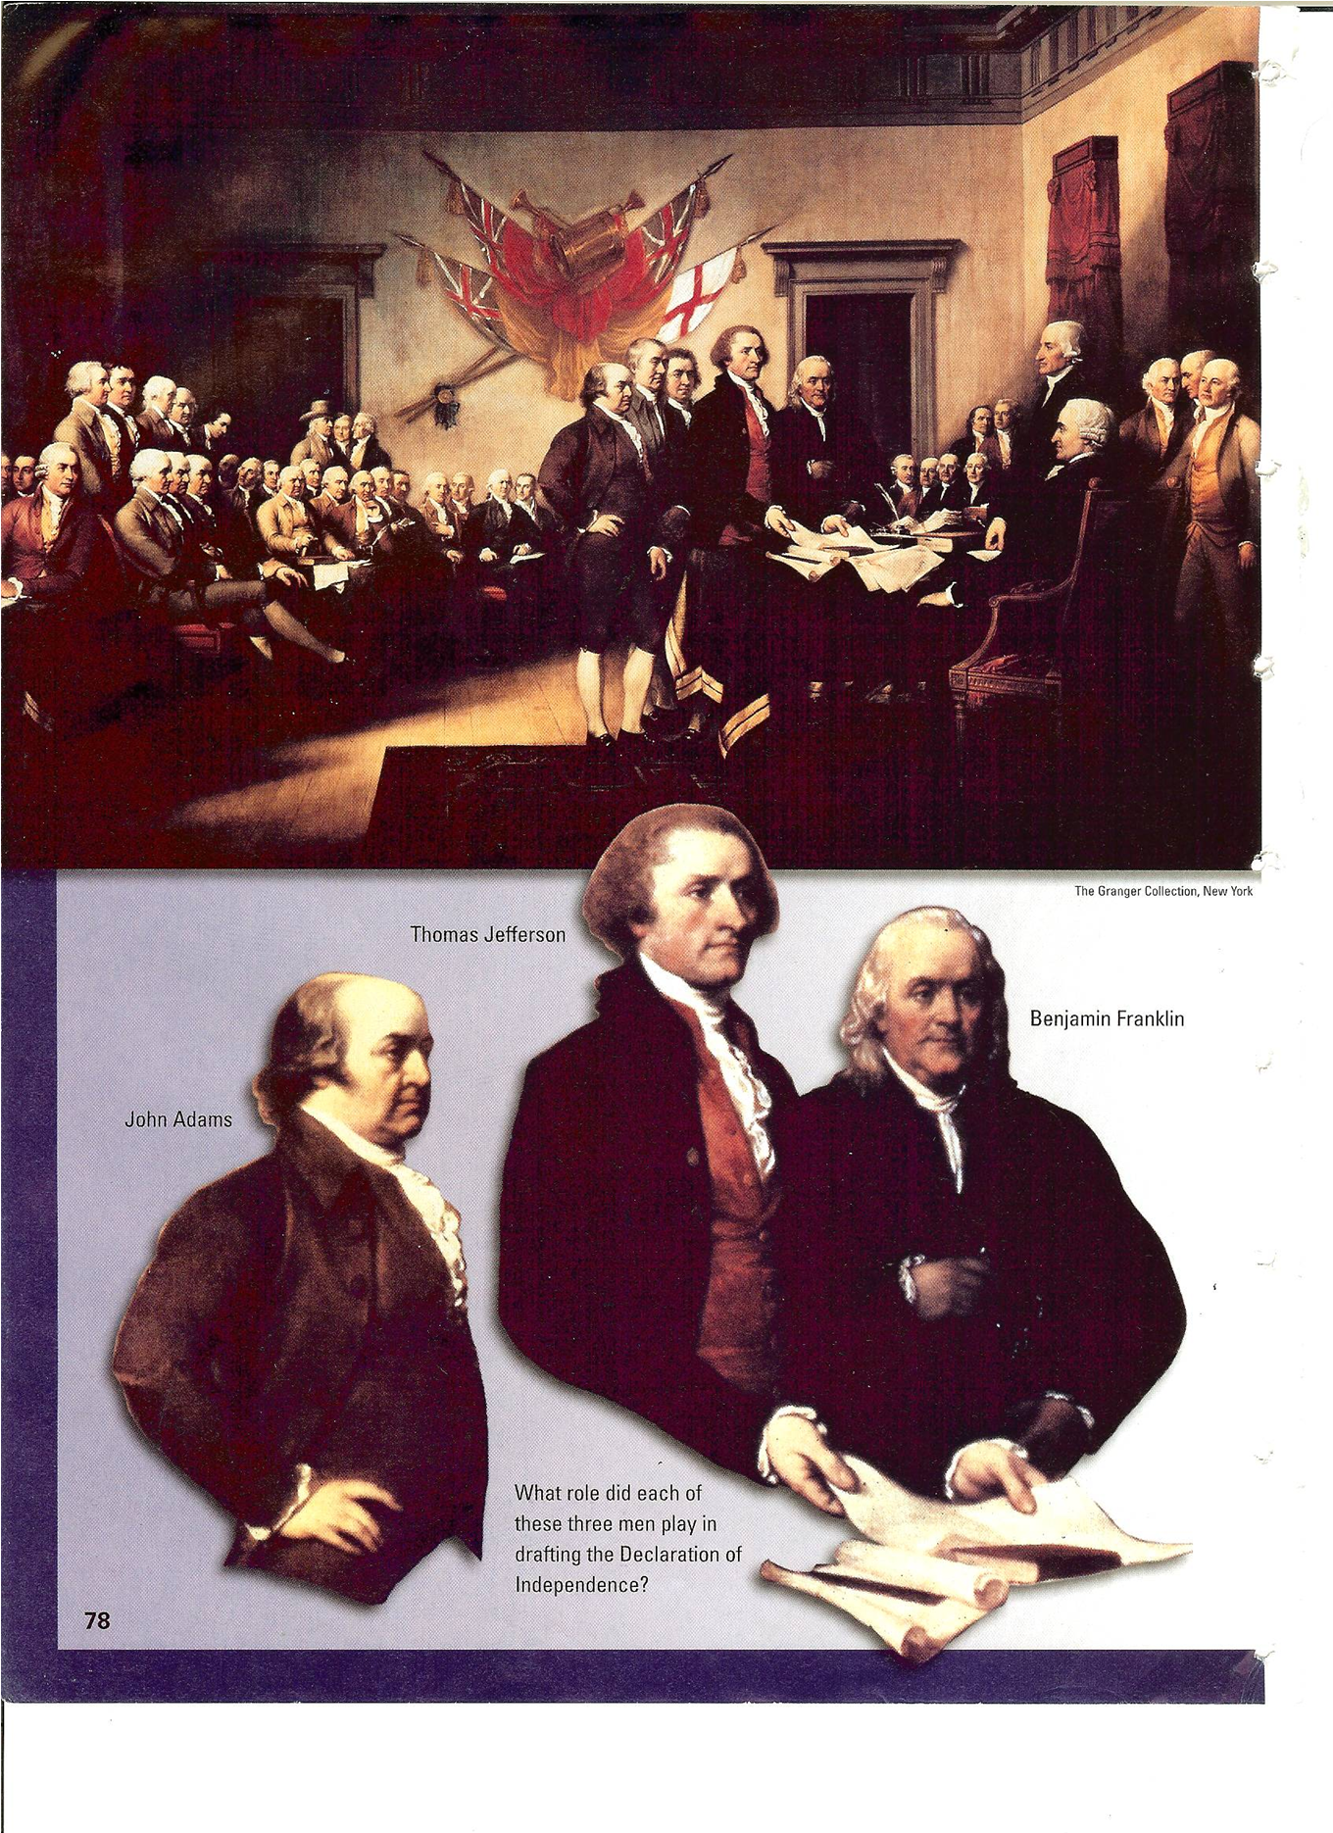
Parts of the Declaration
1
2
3
4

Slide 39
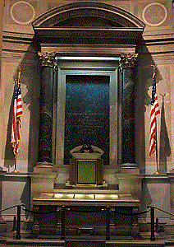
What happened after it was signed and where is it now?

Slide 40
8.3 American Political System
Chapter 6 The American Revolution
1. petitions (p. 79)
2. independence (79)
3. Bunker Hill (p. 80)
4. George Washington (p. 80)
5. Continental Army
6. Ticonderoga (p. 81)
7. Traitor (p. 82)
8. Olive Branch Petition (p.82)
9. Natural Rights (p.83)
10. Thomas Jefferson
11. Declaration of Independence (p. 83)
12. King George III (83)

Slide 41
The
American
Revolution:
1775-1783
Ms. Susan M. Pojer
Horace Greeley HS Chappaqua, NY

Slide 42
On the Eve of the Revolution ?
 | Britain | Americans
Advantages | ? | ?
Disadvantages | ? | ?

Slide 43
Loyalist
Strongholds

Slide 44
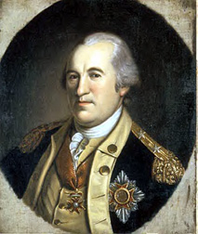

Washington’s Headaches
Only 1/3 of the colonists were in favor of a war for independence [the other third were Loyalists, and the final third were neutral].
State/colony loyalties.
Congress couldn’t tax to raise money for the Continental
Army.
Poor training [until
the arrival of
Baron von Steuben.

Slide 45
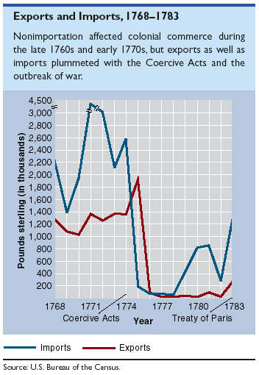
Exports & Imports: 1768-1783

Slide 46
Military Strategies
The Americans
The British
Attrition [the Brits had a long supply line].
Guerilla tactics [fight an insurgent war → you don’t have to win a battle, just wear the British down]
Make an alliance with one of Britain’s enemies.
Break the colonies in half by getting between the No. & the So.
Blockade the ports to prevent the flow of goods and supplies from an ally.
“Divide and Conquer” → use the Loyalists.

Slide 47
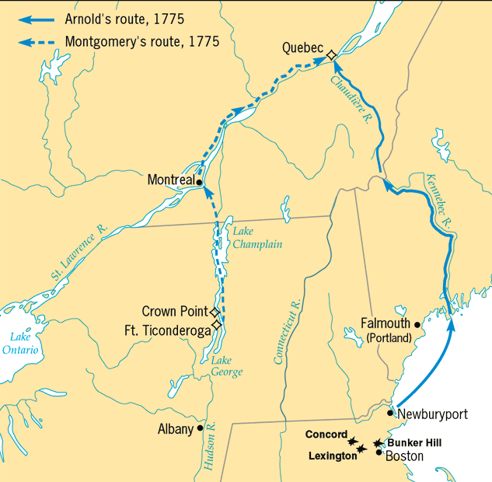
Phase I: The Northern Campaign
[1775-1776]

Slide 48
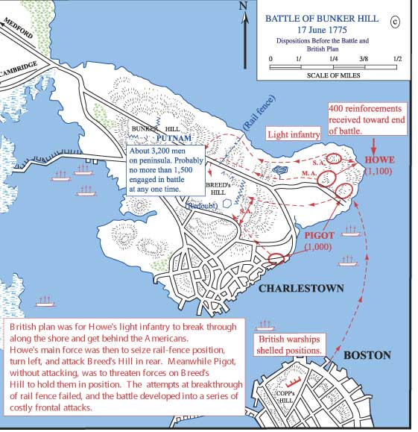
Bunker Hill (June, 1775)
The British suffered over 40% casualties.

Slide 49
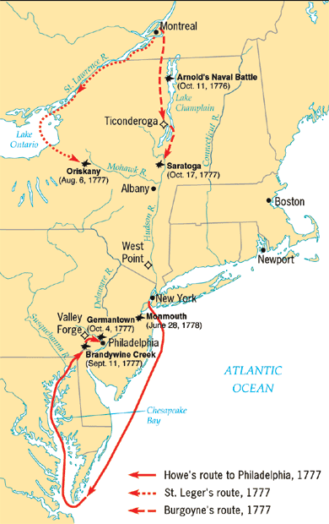
Phase II:
NY & PA
[1777-1778]

Slide 50
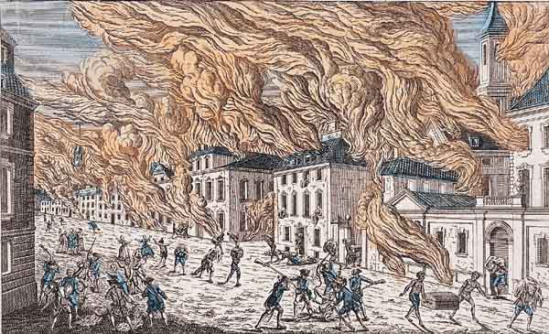
New York City in Flames
(1776)

Slide 51
8.2 – Forming a New Nation
Chapter 7 - The American Revolution
1. Mercenaries ( 89)
2. Thomas Paine’s The Crisis (p. 92)
3. Trenton (p. 92)
4. strategy (p. 93)
5. Saratoga (p. 94)
6. Valley Forge (94)
7. ally (p. 94)
8. beheld (p. 95)
9. guerilla troops (96)
10. Lord Cornwallis(96)
11. Yorktown (p. 96)
12. Treaty of Paris 100

Slide 52
Phase II:
NY & PA
[1777-1778]

Slide 53
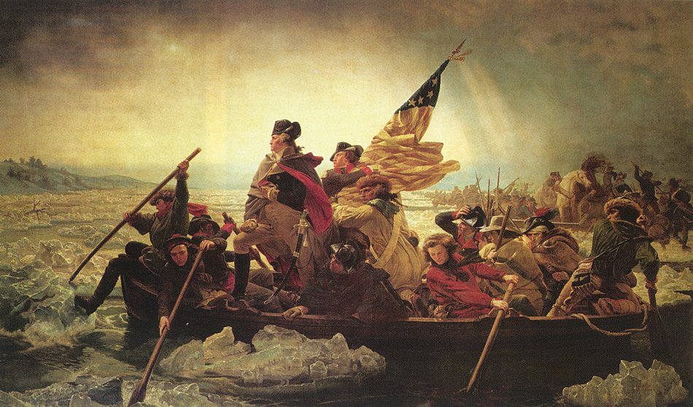
Washington Crossing the Delaware
Painted by Emanuel Leutze, 1851

Slide 54
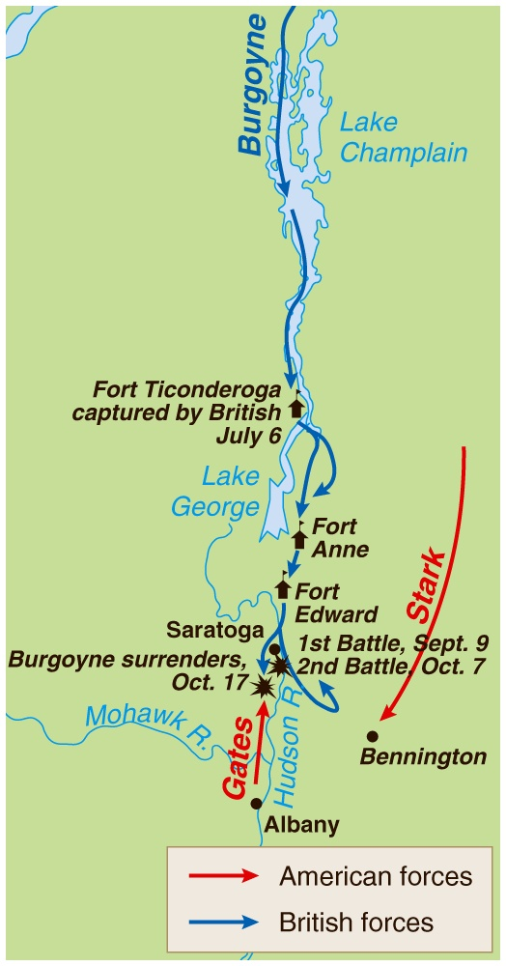
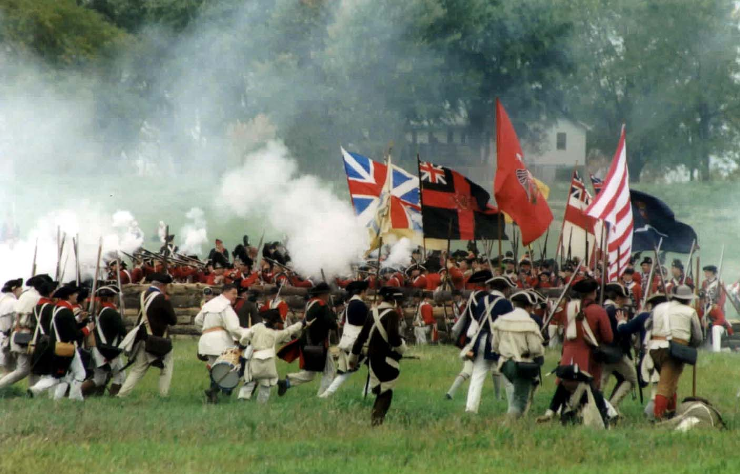
Saratoga:
“Turning Point”
of the War?
A modern-day re-enactment

Slide 55
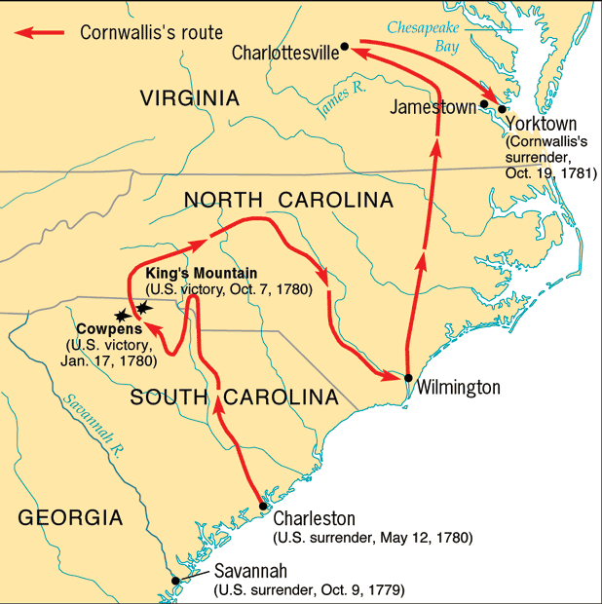
Phase III: The Southern Strategy [1780-1781]

Slide 56
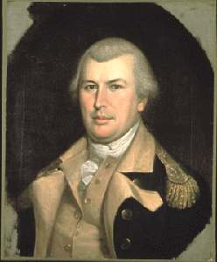
Britain’s “Southern Strategy”
Britain thought that there were more Loyalists in the South.
Southern resources were more valuable/worth preserving.
The British win a number of small victories, but cannot pacify the countryside [similar to U. S. failures in Vietnam!]
Good US General:
Nathanial Greene

Slide 57
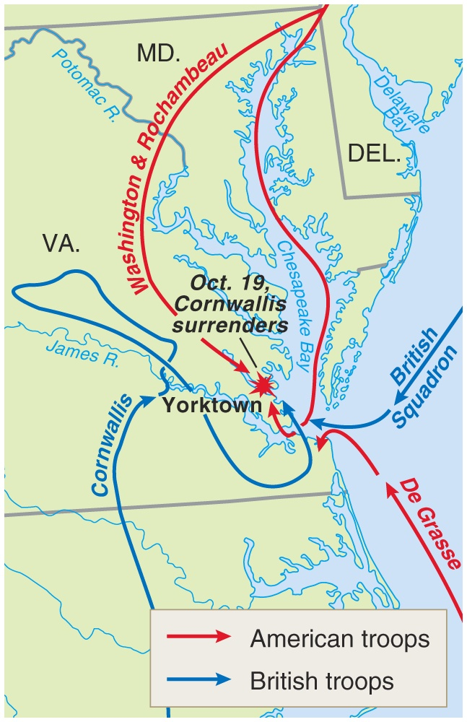
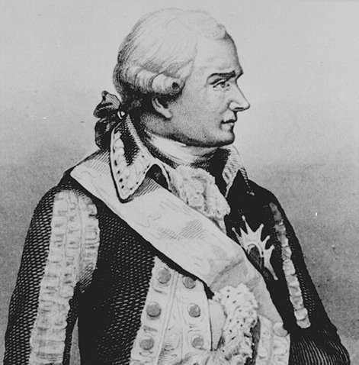
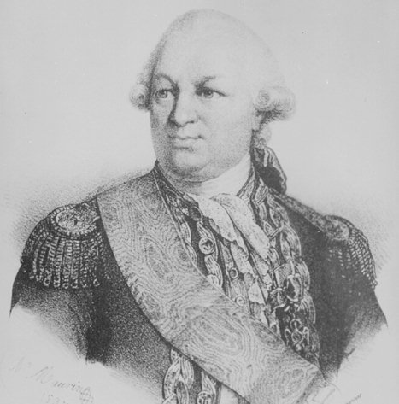
The Battle of Yorktown (1781)
Count de Rochambeau
Admiral
De Grasse

Slide 58
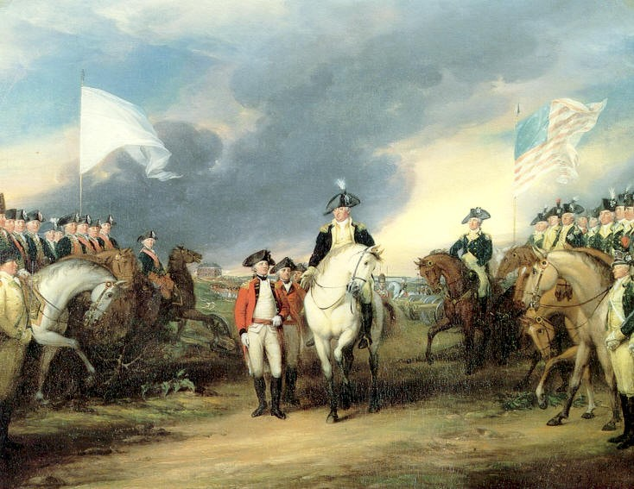
Cornwallis’ Surrender at Yorktown:
“The World Turned Upside Down!”
Painted by John Trumbull, 1797

Slide 59
Why
did the British
Lose???

Slide 60
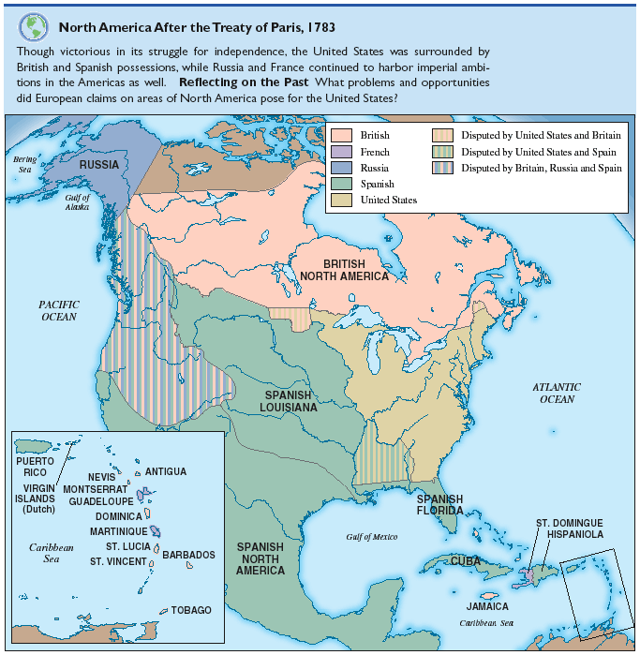
North America After the
Treaty of Paris, 1783

Slide 61
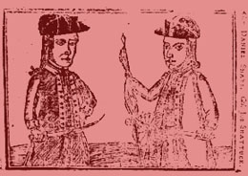
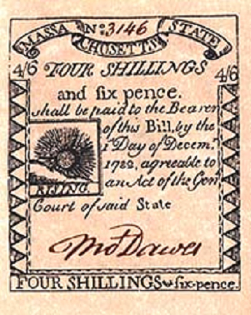
Shays’ Rebellion: 1786-7
Daniel Shays
Western MA
Small farmers angered by crushing debts and taxes.

Slide 62
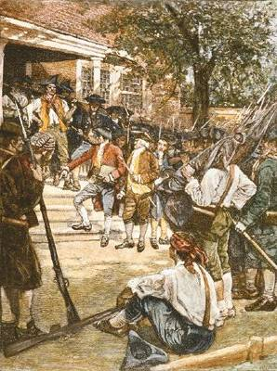

Shays’ Rebellion: 1786-7

Slide 63
Shays’ Rebellion: 1786-7
There could be no stronger evidence of the want of energy in our governments than these disorders.
-- George Washington

Slide 64
8.3 American Political System
Chapter 8 CREATING THE CONSTITUTION
1. Articles of Confederation (p.103)
2. Constitutional Convention (p. 106)
3. James Madison
4. constitution (108)
5. state constitutions (pp. 108, 433)
6. republic (p. 108)
7. Virginia Plan (109)
8. New Jersey Plan
9. the Great Compromise (p110)
10. the Three-Fifths Compromise (p. 112)
11. Electoral College (p. 114)
12. ratify (p. 115)

Slide 65
Articles
of
Confederation
Government:
1781-1789

Slide 66

Federalist vs. Anti-Federalist
Strongholds at the End of the War

Slide 67
Weaknesses of the
Articles of Confederation
A unicameral Congress
[9 of 13 votes to pass a law].
13 out of 13 to amend.
Representatives were frequently absent.
Could not tax or raise armies.
No executive or judicial branches.

Slide 68
State Constitutions
Republicanism.
Most had strong governors with veto power.
Most had bicameral legislatures.
Property required for voting.
Some had universal white male suffrage.
Most had bills of rights.
Many had a continuation of state-established religions while others disestablished religion.

Slide 69

Disputed Territorial Claims
Between Spain & the U. S.:
1783-1796

Slide 70

Land Ordinance of 1785

Slide 71
Shays’ Rebellion: 1786-7
Daniel Shays
Western MA
Small farmers angered by crushing debts and taxes.

Slide 72
Shays’ Rebellion: 1786-7

Slide 73
Shays’ Rebellion: 1786-7
There could be no stronger evidence of the want of energy in our governments than these disorders.
-- George Washington

Slide 74

Northwest Ordinance of 1787
One of the major accomplishments of the Confederation Congress!
Statehood achieved in three stages:
  Congress appointed 3 judges & a governor to govern the territory.
  When population reached 5,000 adult male landowners → elect territorial legislature.
  When population reached 60,000 → elect delegates to a state constitutional convention.

Slide 75

The United States in 1787

Slide 76
Annapolis Convention (1786)
12 representatives from 5 states
[NY, NJ, PA, DE, VA]
GOAL → address barriers that limited trade and commerce between the states.
Not enough states were represented to make any real progress.
Sent a report to the Congress to call a meeting of all the states to meet in Philadelphia to examine areas broader than just trade and commerce.

Slide 77


Slide 78
Drafting the Constitution
Main Idea
The Constitutional Convention tried to write a document that would address the weaknesses of the Articles of Confederation and make compromises between large and small states and between the North and South.
Reading Focus
What different points of view emerged at the Constitutional Convention?
What compromises did the delegates make at the Constitutional Convention?
How does a system of checks and balances prevent any one branch of the federal government from becoming too powerful?

Slide 79
The Constitutional Convention
Many were frustrated with the Articles of Confederation: farmers, veterans, merchants doing business between states, and creditors of the Continental Congress who had not been paid.
Congress called all the states to meet in Philadelphia in May 1787 to revise the Articles of Confederation.

Slide 80

The Constitutional Convention begins
1787 - Philadelphia
Delegates from all the states invited to a convention to improve the Articles of Confederation, which were not working
Only RI didn’t attend
55 Delegates attended

Slide 81
Leaders of the Convention
George Washington was asked to preside (lead) over the convention.
James Madison kept notes of the discussions and is often called “The Father of the Constitution.”
The men who wrote the Constitution are called the “Founding Fathers.”
All the participants in the Convention were wealthy, white, males.

Slide 82

The Founding Fathers

Slide 83
Issues that divided the Nation’s leaders
The power of the federal government. Would the states or the federal government have the most power?
Representation in Congress (How many members on Congress would each state get? – small states wanted equal representation, large states wanted it to be determined by population of the states
Slavery – How would slaves be counted? Would the slave trade continue?

Slide 84
The Virginia Plan
Called for a new national government. Threw out the Articles of Confederation
Three separate branches of government. – a legislative branch, executive branch, and judicial branch
Representation in the legislative branch based on population of state
Large states like the plan, small states don’t.

Slide 85
New Jersey Plan
Legislature - has one house.
Each state gets one vote.
Small states like the plan, the large states hate it.
There would have to be a compromise.

Slide 86
The Great Compromise
Legislature would have two houses (parts): House of Representatives and a Senate
House - based on the population of state
Senate - two senators per each state

Slide 87


Slide 88
Slavery
The Southern states refused to approve the Constitution unless slavery continued.
It was a terrible compromise to make, but the Northern states had no choice if they wanted a Constitution.
3/5 Compromise - Made each slave worth 3/5 of a vote in deciding numbers in House of Representatives
Congress can not ban the slave trade until 1808.

Slide 89


Slide 90
8.3 American Political System
Chapter 9 The Constitution: A More Perfect Union
1. the Preamble (120)
2. popular sovereignty (p. 120)
3. legislative branch
4. bicameral (p. 121)
5. bill (p. 122)
6. veto (p. 122)
7. executive branch
8. impeach (p. 124)
9. judicial branch (124)
10. amendment (p. 127) 11. federal system (128)
12. interstate commerce (p. 128)
13. political parties (130)
14. interest groups (130)
15. checks and balances (p. 126)

Slide 91

8.5 – Re
Key words or Concepts
Muham
Qur’
Sunn
Five
Arabi
Car

Slide 92

8.5 – Re
Key words or Concepts
Muham
Qur’
Sunn
Five
Arabi
Car

Slide 93


Slide 94


Slide 95


Slide 96


Slide 97


Slide 98


Slide 99


Slide 100


Slide 101


Slide 102


Slide 103


Slide 104


Slide 105


Slide 106



Slide 107


Slide 108


Slide 109
8.3 American Political System
Chapter 10 The Bill of Rights
1. ratification (p 133)
2. bill of rights p 133
3. separation of church + state
4. self-incrimination
5. assemble (p. 137)
6. press (p. 136)
7. seizure (p. 138)
8. warrant (p. 139
9. defendants ( p.139)
10. grand jury (p. 139)
11. double jeopardy
12. taking-the-fifth (139)
13. due process (140)
14. just compensation
15. bail (p. 141)

Slide 111


Slide 112


Slide 113


Slide 114
Ratifying the Constitution
Main Idea
Federalists and Antifederalists struggled over the principles of the new Constitution. But the promise of adding a Bill of Rights brought about ratification.
Reading Focus
What arguments for and against the Constitution were put forth by Federalists and Antifederalists?
What ideas were published in The Federalist?
Why was adding a Bill of Rights significant in the ratification process?

Slide 115
Federalists and Antifederalists
The new Constitution created a strong national government with certain powers left to the states.
When it was published, the drastic changes surprised and angered some people. They feared the idea of a too-powerful national government.
Federalists: supporters of the Constitution
Antifederalists: opponents of the Constitution

Slide 116
Federalists and Antifederalists
Federalist viewpoint
Led by James Madison, John Dickinson, and Alexander Hamilton
Benjamin Franklin and George Washington also backed the Federalists.
Federalist cause was generally popular in the cities, but they were outnumbered in the general population.
Well organized and knew how to gather political support

Slide 117
Federalists and Antifederalists
Antifederalist viewpoint
They were less organized and less unified than the Federalists.
Their core consisted of farmers and planters.
Agreed on one central issue: they distrusted any central authority
Believed strong national government would lead to a kind of tyranny like the kind they fought against in the Revolution.
Worried that the government would abuse both states’ rights and individual liberties
Thought the new government favored the educated and wealthy over ordinary people
Led by Samuel Adams, Patrick Henry, and Richard Henry Lee
Robert Yates, New York delegate, wrote anti-Constitution essays under the name Brutus.

Slide 118
Federalists and Antifederalists
Ratification process
Antifederalists demanded the addition of a Bill of Rights.
Wanted to spell out some basic rights in the Constitution to make sure those rights would be protected
Adding the rights became the main focus of the struggle over ratification.
Congress called for special ratifying conventions in each state.

Slide 119
The Federalist Papers
A series of essays discussing and defending the Constitution were published in New York newspapers.
Written under the pen name Publius
Circulated widely in other states
Collected in a book, The Federalist, also known as the Federalist Papers
Main goal of essays was to persuade New York delegates to ratify the document by explaining the advantages it would bring
Publius was three Federalists: James Madison, Alexander Hamilton, and John Jay

Slide 120
The Federalist Papers
Ideas in the Federalist
Hamilton wrote that the decision they were about to make was important for the whole world.
Madison warned against the dangers of factions—groups with specific, often opposing, interests.
  Had torn apart some European governments
  They were a natural part of American society and should not be suppressed.
  A republican government would help balance the influence of factions.
He explained how the separation of powers described in the Constitution would limit government powers.

Slide 121
The Federalist Papers
Adding a Bill of Rights
Fight for ratification
The Federalists were better prepared than their opponents. They quickly organized and gained control of several state conventions, especially in small states.
After 11 states had ratified the Constitution, the Congress of the Confederation set dates for elections to choose members of Congress and presidential electors.

Slide 122
Adding a Bill of Rights
Constitutional amendments
Several crucial states had ratified the Constitution only because they were promised a bill of rights.
Once the new Congress was elected, it needed to add the bill in the form of amendments to the Constitution.
James Madison took charge of putting the Bill of Rights through Congress.
He pointed out that in England the constitution limited only the king’s power, not Parliament’s. The amendments would protect against all abuses of power.
The states approved 10 of the 12 amendments that Congress had approved. They became the Bill of Rights.

Slide 123
Adding a Bill of Rights
The Bill of Rights
First eight amendments dealt with individual civil liberties.
Ninth Amendment stated that listing certain rights given to the people did not mean that other rights did not exist as well.
The final amendment addressed the actions that states could do.
Tenth Amendment defined two kinds of government powers.
  Delegated powers: powers that the Constitution gives to each branch of the national government
  Reserved powers: powers that the Constitution does not specifically give to the federal government or deny to the states
Reserved powers belong to the states or to the people.

Slide 125



Slide 126



Slide 127
This PowerPoint has been brought to you by the Pinole Middle School
Social Science Department
Ted Dunn
Chair History Department

