Slide 1
7th Grade Social Science Review without videos
The 7th Grade portion is 31% of the 8th Grade Test

Slide 2
The Fall of Rome begins a new era in History
The Middle Ages

Slide 3
This PowerPoint has been brought to you by the Adams Middle School Social Science Department
Renee Terry and Ted Dunn
History Department

Slide 4
World History and Geography: Ancient Civilizations
7.6 – Medieval Europe (Two Questions)
7.8 – The Renaissance (Two Questions)
7.9 – The Reformation (Three Questions)
7.10 – The Scientific Revolution (Two Questions)
7.11 – Exploration (Three Questions)

Slide 5
Medieval Europe

Slide 6
7.6 – Key words or Concepts
Feudalism
Monarch
Papacy
Magna Carta
Habeas Corpus
Crusades
The Catholic Church

Slide 7
Social Structure
Medieval Europe operated under the Feudal system after the fall of Rome
The Feudal system is a social and political system which ties the people to the land
It was a way of protecting property
People pledged loyalty to the King

Slide 8
CH 2 THE DEVELOPMENT OF FEUDALISM IN WESTERN EUROPE MAIN TOPICS: 1. HISTORY OF TIMES 2. DEF OF FEUDALISM 3. MONARCHS 4. LORDS / NOBLES 5. KNIGHTS 6. PEASANTS / SERFS

Slide 10
Social Structure- Continued
The King would then give land to lords
The lords would promise to supply the king with knights in times of war
At the bottom of the social structure were peasants
Beneath them were serfs, serfs were not allowed to leave the land

Slide 11
Religion
During this time, Religion becomes the center of life
Most people belonged to the Roman Catholic Church
The church acquired great power both political and economic
At the top of the Church was the Pope

Slide 13
Cooperation
The Catholic Church becomes influential in Europe with Charlemagne
Charlemagne built his empire with the help of Pope Leo III
Charlemagne could provide the Pope with an army
He was crowned Holy Roman emperor by the Pope

Slide 14
Conflict within the Church
Pope Gregory VII and Henry IV had a great Conflict
Pope Gregory refused to allow Henry to appoint church officials but Henry did it any way
The Pope had Gregory thrown out of the church and told the his people not to listen to him
Henry begged forgiveness and was readmitted to the church
He had to admit that the Pope and the Church had great power

Slide 17
The Crusades
Pope Urban II called for the Crusades
The Crusade was a series of eight wars
It was fought between Christians and Muslims
The Christians goal was to capture the holy land including the city of Jerusalem
The Christians were only successful in their first war
The Muslims recaptured the Holy land under the sultan Saladin

Slide 18
ROUTES OF THE CRUSADES

Slide 19
The Lasting Effects of the Crusades
Jews suffered during the crusades
Some were killed others lost their homes and property
Muslims survived the Crusades and expanded their empire to include parts of eastern Europe, all of the Middle East, and most of India

Slide 20
The effect of Christians
The Crusades had the greatest impact on Christians
They were introduced to advancements in science, mathematics, and astronomy.
They were also introduced to goods and spices from Africa and Asia

Slide 21
Renaissance
Lets start talking about Europe after the Middle Ages.
This will be a combination of slides and video clips so follow along with your Grey Student Work Book CH 28, 29, and 30

Slide 22
7.8 – Key words or Concepts
Classical Learning
Humanism
The Gutenberg Bible
Dante Alighieri
Leonardo da Vinci
Michelangelo
Shakespeare

Slide 23
Humanism
The Renaissance began in Italy and spread throughout Europe
It is a rediscovery of the classical culture of Greece and Rome
It occurred because of a growth in trade and commerce
Humanism is the area of study that focuses on human life and culture
This encouraged new ways of thinking – a balance between intellect and religious faith

Slide 25
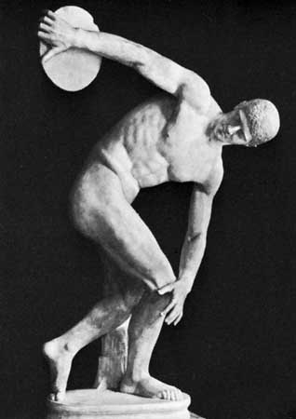

Slide 26
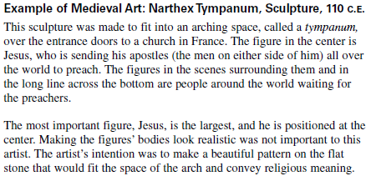

Slide 27
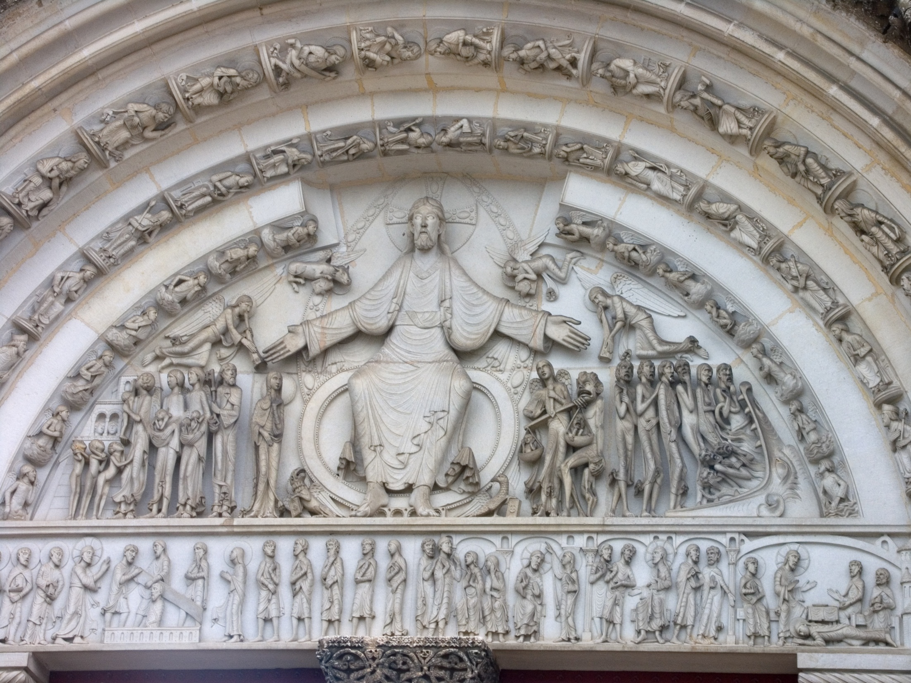

Slide 28
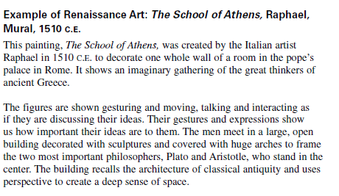

Slide 29
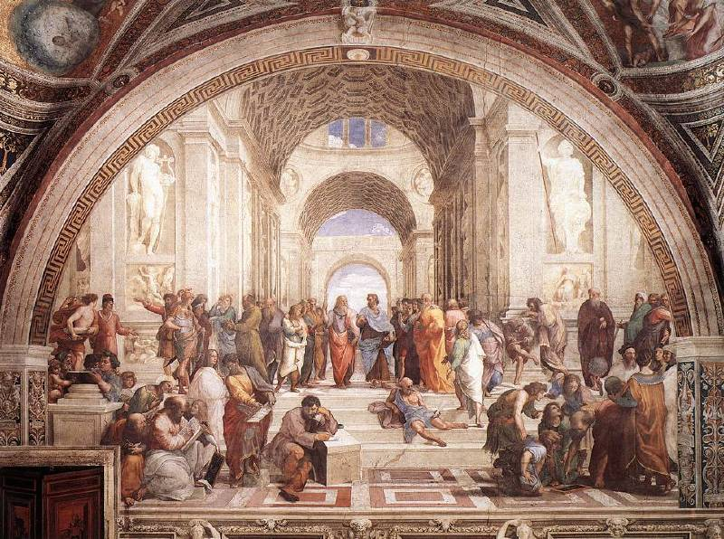
The School of Athens – Raphael,
Da Vinci
Raphael
Michelangelo

Slide 30
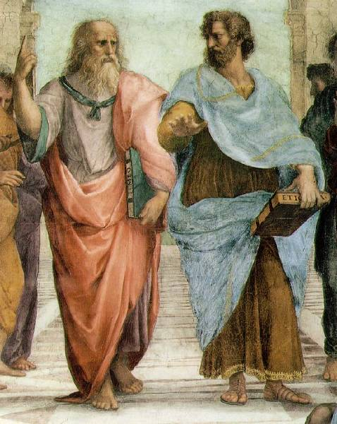
The School of Athens – Raphael, details
Plato: looks to the heavens [or the IDEAL realm].
Aristotle: looks to this earth [the here and now].

Slide 31
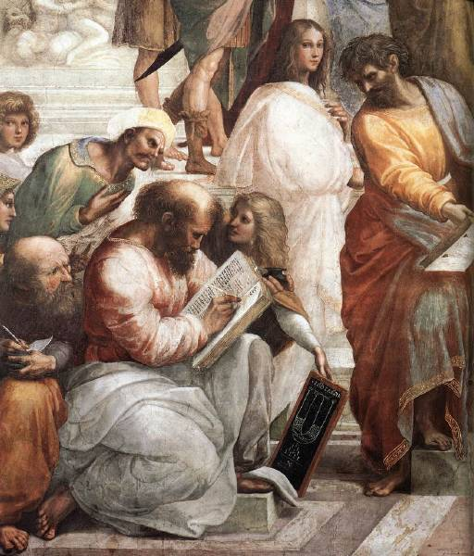
Averroes
Hypatia
Pythagoras

Slide 32
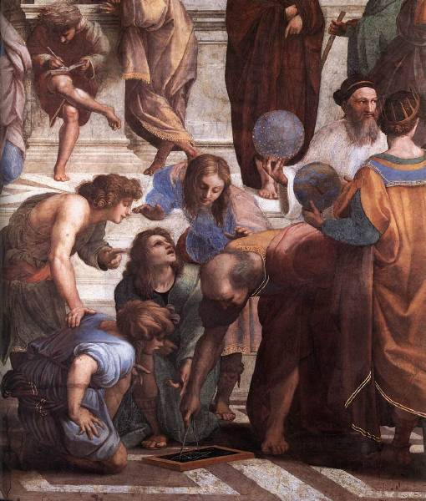
Zoroaster
Ptolemy
Euclid

Slide 33
Renaissance Advancements
The idea of humanism influenced artists and thinkers
Michelangelo looked back to the classics when he carved his statue David in white marble
Da Vinci was an artist, scientist, and Inventor
Literature was influenced by humanism. Writers began to write in their own dialects and not just in Latin
Dante Alighieri wrote “The Divine Comedy” about purgatory

Slide 34
Characteristics
of
Renaissance Art

Slide 35
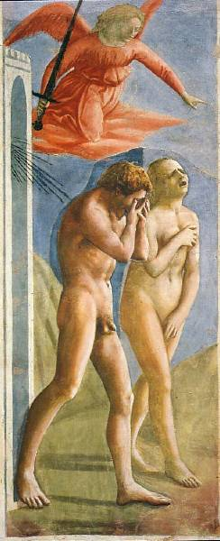
1. Realism & Expression
Expulsion from the Garden
Masaccio
1427
First nudes since classical times.

Slide 36
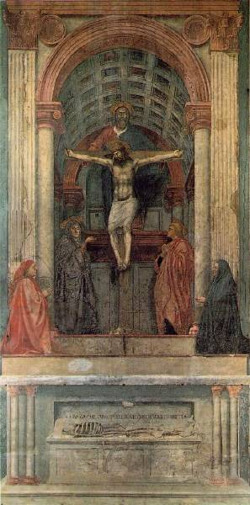
2. Perspective
The Trinity
Masaccio
1427
Perspective!
Perspective!
Perspective!
Perspective!
Perspective!
Perspective!
Perspective!
First use of linear perspective!
What you are, I once was; what I am, you will become.

Slide 37
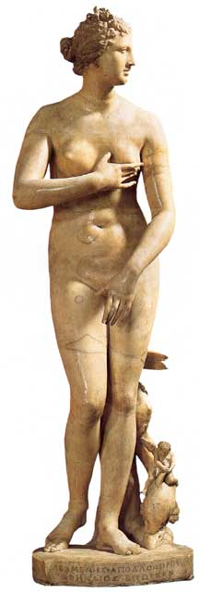
3. Classicism
Greco-Roman influence.
Secularism.
Humanism.
Individualism → free standing figures.
Symmetry/Balance
The “Classical Pose” Medici “Venus” (1c)

Slide 38
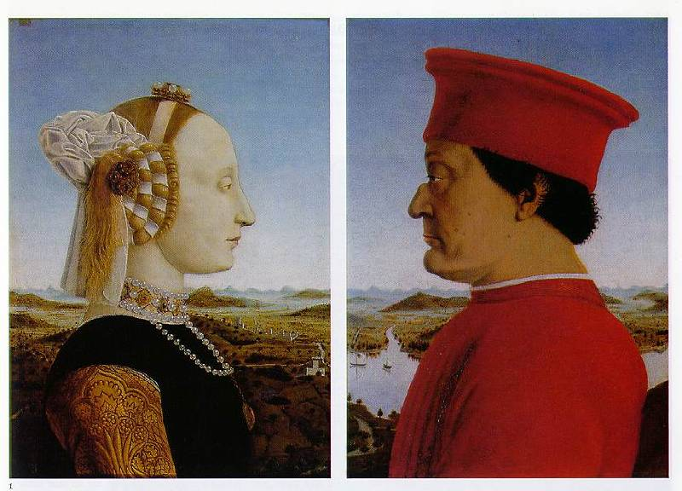
4. Emphasis on Individualism
Batista Sforza & Federico de Montefeltre: The Duke & Dutchess of Urbino
Piero della Francesca, 1465-1466.

Slide 39
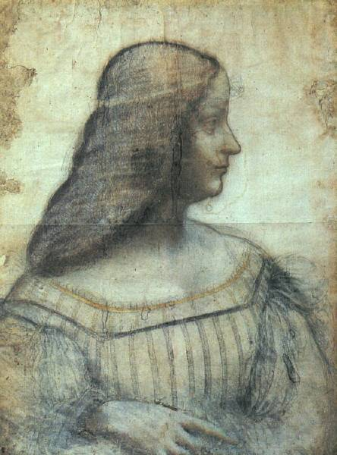
Isabella d’Este – da Vinci, 1499
1474-1539
“First Lady of the Italian Renaissance.”
Great patroness of the arts in Mantua.
Known during her time as “First Lady of the World!”

Slide 40
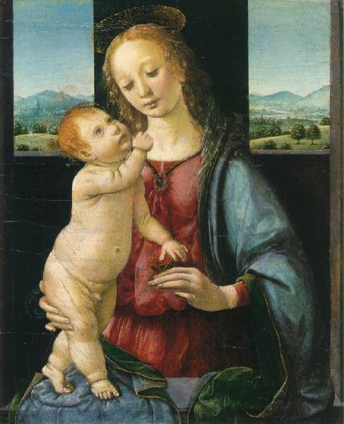
5. Geometrical Arrangement of Figures
The Dreyfus Madonna with the Pomegranate
Leonardo da Vinci
1469
The figure as architecture!

Slide 41
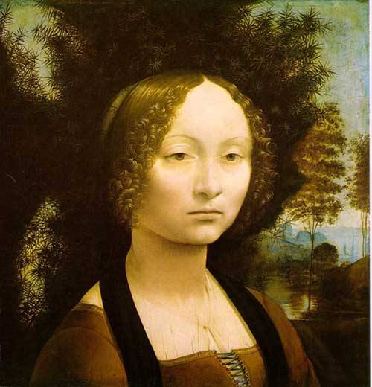
6. Light & Shadowing/Softening Edges
Sfumato
Chiaroscuro

Slide 42
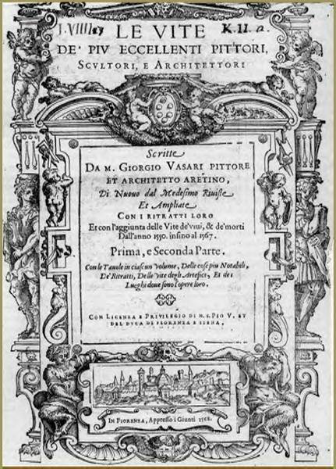
7. Artists as Personalities/Celebrities
Lives of the Most Excellent Painters, Sculptors, and Architects
Giorgio Vasari
1550

Slide 43
The
Renaissance
'Individual'

Slide 44
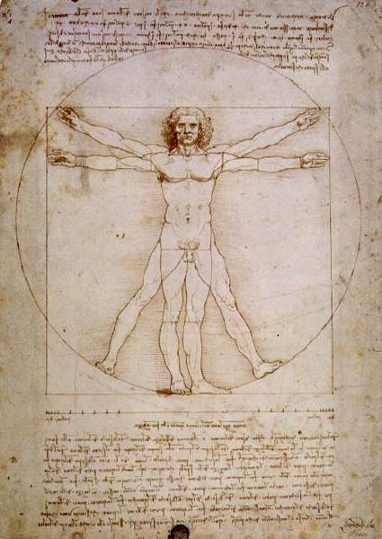
Vitruvian Man
Leonardo da Vinci
1492
The L’uomo universale

Slide 45
The Renaissance “Man”
Broad knowledge about many things in different fields.
Deep knowledge/skill in one area.
Able to link information from different areas/disciplines and create new knowledge.
The Greek ideal of the “well-rounded man” was at the heart of Renaissance education.

Slide 46
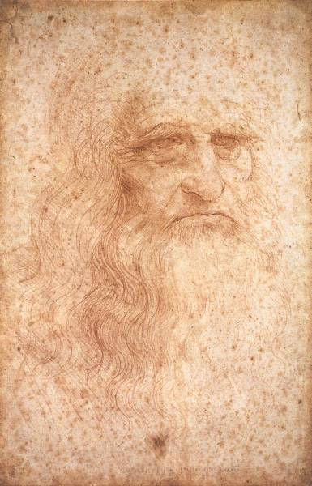
1. Self-Portrait -- da Vinci, 1512
Artist
Sculptor
Architect
Scientist
Engineer
Inventor
1452 - 1519

Slide 47
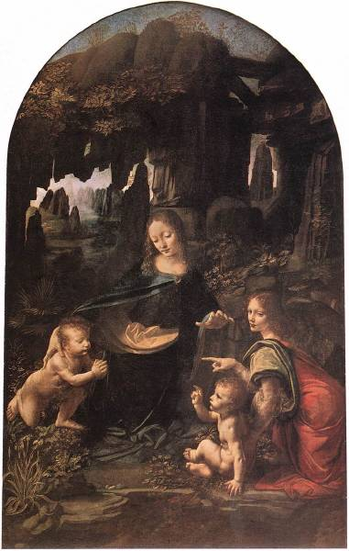
Leonardo, the Artist
The Virgin of the Rocks
Leonardo da Vinci
1483-1486

Slide 48
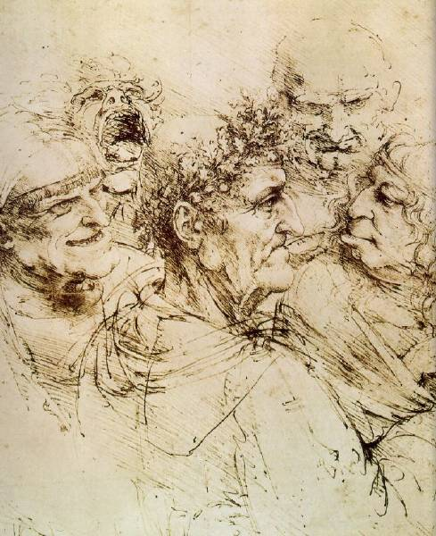
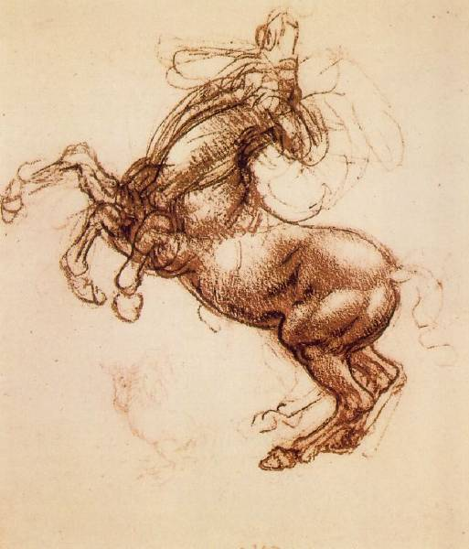
Leonardo, the Artist: From hisNotebooks of over 5000 pages (1508-1519)

Slide 49
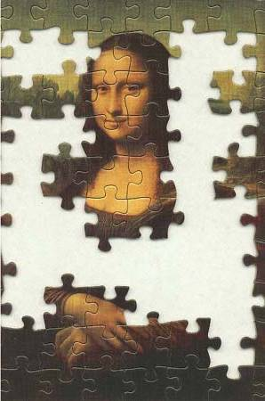
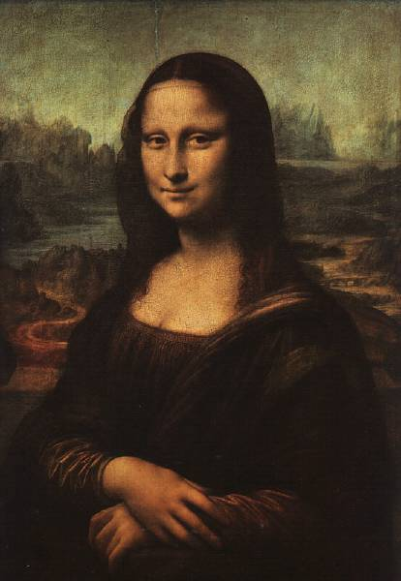
Mona Lisa – da Vinci, 1503-4
?

Slide 50
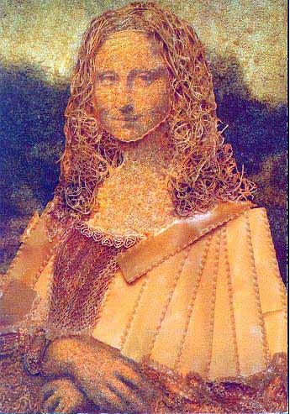
A Macaroni Mona

Slide 51
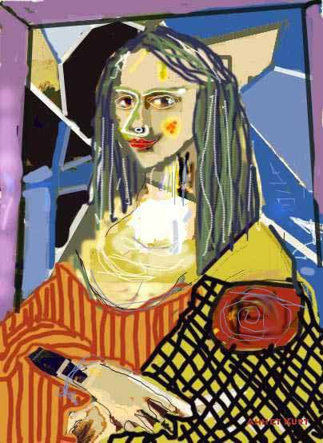
A Picasso Mona

Slide 52
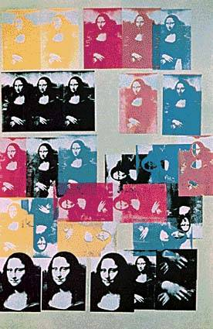
An Andy Warhol Mona

Slide 53
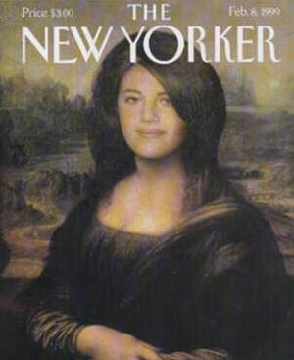
A “Mona”ca Lewinsky

Slide 54
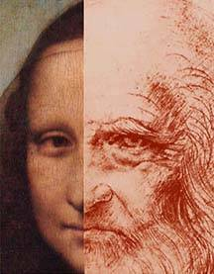
Mona Lisa OR da Vinci??

Slide 55
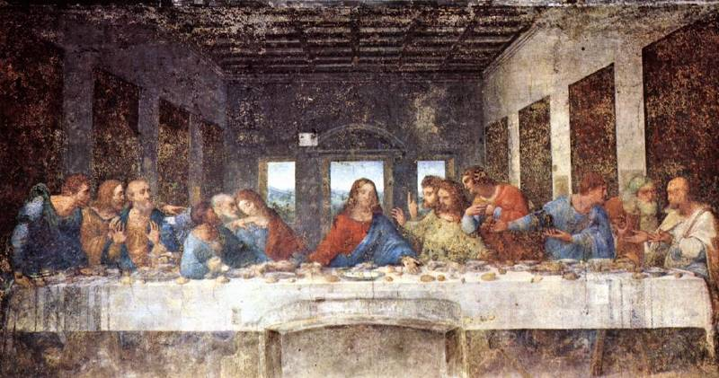
The Last Supper - da Vinci, 1498 & Geometry

Slide 56
The Last Supper - da Vinci, 1498 & Geometry

Slide 57
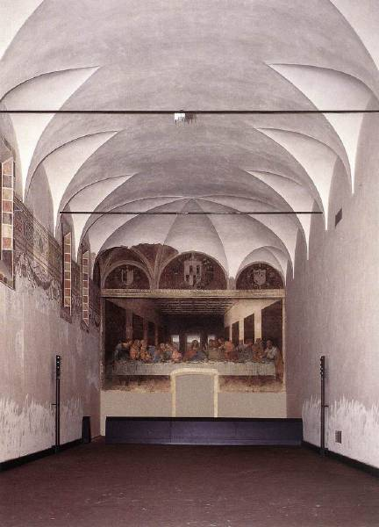
Refractory
Convent of Santa Maria delle Grazie
Milan

Slide 58
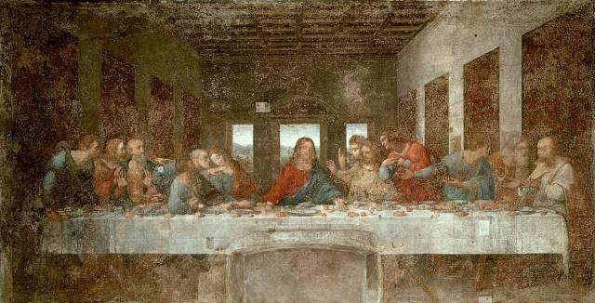
The Last Supper - da Vinci, 1498
vertical
horizontal
Perspective!

Slide 59
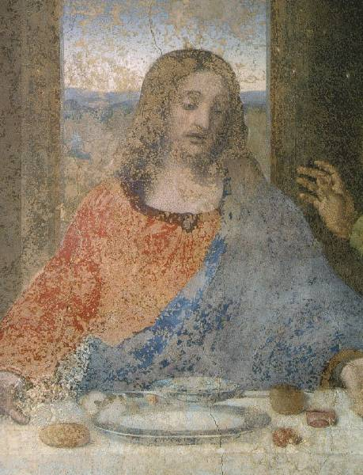
Deterioration
Detail of Jesus
The Last Supper
Leonardo da Vinci
1498

Slide 60
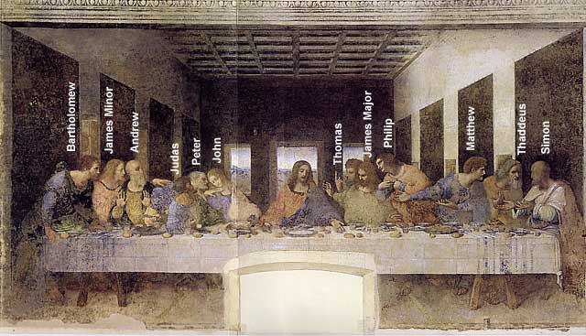
A Da Vinci “Code”: St. John or Mary Magdalene?

Slide 61
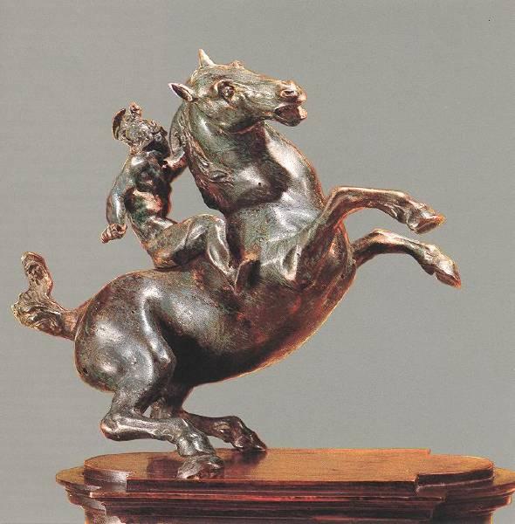
Leonardo, the Sculptor
An Equestrian Statue
1516-1518

Slide 62
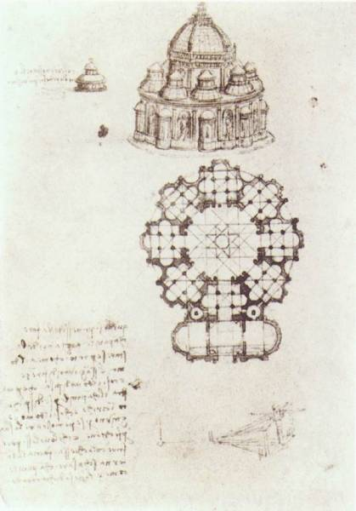
Leonardo, the Architect: Pages from his Notebook
Study of a central church.
1488

Slide 63
dante
Dante Alighieri wrote “The Divine Comedy” about purgatory

Slide 64
Dante Alighieri wrote “The Divine Comedy” about purgatory

Slide 65
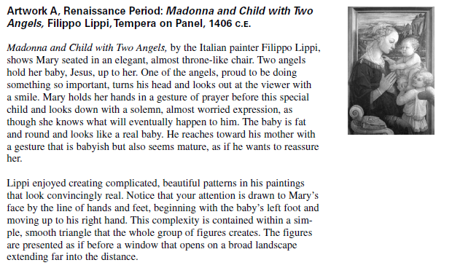

Slide 66
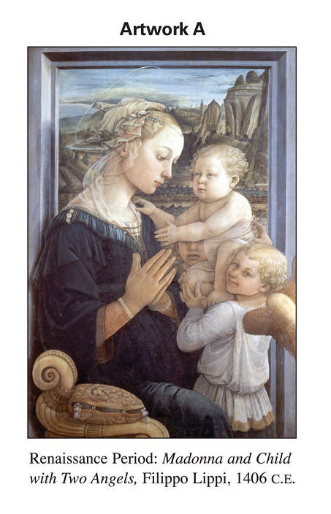

Slide 67
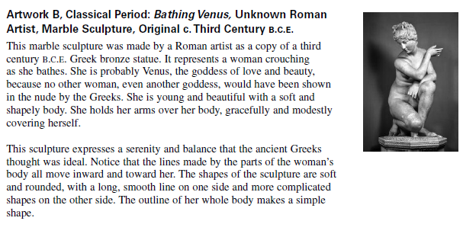

Slide 68
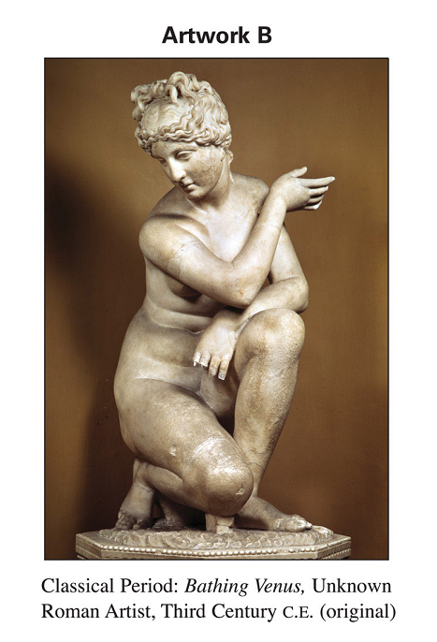

Slide 69
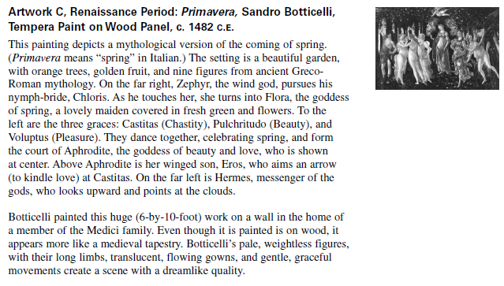

Slide 70
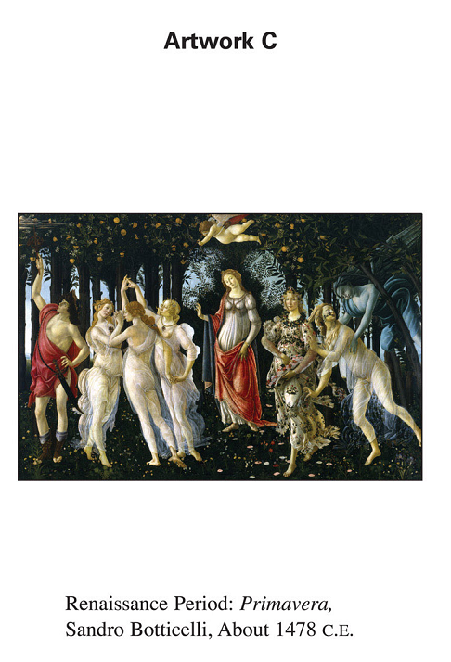

Slide 71
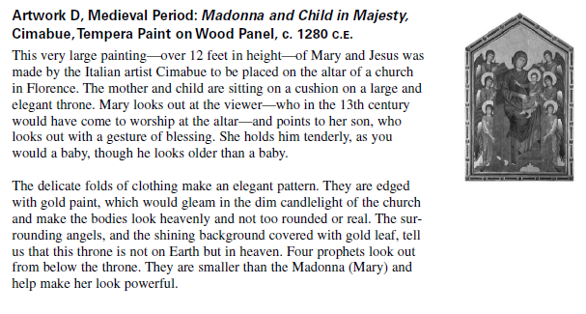

Slide 72
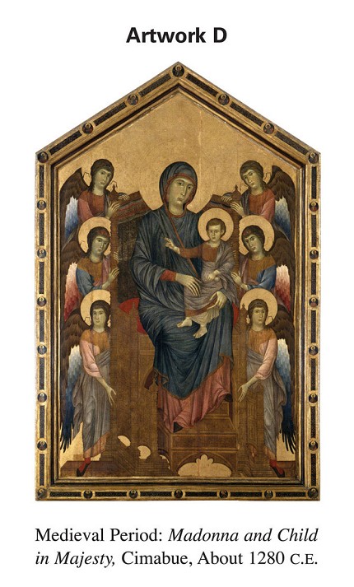

Slide 73
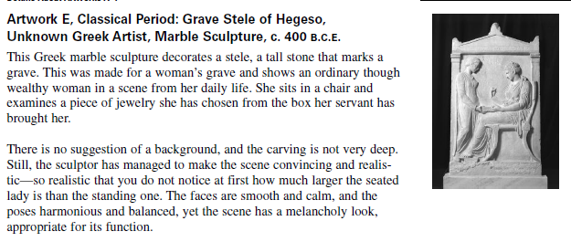

Slide 74
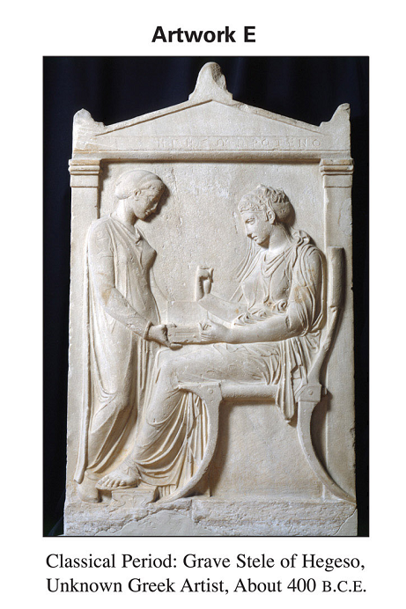

Slide 75
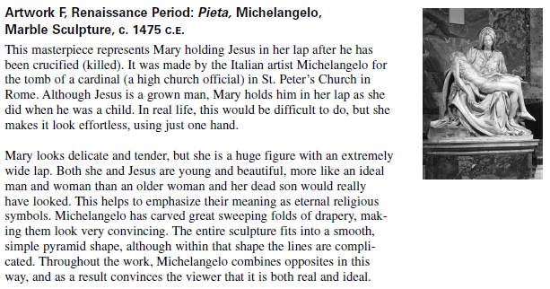

Slide 76
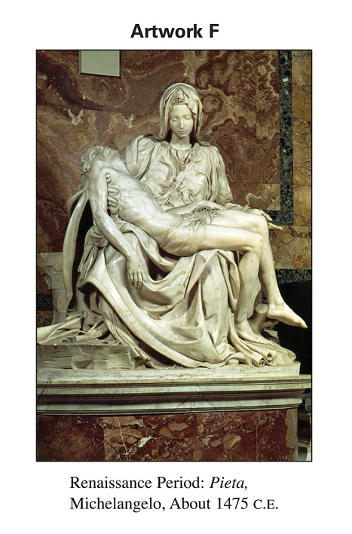

Slide 77
Johann Gutenberg developed a new type of printing press with movable type
These characters could be rearranged and used over and over again
William Shakespeare was a major figure in the English Renaissance
He is remembered as one of the greatest poets and playwrights

Slide 78
The Reformation

Slide 79
7.9 – Key Words and Concepts
Indulgences
Reformation
Federalism
Protestant
Missionary
Golden Age of Cooperation

Slide 80
The Weakening of the Catholic Church
The Catholic Church was in the practice of selling indulgences
Indulgences was the release from punishment or sin

Slide 81
They also sold offices or leadership position
Buyers could simply pay for a job and some people didn’t actually perform their duties
All Catholics paid taxes to the Church
Many people resented having to pay two taxes, one to their own government and the other to the Church

Slide 82
Calls for Reform
Desiderius Erasmus – humanist from Holland was a priest and Catholic
He wrote a book called “The Praise of Folly”
The book talked about abuses within the church
He wanted to reform the church from within

Slide 83
Martin Luther
Martin Luther was raised a Catholic who once vowed to become a monk. He became a priest.
He disliked the selling of indulgences
He broke away from the Church and started a new one
His followers were called Lutherans

Slide 84
John Calvin
John Calvin was a French humanist
He started a Protestant branch in Geneva
He emphasized that salvation came from God
He believed in hard work and careful use of money

Slide 85
William Tyndale
William Tyndale – was an English priest, scholar and writer
He attacked corruption in the Church and defended the Reformation
He spent a year of his life in prison for his beliefs
He was burned at the stake in 1536.
He translated the New Testament and parts of the Old Testament into English
His version is called the King James Bible

Slide 86
Effects of the Reformation
Wars between Catholics and Protestants left many over a million people dead.
A boundary was developed as a result of the thirty years war that separated Catholic and Protestants
Most of northern Europe and Germany was Protestant
Spain, Portugal, Italy and France remained Catholic

Slide 87
Many groups both Catholic and Protestant found it difficult to live in Europe
Catholics were persecuted in Protestant Countries
Protestants were persecuted in Catholic areas
Many groups were dissatisfied and left Europe altogether and established colonies in the New World

Slide 89
The Scientific Revolution

Slide 90
7.10 Key Words and Concepts
Scientific Revolution
Renaissance humanism
Scientific theories

Slide 91
Several factors contributed to the Scientific Revolution
Renaissance thinkers questioned traditional learning and began to observe things for themselves
The Scientific Revolution begins with Copernicus
He believed that the Earth and other things traveled around the sun
He was able to describe the planets and their orbits

Slide 92
Discoveries by Galileo supported Copernicus
Newton developed the law of gravity
He showed that this law was true everywhere in the known universe

Slide 93
These ideas where possible by the use of New inventions
Scientists used the telescope, microscope, thermometer and barometer to explain how things worked
All of these ideas and inventions had global roots
The Scientific Revolution had contributions from Greece, the Jews, Christians and Muslims

Slide 94
The Age of Exploration and The Enlightenment

Slide 95
7.11 – Key words and Concepts
Voyages of discovery
Cartography
Modern Capitalism
Enlightenment thinkers
John Locke
English Bill of Rights

Slide 96
The Age of Exploration
Beginning in the 1400’s, Europeans went on great voyages of discovery
The voyages of Christopher Columbus led to Spanish colonization of the Americas
England France and the Netherlands explored North America
It increased Europeans knowledge of the World

Slide 97
The Enlightenment
As a result of these great voyages, an exchange of plants, animals, technology, and disease occurred between the New and Old World
Ideas such as those from the Enlightenment will influence democratic thought in the Americas in their quest for independence

Slide 98
The idea of Natural laws were used in the writing of the Declaration of Independences and much of the colonial writing about Independence.
These ideas come from Enlightenment thinkers such as John Locke and Charles-Louis Montesquieu

Slide 99
This PowerPoint was originally brought to you by the Adams Middle School Social Science Department
Ted Dunn and Renee Terry
History Department

