Slide 1
Social Science Review for 6th Grade Standards and Rome as covered in the 7th Grade
Designed by: Adams Middle School History Department
PowerPoint developed by: Renee Terry and Ted Dunn

Slide 2
6th Grade Social Science Review
In 2004 the 6th Grade portion was 22% of the 8th Grade Test, last year 2010 it was much less

Slide 3
World History and Geography: Ancient Civilizations
(as found in the TCI text)
6.1 – From the Paleolithic era to the agricultural revolution (One Question)
6.2 – Mesopotamia, Egypt, and Kush (Two Questions)
6.3 – Ancient Hebrews (Three Question)
6.4 – Ancient Greece (Three Questions)
6.5 – Ancient India (Two Questions)
6.6 – Ancient China (Two Questions)
6.7 – Ancient Rome (Three Questions)
7.1 – The Fall of Rome (One Question)
7.6 - The Byzantine Empire

Slide 4
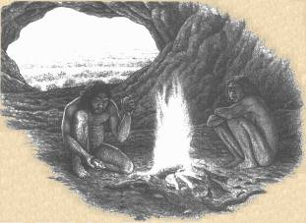
Early Man and Settlement

Slide 5
6.1 – Key words or concepts
Development of tools
Use of fire
Adaptation
Domestication

Slide 6
The Development of Man
Man development from hunter-gatherers is assisted by man’s control of fire and the development of tools.
Man forms social group for protection
Man is able to change his environment to fit his needs.
Man learns to domesticate plants and animals.

Slide 7
This leads to the development of Ancient civilizations

Slide 8
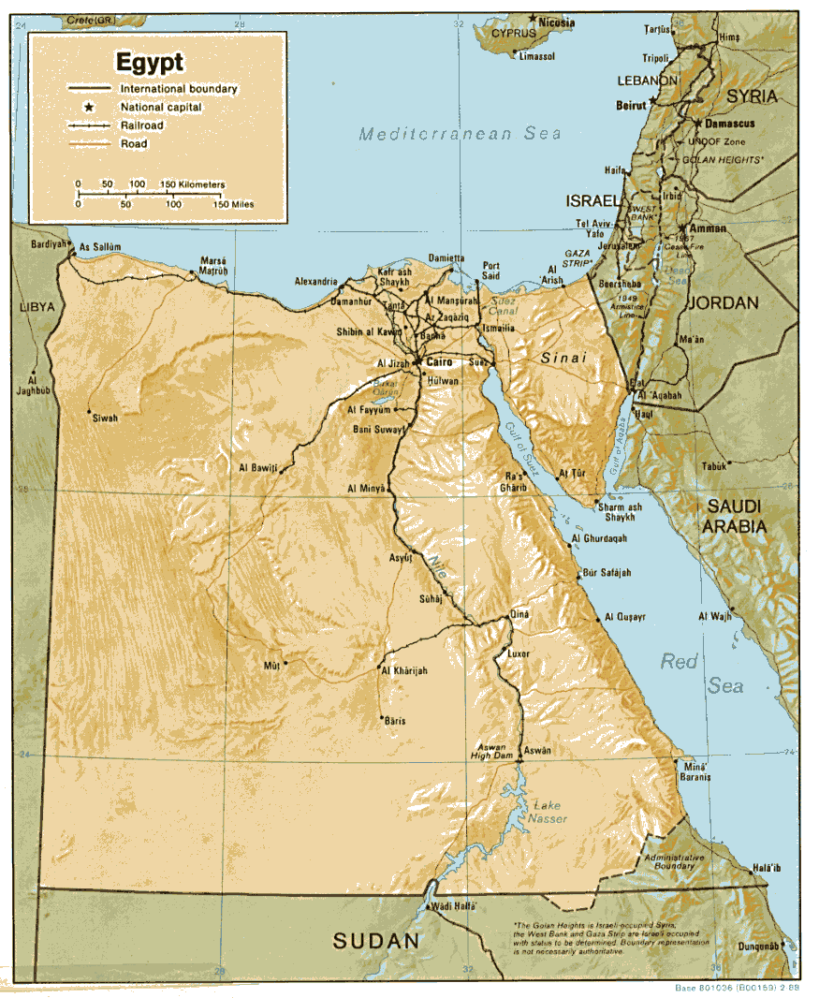
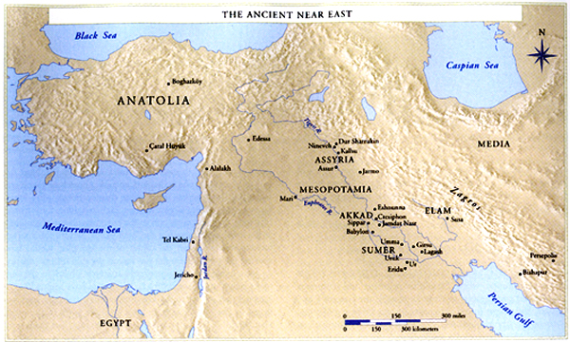
Ancient Egypt, Kush, and Mesopotamia

Slide 9
6.2 – Key words or Concepts
River systems
Surplus
Social Structure
Hammurabi’s Code
Egyptian Art
Hieroglyphics

Slide 10
Geography
Early Civilizations develops along river systems
Early Man develops irrigations systems
They use the annual flooding of these rivers to farm
As a result, people were able to produce a surplus

Slide 11
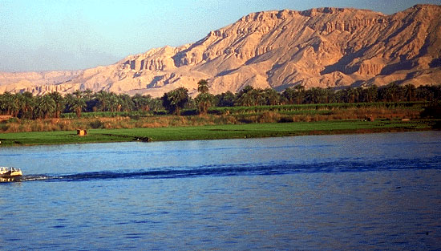
Egypt / Kush – The Nile River

Slide 12
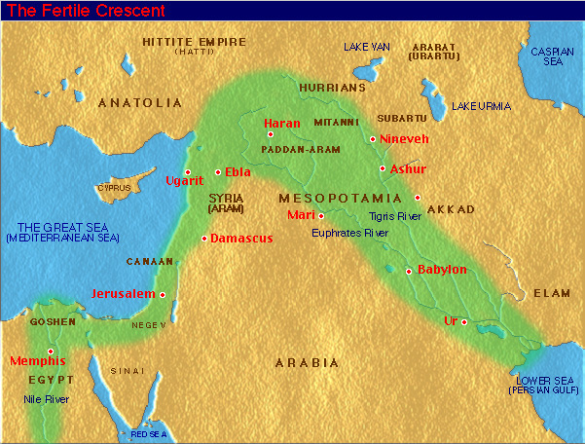
Mesopotamia –Tigris and Euphrates Rivers
Fertile Crescent

Slide 13
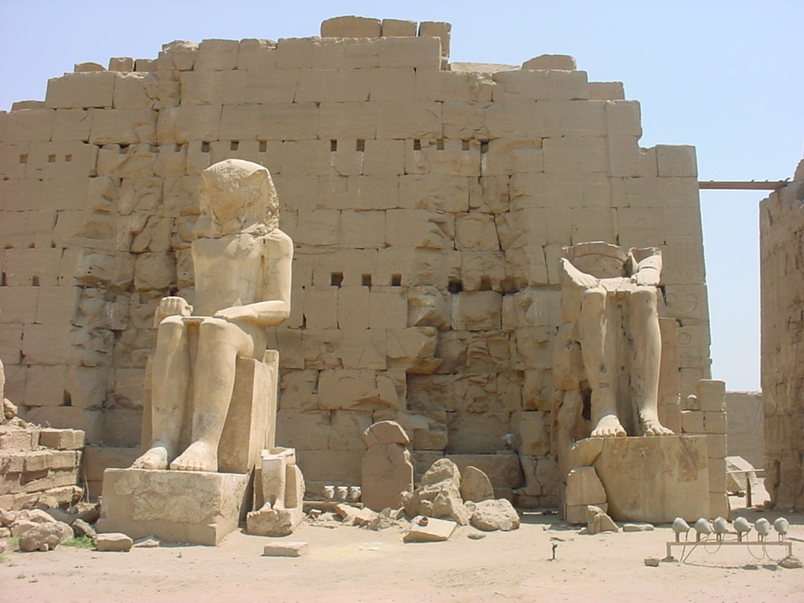
Religion
Religion and Politics were closely related.
Rulers had absolute power
Religions were centered around several Gods (Polytheistic).
Egyptians had a strong belief in an afterlife, this is seen in their art and architecture.

Slide 14
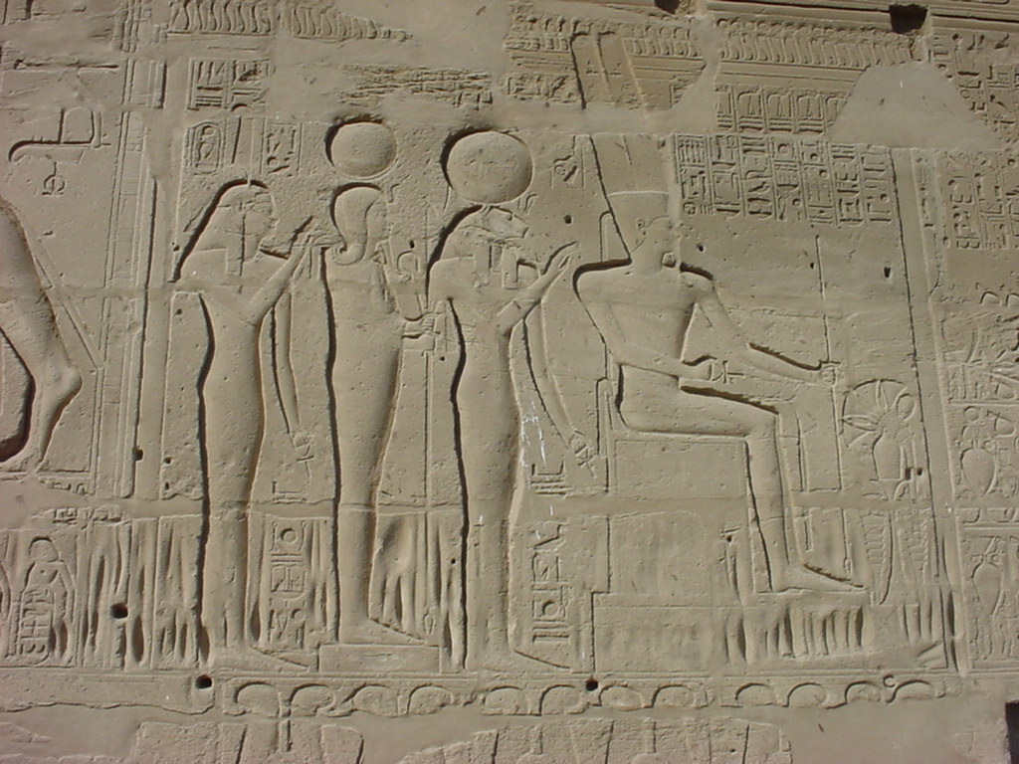
Rulers were worshiped as semi-divine

Slide 15
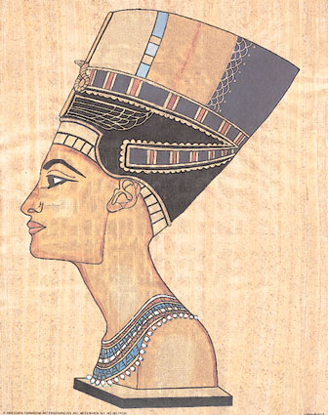
Queen Hatshepsut
Egypt’s first female pharaoh
Under her rule, Egyptian art and architecture flourished
She was known for her encouragement of trade
She commanded respect, sometimes wearing men’s clothing and the fake beard worn by male pharaohs

Slide 16
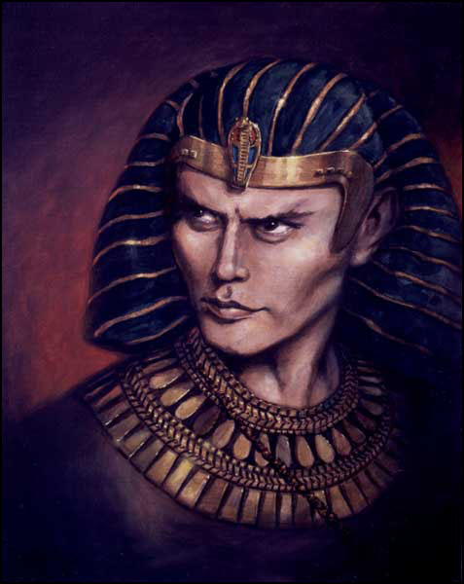
Rameses II
-Ramses was one of the most prolific “builders” in all of Ancient Egypt.
Ramses II was born about 1303 B.C.
Ramses II assumed the throne in 1279 B.C.
He built a great city called Pi-Ramses (House of Ramses)

Slide 17
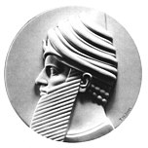
Hammurabi – Father of Laws
Famous Babylonian leader –The Code of Hammurabi – 1750 B.C.
A series of 282 laws that dealt with every part of daily life.
These laws included one of the worlds first tax codes.

Slide 18
Ancient Hebrews*
The study of the Ancient Hebrews are found in the teachings of the Bible.

Slide 19
6.3 – Key words or Concepts
Monotheism – Belief in One God
Moral laws
Righteousness
Justice
Exodus
Israel
Jewish
Torah

Slide 20
The Significance of The Ancient Hebrews
Abraham is the founder of the Israel Nation
People belonging to this Nation are called Hebrews
It is the first truly monotheistic society, beginning around 2000 B.C.
Monotheism – Belief in only one God.

Slide 21
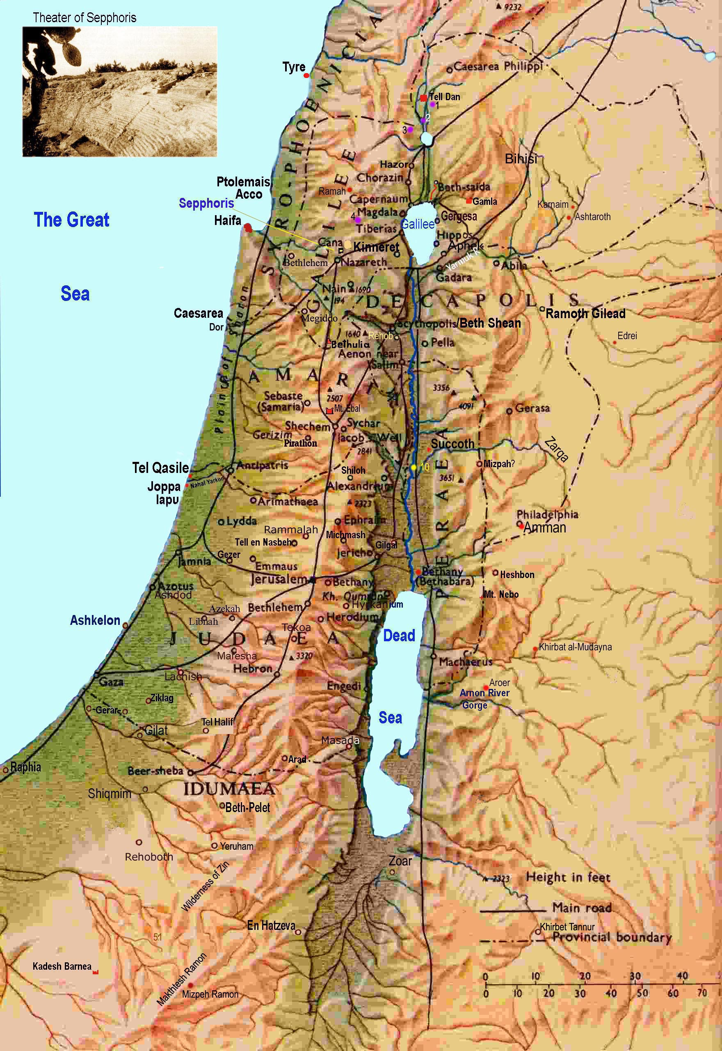
Geography
According to the Torah, Abraham lived near Ur in Mesopotamia
Abraham and his clan moved to Canaan
Canaan is said to be the same area as current day Israel
Around 1800 B.C.E, many Hebrews moved to Egypt and lived as slaves until the Exodus

Slide 22
Moses
The Exodus – Approximately 1225 B.C. Moses leads the Israelites out of Slavery in Egypt, across the Red Sea, and into the Arabian Peninsula.
Moses gives the ancient Hebrews their laws – the ten commandments
The Ten Commandments became the foundation for modern Western Law

Slide 23
Politics
The Bible tells the story of David and Goliath
With faith in God, David defeats Goliath with a stone
David becomes King of Israel
He established the city of Jerusalem and built its first great temple
David’s son was Solomon.

Slide 24
The Diaspora
Throughout history, Jews have suffered for their beliefs
The Diaspora refers to their exile from their homeland
They are found dispersed throughout the Middle East and Europe
They survived and developed despite this dispersion
The Jewish people are mentioned our standards though the study of Rome, Europe, and Islam

Slide 25
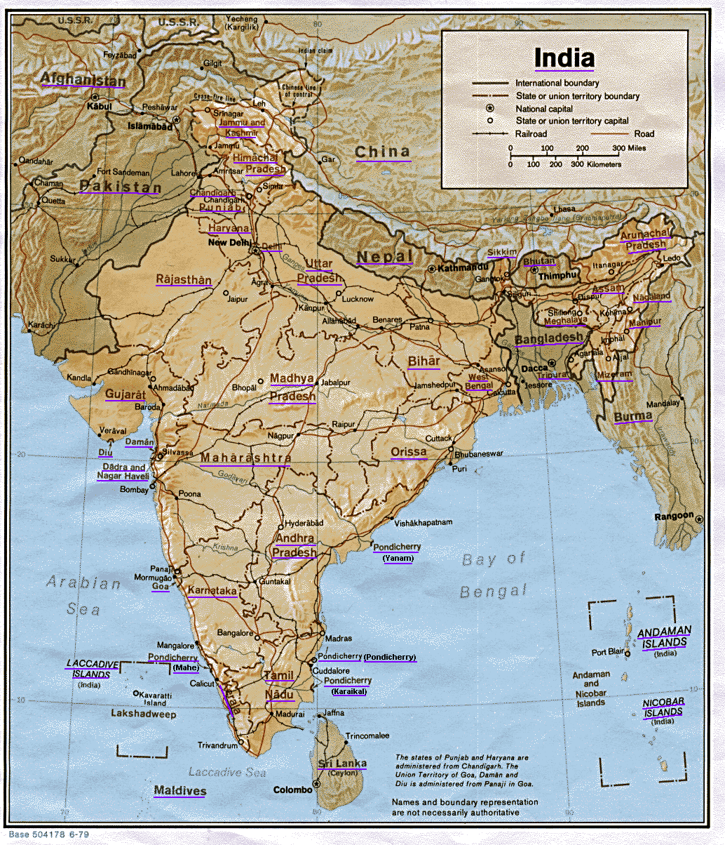
Ancient India

Slide 26
6.5 – Key words or Concepts
Caste system
Buddhism
Sanskrit

Slide 27
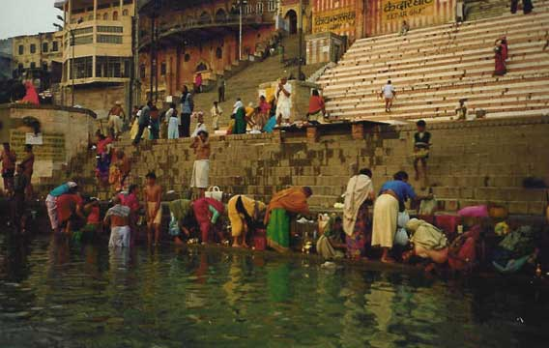
Geography
The Indus River is 1,800 miles long
It empties into the Arabian Sea, to the West.
The Ganges River flows Eastward and empties into the Northern end of the Bay of Bengal.

Slide 28
Social Structure
The Aryan’s social class system led to the development of India’s caste system.
A person born into a caste could never move into a higher caste.
At the bottom of this ordering were the untouchables.

Slide 29
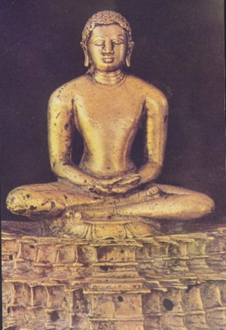
Religion
Buddhism begins in India
Religion started by Prince or Rajah, Siddhartha Gautama – 563 to 483 B.C.
At age 30, he left his palace to find “the truth.” Life is suffering – How do we deal with it?

Slide 30
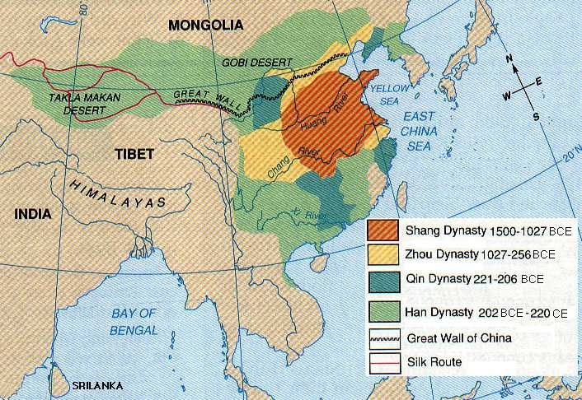
Ancient China

Slide 31
6.5 – Key words or Concepts
Confucianism
Taoism
Shi Huang di
Han Dynasty
Silk Road

Slide 32
Geography
The Huang He – Also know as the Yellow River. This river is 2,900 miles long!
Chang Jiang River – Also known as the Long River or in common Chinese the Yangzte River. It is about 3,400 miles long! This is the longest river in China.

Slide 33
China is isolated in it location by:
The Gobi Desert is to the North.
The Himalaya Mountains are to the South
China is surrounded by oceans and Seas on 1/3 of the country
The only area that leaves China vulnerable is the huge wide grassland area to its north.

Slide 34
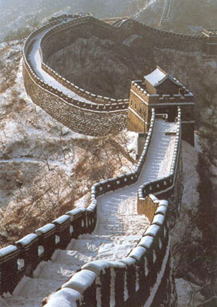
The only area where China is vulnerable the huge wide grassland area to its north.
To fix this, the Great Wall of China was built.

Slide 35
Politics
All Dynasties rule with the mandate from heaven. When a Dynasty looses the Mandate, power changes hands.
The Han Dynasty lasted for over 400 years! (206 B.C. to 220 A.D.)
China is reunited under the Qin Dynasty under the leadership of Qin Shihuangdi

Slide 36
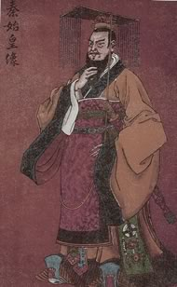
Qin Shihuangdi
Ruled from 221 to 206 B.C. Pronounced (Chin Shir Wong Di).
China’s first Emperor
United China in 221 B.C.
He was a violent ruler and was almost assassinated 3 (three) times!

Slide 37
Economics
The “Silk Road” and other “highways” – Used to transport many types of goods over thousands of miles. Some of these items where silk (Chinese), spices, lumber and horses.
The Silk Road went through more than 20 major European and Asian cities. (Rome, Byzantium, Antioch, Baghdad, Chang’an.)
The Silk Road exchanged both goods and ideas.

Slide 38
Religion
China’s main religion was Confucianism
Confucianism was developed by Confucius
Confucianism sought to establish social order, encourage harmony, and create a system of right and wrong
They also had Daoism – Founded by Laozi
Daoism teaches that people gain happiness through living in harmony with nature

Slide 39
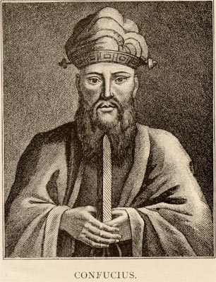
Confucius
His real name was Kongfuzi or Kong Qiu.
He lived from 551 to 479 B.C.
Confucius was a philosopher
Wrote a series of Proverbs.
Confucius says: “The gentleman first practices what he preaches and then preaches what he practices.”

Slide 40
Economics
The “Silk Road” and other “highways” – Used to transport many types of goods over thousands of miles. Some of these items where silk (Chinese), spices, lumber and horses.
The Silk Road went through more than 20 major European and Asian cities. (Rome, Byzantium, Antioch, Baghdad, Chang’an.)
The Silk Road exchanged both goods and ideas.

Slide 41
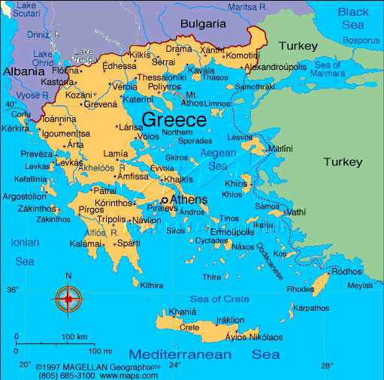
Ancient Greece

Slide 42
Discovering Ancient Greece
Video on Ancient Greece shown here go to Ed1Stop.org for video get password from Mr. Dunn

Slide 43
6.4 – Key words or Concepts
City State
Mediterranean
Mountainous
Dictatorship
Citizenship
Democracy
Mythology
Alexander the Great
Plato
Aristotle

Slide 44
Geography
The Greeks used the Aegean Sea in order to move around and trade goods with other peoples in the region of the Mediterranean Sea.
Greece is surrounded by rugged mountains
Because of these mountains, the Greek city states developed individually.

Slide 45
Religion
The Greeks believed in many gods
They believed their Gods had direct control over their lives and even interacted with them
They used the stories of their gods to explain what happened in life

Slide 46
Politics
Greece goes from tyrants to an early form of democracy
Greece begins the idea of citizenship
Established Direct Democracy and Representative Democracy

Slide 47
Athenian / Direct Democracy
The difference between a direct democracy and a representative democracy.
A direct democracy gives every citizen a direct role in government decisions.
A representative democracy gives citizens the right to vote for their leaders, who then make the decisions for them, supposedly with their best interest in mind.

Slide 48
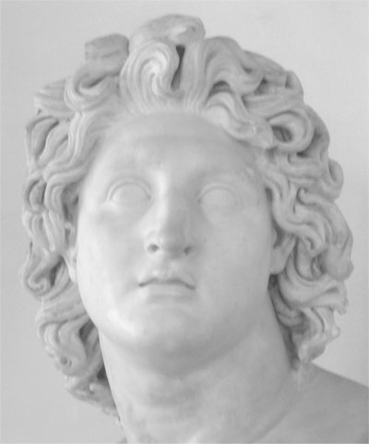
Alexander the Great
Alexander eventually became the king who wanted “the world”.
The empire reached from Egypt, in the West, to the West side of India… over 3,500 miles!
In 334 B.C., Alexander defeated Darius III, King of the Persian Empire.
In 323 B.C. he died of Malaria. He was 33.

Slide 49
Alexander the Great
Video on Alexander the Great shown here go to Ed1Stop.org for video get password from Mr. Dunn

Slide 50
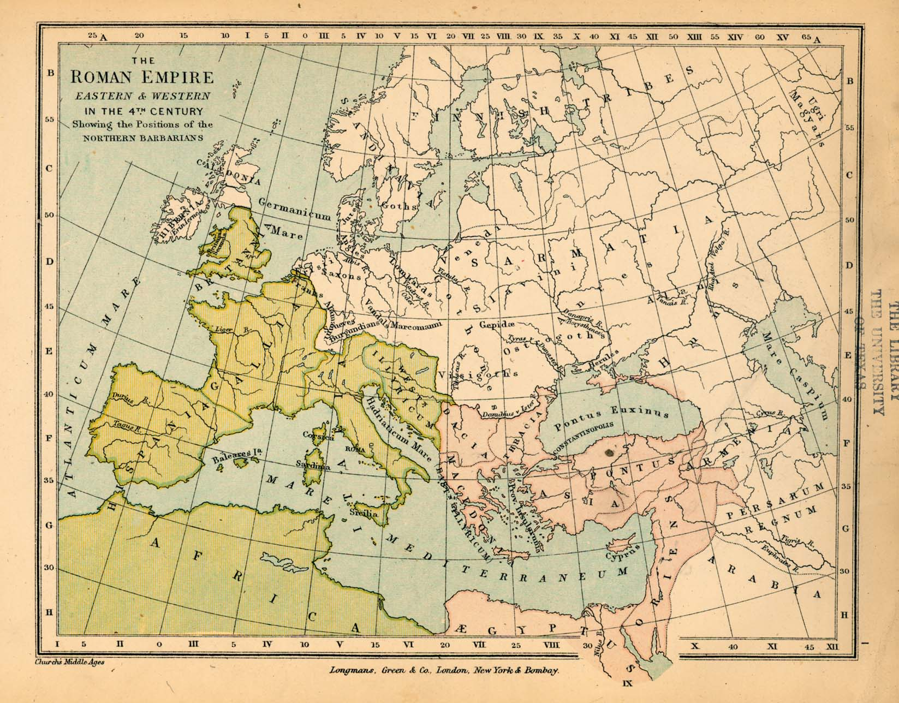
Ancient Rome

Slide 51
Rome’s Beginnings
Video on Rome’s Beginnings shown here go to Ed1Stop.org for video get password from Mr. Dunn

Slide 52
6.7 – Key words or Concepts
Julius Caesar
Republic
Augustus
New Testament
St. Paul the Apostle
Resurrection
Salvation
Legacy of Rome

Slide 53
Geographical Borders of Rome at its height
Reached it’s height by A.D. 117
At its height, it extended from Britain in the North, Africa in the South, Spain in the West, and Syria in the East
It covered parts of Africa, Asia and Europe
It bordered the Mediterranean Sea, Atlantic Ocean and North Sea

Slide 54
Politics
Romans established a Republic
They developed a written constitution
Rome depended on its citizens

Slide 55
Early Strengths of the Roman Empire
Roman citizenship – the right to participate in government
Roman law – courts with representation
Its provinces provided Rome with protection, food, and taxes

Slide 56
Lasting Contributions
Architecture – buildings, columns
Engineering – irrigation, indoor bath houses, aqueducts
Roman Catholic Church

Slide 57
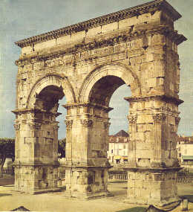
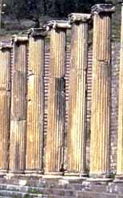
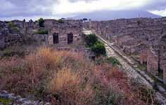
Architecture
The Arch
Columns were used to support buildings
Rome had an extensive road system

Slide 58
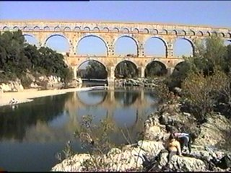
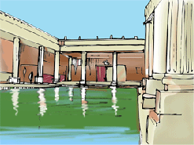
Engineering
Roman Bath houses were indoors with running water. Sometimes these pools were filled with milk or wine
Aqueducts supply water that was used in cities as well as for growing food.

Slide 59
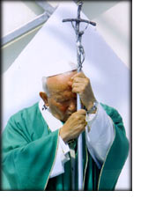
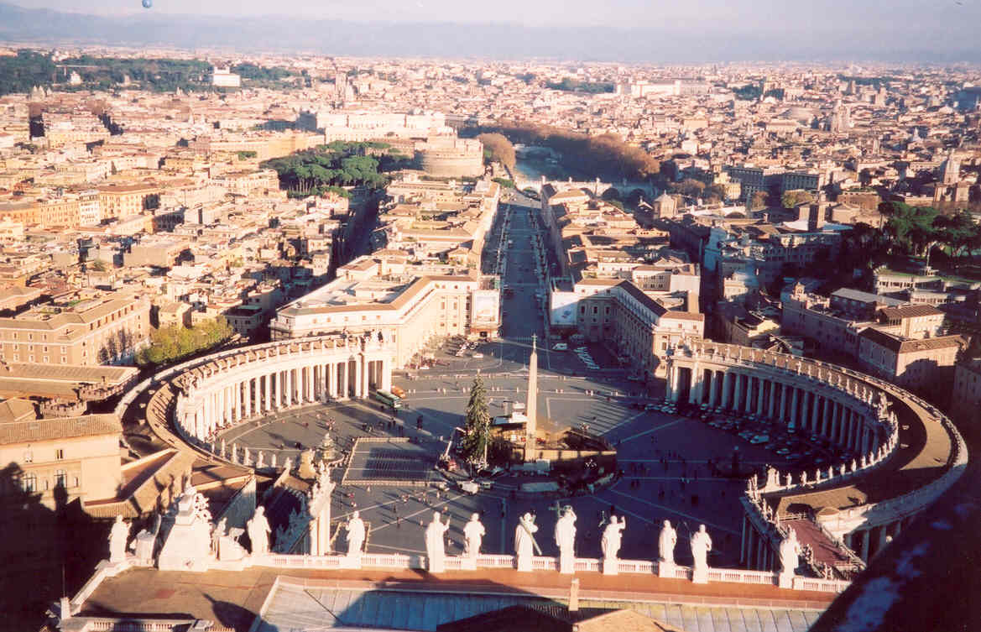
The Roman Catholic Church
Vatican City
Pope John Paul II

Slide 60
The Spread of Christianity
The birthplace of Christianity was Judea
Judea came under Roman rule in 63 B.C.E.
Jesus was born outside the city of Bethlehem
At age 30 he was baptized in the Jordan River by John the Baptist.
Jesus developed a small number of followers, or disciples
Jesus was nailed to a cross and killed as a common criminal

Slide 61
Jesus was killed on Friday, gospel says on Sunday he rose from the dead
His disciples taught that he was the son of God
The New Testament contains the teachings of Jesus
A missionary, Paul, preached of Christ to the Greeks
Christians were continued to be treated poorly by Romans

Slide 62
Gradually peoples beliefs began to change
Emperor Constantine gave Christians freedom to practice with the adoption of the Edict of Milan, 313 A.D.
By 395, Christianity becomes the official religion of Rome

Slide 63
7.1 - The Fall of Rome

Slide 64
HISTORY ALIVE!
THE MEDIEVAL WORLD AND BEYOND
CH 1
The Legacy of the Roman Empire

Slide 65
Legendary Rome
Video on Rome’s Beginnings shown here go to Ed1Stop.org for video get password from Mr. Dunn

Slide 66
Standards Used
7.1 Students analyze the causes and effects of the vast expansion and ultimate disintegration of the Roman Empire.
7.1.1. Study the early strengths and lasting contributions of Rome (e.g., significance of Roman citizenship; rights under Roman law; Roman art, architecture, engineering, and philosophy; preservation and transmission of Christianity) and its ultimate internal weaknesses (e.g., rise of autonomous military powers within the empire, undermining of citizenship by the growth of corruption and slavery, lack of education, and distribution of news).
7.1.2. Discuss the geographic borders of the empire at its height and the factors that threatened its territorial cohesion.
7.1.3. Describe the establishment by Constantine of the new capital in Constantinople and the development of the Byzantine Empire, with an emphasis on the consequences of the development of two distinct European civilizations, Eastern Orthodox and Roman Catholic, and their two distinct views on church-state relations.

Slide 67
OBJECTIVES OF CH 1
describe the internal weaknesses of the Roman Empire and identify reasons for the fall of the empire in the west.
describe the rise of the Byzantine Empire, including the establishment of a new capital in the east by Constantine.
describe common Roman art forms and identify items from modern life that utilize similar designs and techniques.
explain how Roman engineering achievements in science, technology, architecture, and engineering have been incorporated into modern life.
describe the influence of Latin on modern languages and identify examples of English words derived from Latin terms.
identify the relationship between Roman law and philosophy, and modern thought.

Slide 68
OVERVIEW OF CH 1
In this lesson, students learn the reasons for the fall of the Roman Empire and how ancient Roman culture continues to affect life today.
Students will discover more about an aspect of Roman culture, such as art, architecture and engineering, or language that influences us today.

Slide 69
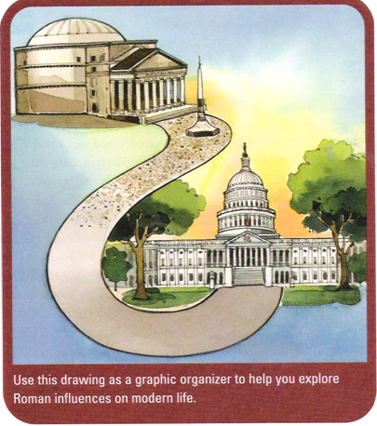
CHAPTER 1
The Legacy of the Roman Empire
MAIN IDEAS:
THE ROMAN EMPIRE
27 B.C.E. TO 476 C.E.
ART
ARCHITECTURE & ENGINEERING
LANGUAGE
WRITING
PHILOSOPHY, LAW, & CITIZENSHIP

Slide 70
READING NOTES CH 1
1.2 THE END OF THE ROMAN EMPIRE IN THE WEST PP.8+9
THE 1ST EMPEROR OF ROME WAS CAESAR AUGUSTUS

Slide 71
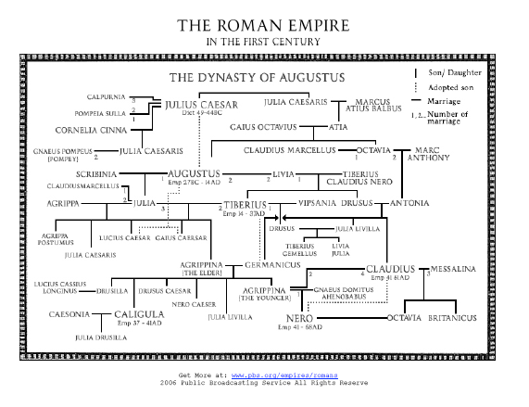

Slide 72
1.2.1 Problems in the Late Empire
No single reason for end, instead historians point to a combination of reasons:
1. Political Instability
  There was never a good way to transfer power , sometimes they fought each other for power and sometimes it was peaceful, but corrupt (not honest)
2. Economic and Social Problems
  To finance the huge armies taxes were high
  This hurt the economy, created gap bet rich + poor
  Corruption was also a big problem

Slide 73
1.2.1 Problems in the Late Empire
3. Weakening Frontiers
  By 300’s Germanic Tribes attacking border
  Once the empire was so large local men were recruited into Roman Legions, but these soldiers had little loyalty to Rome

Slide 74
1.2.2 The Fall of Rome
Constantine moves capital to Byzantium – in 330 C.E.
After this, there are rulers in both cities, and they split the empire
  West – Capital = Rome
  East – Byzantium = (Constantinople)
In 410 C.E. a Germanic tribe attacks + loots Rome, and then leaves
476 C.E. last emperor in west driven out
  Byzantine Empire lasts 1000 years longer
  Rome’s fall did not mean the end of the Roman civilization, just that the Influence of Rome has lived on all the way to our time.

Slide 75
1.3 ART
What important art forms did the ancient Romans develop?
  Romans created realistic statues and colorful mosaics.
  They also painted frescoes that often showed (3D) three-dimensional landscapes.
    Romans made decorative bottles of blown glass, developed the arts of gem cutting and metalwork, and created cameos.

Slide 76
1.3 ART
What are some examples of Roman art forms that influence modern life?
  Some examples of Roman art forms that influence modern life are:
  the murals on found in restaurants, banks, and on the sides of buildings;
  creation of lifelike statues;
  cut gems and cameos found in stores.

Slide 77
1.4 ARCHITECTURE + ENGINEERING
What were some important architectural and engineering achievements of the ancient Romans?
  Important architectural and engineering achievements of the Romans were:
    the arch,
    the vault,
    and the dome.
  They also used concrete to create large buildings.
    The Romans developed the stadium and the triumphal arch.
    They were also great road, bridge, and aqueduct builders.

Slide 78
1.4 ARCHITECTURE + ENGINEERING
What are some examples of Roman architecture and engineering that influence modern life?
  Many modern churches, banks, and government buildings follow Roman designs.
  Many communities have stadiums that are built like the Roman Colosseum.
  Some modern freeways are built over Roman roads, and parts of aqueducts are still used today.

Slide 79
1.5 Language and Writing - A
How is the Latin alphabet different from the English alphabet?
The Latin alphabet has 23 letters while the English alphabet has 26 letters.

Slide 80
1.5 Language and Writing - B
How were the numbers 1, 10, 100, and 1,000 written by the Romans?
1 | I
5 | V
10 | X
50 | L
100 | C
500 | D
1000 | M

Slide 81
1.5 Language and Writing
What are some examples of Roman language that influence modern life?
Some examples of Roman language that influence modern life are the use of:
  Roman proverbs,
  Roman words such as civis,
  and Roman prefixes.

Slide 82
1.6 Philosophy, Law, and Citizenship
What were the most important ideas in Roman philosophy, law, and citizenship?
  The most important ideas in Roman philosophy were
    (1) live in a way that agrees with nature and
    (2) the one truly good thing in life is to have good character.
  The most important idea in Roman law is natural law, which says that everyone has certain rights.
  Roman citizens had full rights and responsibilities in government and society.

Slide 83
1.6 Philosophy, Law, and Citizenship
What are some examples of ways Roman philosophy, law, and citizenship have affected modern life?
  Today we call someone who bears pain and suffering bravely “stoic.”
  Some modern legal codes in Europe are based on Roman laws.
  And many people today believe that all humans have basic rights that no law can take away.
  In the United States, all citizens have the same rights, which are protected by the Constitution.

Slide 84
What Happened to Rome?
Emperor Theodosius I wrote in his will that upon his death, Rome would be split into two Eastern Rome and Western Rome
The Roman Empire, or Western Rome falls to Barbarians in 476 AD
The fall of The Western Roman empire begins the period referred to as the Dark Ages.

Slide 85
HISTORY ALIVE!
THE MEDIEVAL WORLD AND BEYOND
CH 6
The Byzantine Empire

Slide 86
Byzantium
Video on Byzantium shown here go to Ed1Stop.org for video get password from Mr. Dunn

Slide 87
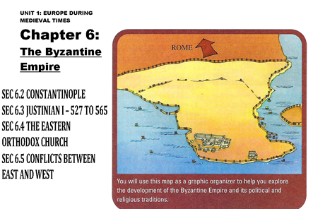

Slide 88
Standards Used
7.1 Students analyze the causes and effects of the vast expansion and ultimate disintegration of the Roman Empire.
  7.1.3 Describe the establishment by Constantine of the new capital in Constantinople and the development of the Byzantine Empire, with an emphasis on the consequences of the development of two distinct European civilizations, Eastern Orthodox and Roman Catholic, and their two distinct views on church-state relations.

Slide 89
OBJECTIVES OF CH 6
explain the importance of the city of Constantinople as a trading hub and how it emerged as the capital of the Byzantine Empire.
describe the importance of the reign of Justinian I and the lasting impact of the new code of laws organized during his reign.
trace the development of the Eastern Orthodox Church and its relations with the west.

Slide 90
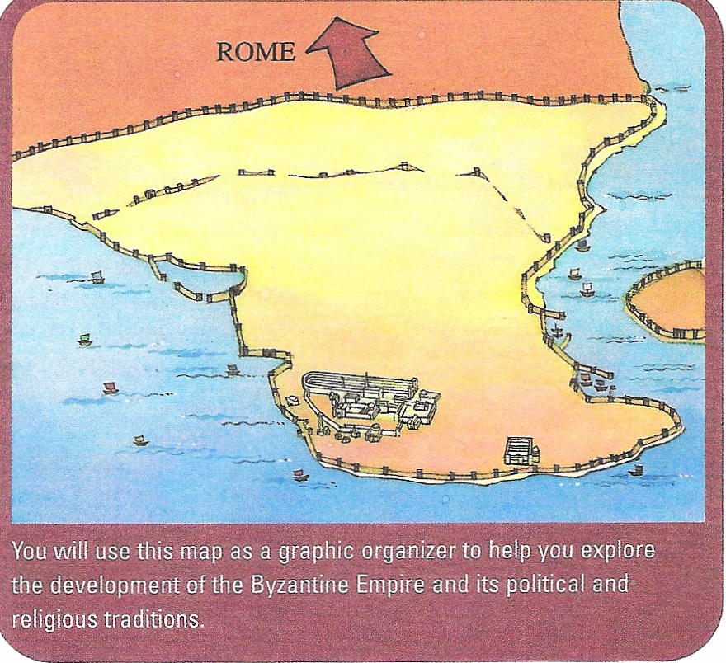

Slide 91
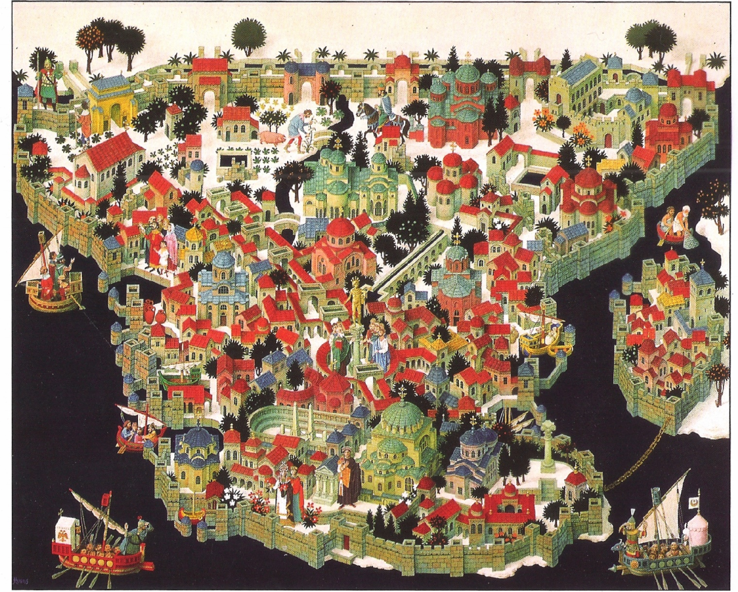

Slide 92
NOTES CH6 SEC 6.2 page 62
CONSTANTINOPLE
It was located more than 800 mi east of Rome
The site was easy to defend
  It was a peninsula – surrounded on 3 sides by water
  It had miles of walls + watchtowers
  It had a chain across the harbor for protection
Stood at the crossroads bet Europe + Asia
It was fabulously wealthy as a city
  For +7oo yrs. was richest + elegant city
  Traded ivory, silk, furs, perfumes + luxury items through its markets

Slide 93
CONSTANTINOPLE continued
At its height, was home to @1 million people
The official language was Greek
It was the most advanced city in Europe
  It had a sewer system
  Hospitals, homes for elderly, + orphanages
But most people still lived in poverty
  Unemployed were fed by the government
  They swept streets + weeded public parks
Chariot races were held in a stadium called the hippodrome

Slide 94
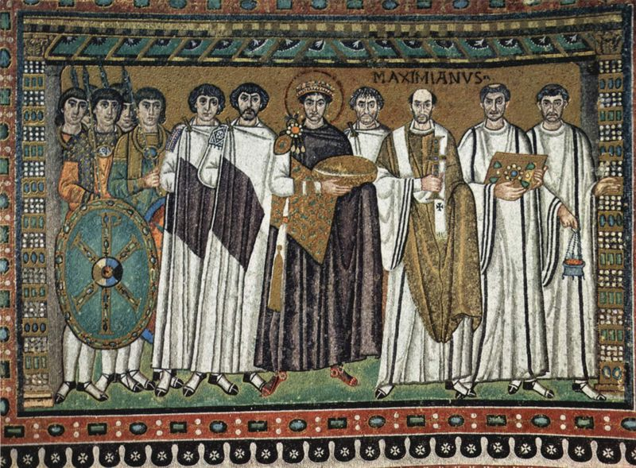

Slide 95
6.3 JUSTINIAN I – 527 TO 565
One of greatest emperors of Byzantium
Almost lost his life in 532 – hippodrome
  Blues + greens rebelled into the streets
  30,000 killed + Constantinople = in ruins

Slide 96
6.3 JUSTINIAN I – 527 TO 565
He rebuilt the city on an even grander scale than before
Put huge sums of money into public works
New bridges, public bathe, parks, roads, and hospitals
He also built the magnificent Hagia Sophia (holy wisdom) one of the most famous buildings in the world

Slide 97
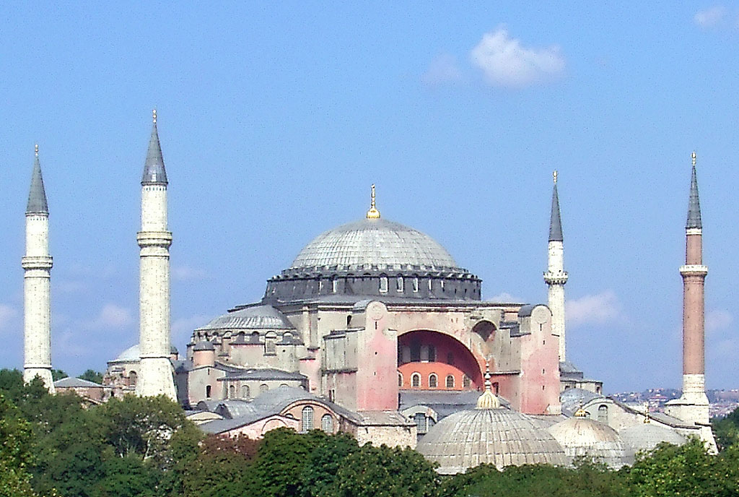
Hagia Sophia

Slide 98
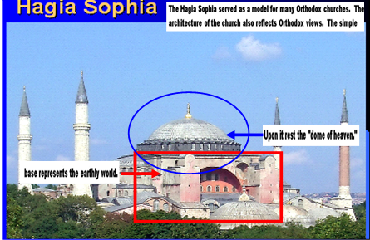

Slide 99
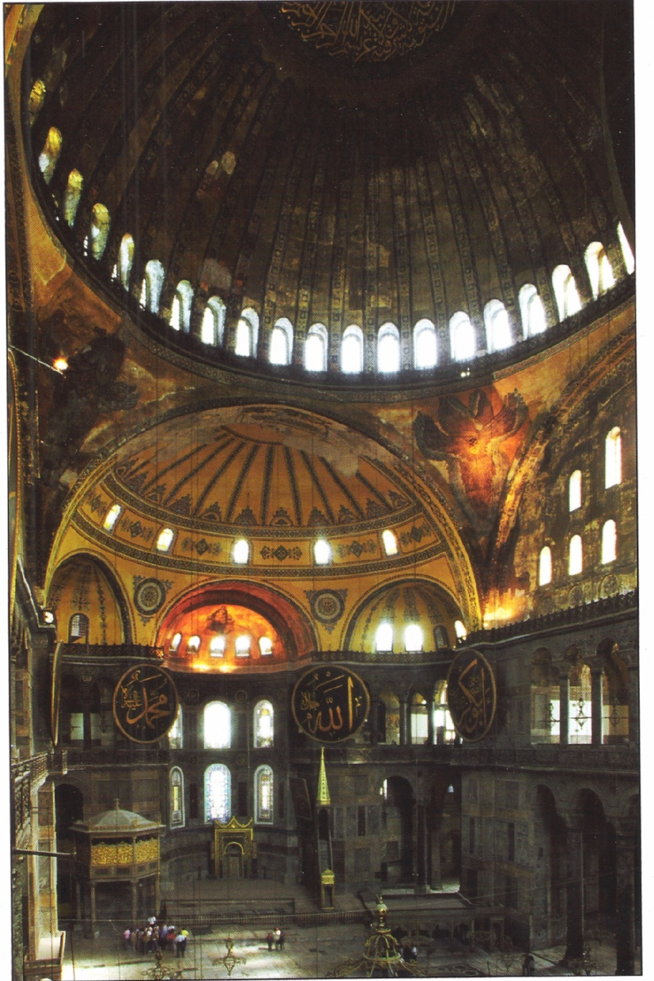
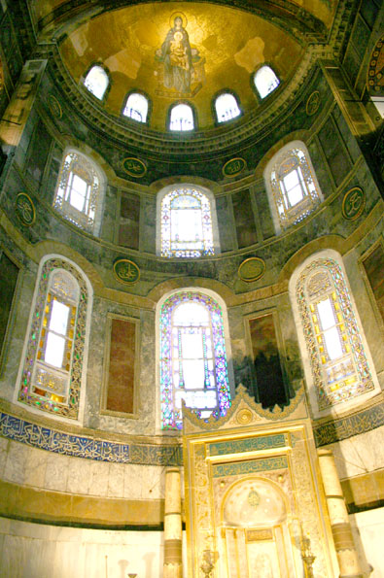

Slide 100
6.3 JUSTINIAN I – 527 TO 565
Was also a great general and tried to reclaim much of Rome's lost territory
  N. Africa, Italy, + southeast Spain
Was most famous for creating a systematic body of law
  A committee revised thousands of outdated + confusing roman law
  Made improvements – extending women’s property rights

Slide 101
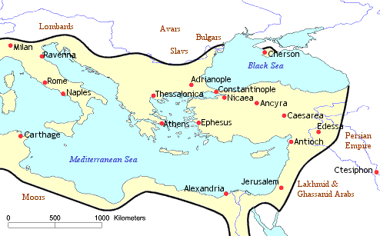
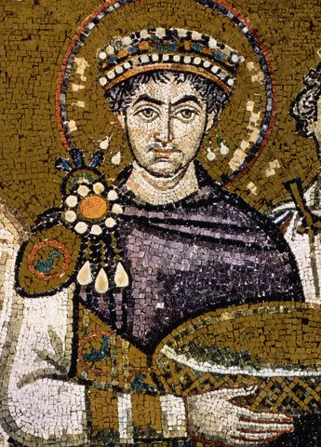
The Byzantine Empire Under Justinian
This map depicts the Empire at the death of Justinian I, who had reigned from 527 to 565 as sole Emperor, sometimes in concert, and sometimes in conflict, with his powerful wife Theodora.

Slide 102
Justinian’s Code of Laws
Laws were fairer to women. They could own property and raise their own children after their husbands died.
Children allowed to choose their own marriage partners.
Slavery was legal and slaves must obey their masters.
Punishments were detailed and fit the crime
His work inspired the modern concept and, indeed, the very spelling of "justice".

Slide 103
6.3 JUSTINIAN I – 527 TO 565
All was not as great as it seemed
  Procopius, the court historian also wrote the secret history
  He called the emperor “a treacherous enemy, insane for murder and plunder”
Throughout byzantine history, distrust and divisions often plagued the imperial court. Justinian’s court was no exception

Slide 106
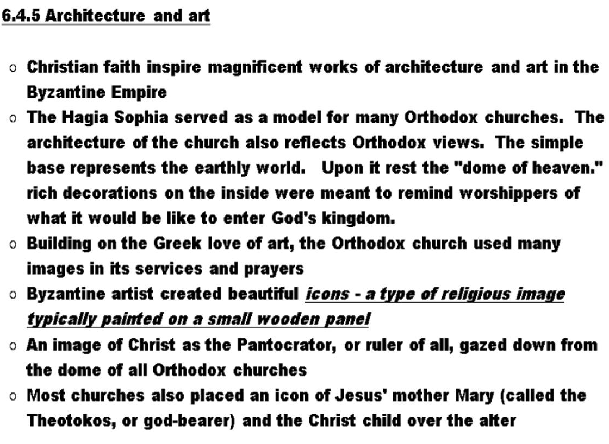

Slide 107
SEC 6.5 CONFLICTS BETWEEN EAST AND WEST SEC 6.5.1 INTRO
Cultural, political and religious differences created a difference between the 2 parts of the old Roman Empire
The eastern half had many cities, much trade, & great wealth
The western half was mostly rural, agricultural, & poorer
Another difference was the heavy Greek influence in the east, while it was a more Germanic and Frankish in west
Greek was the dominant language of the east and Latin of the west, when the liturgy was said.
Finally, the Popes claimed supreme religious authority over Christians while Emperors and Patriarchs did not

Slide 108
SEC 6.5.2 ICONOCLASM
Many Christians used the images of Jesus, Mary, and the saints in worship and prayer, creating icons
Emperor Leo III banned the use of icons in 730 C.E. which was in place until 843 C.E. many religious objects were destroyed.

Slide 109
SEC 6.5.3 THE CROWNING OF A HOLY ROMAN EMPEROR
The Byzantines had a woman Empress Irene as a leader
The crowning of Charlemagne in 800 C.E. also created a problem for the Byzantine Emperors and Patriarchs
SEC 6.5.4 THE FINAL BREAK
1054 C.E. was the final break, when the Patriarch of Constantinople wanted to assert more control over all Christian churches in the east, and closed all Latin churches

Slide 110
Video on Byzantium shown here go to Ed1Stop.org for video get password from Mr. Dunn

Slide 111
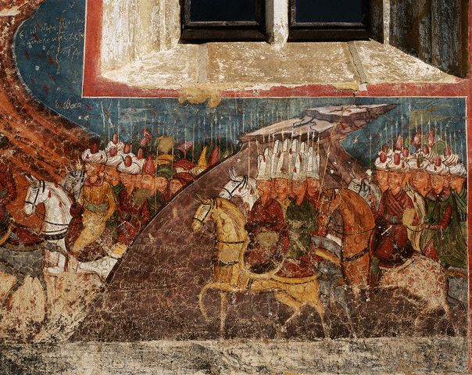
The End of the Byzantine Empire
The Byzantine empire drew to a close in 1453 when forces from the Muslim Ottoman Empire surrounded and conquered Constantinople.
The ancient Christian city was renamed Istanbul and became the capital of the Ottoman Empire.

Slide 112
FALL OF Constantinople
Video on FALL OF Constantinople shown here go to Ed1Stop.org for video get password from Mr. Dunn

Slide 113
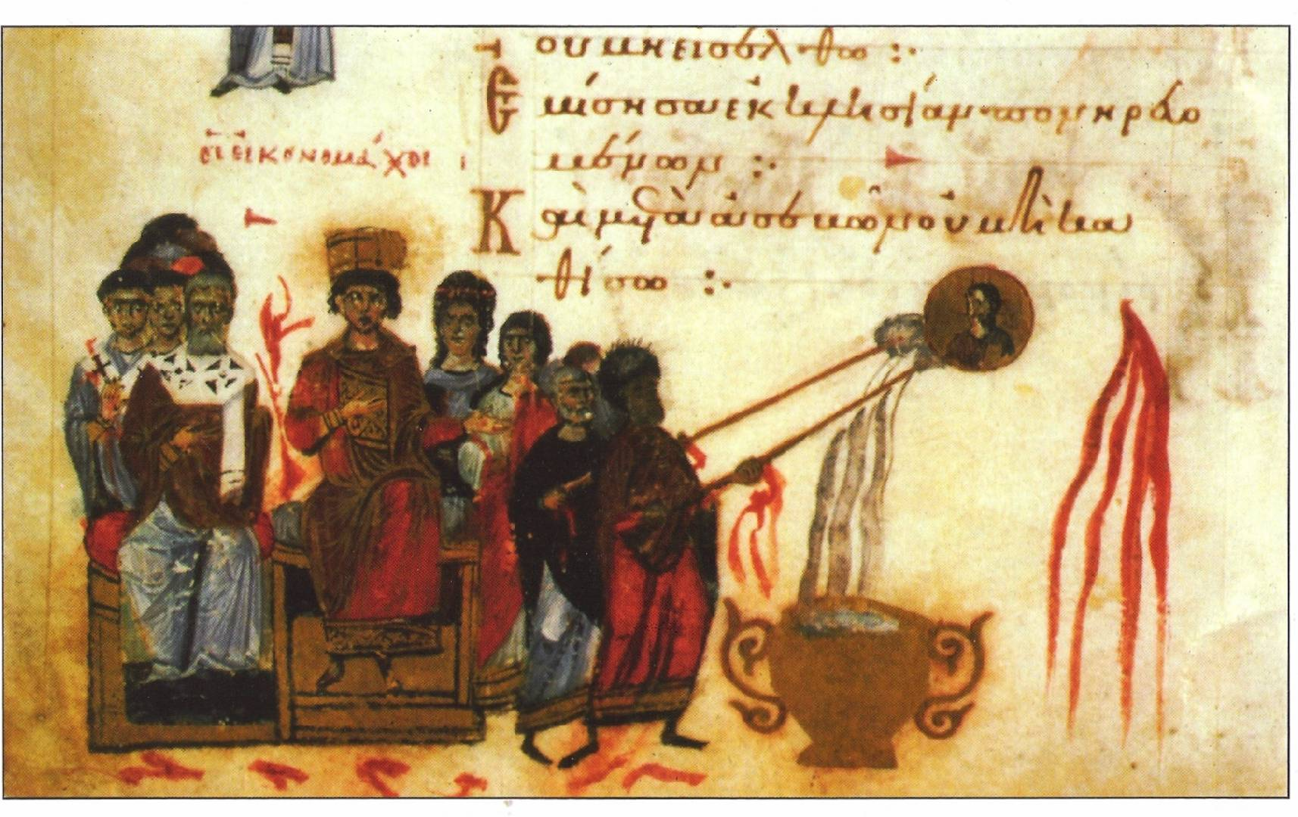

Slide 114
Rise of Byzantium
Eastern Rome become Byzantium and survives for the next 1,000 years
Byzantium helps in the development of two different views on church-state relations
The Roman Catholic Church and The Eastern Orthodox

Slide 115
The Fall of Rome begins a new era in History
The Middle Ages

Slide 116
This PowerPoint has been brought to you by the Adams Middle School Social Science Department
Renee Terry and Ted Dunn
History Department

