Slide 1
¡Haga clic en este botón para obtener interpretación en español!
Notes:
https://wccusd.zoom.us/j/98512818034

Slide 2
Family Huddle
Reunión familiar
Scholar. Team Player. Accountable. Resilient.
Erudito. Jugador de equipo. Explicable. Elástico.
October 2021

Slide 3
Warmup Poll:
Have you ever volunteered (or wanted to) at your child’s school?
Encuesta de calentamiento:
¿Alguna vez ha sido voluntario (o ha querido) en la escuela de su hijo?

Slide 4
SSC Elections
Notes:
Goes with warmup poll- this is one way parents can get involved at Stege!

Slide 5
Stege Vision
At Stege Elementary, we value a community based approach to build pride and purpose in our scholars, faculty, and community. As stakeholders, we hold high expectations and all work together to support students’ critical thinking skills, community leadership, and a joy of learning.
En Stege Elementary, valoramos un enfoque basado en la comunidad para generar orgullo y propósito en nuestros académicos, profesores y comunidad. Como partes interesadas, tenemos altas expectativas y todos trabajamos juntos para apoyar las habilidades de pensamiento crítico de los estudiantes, el liderazgo comunitario y la alegría de aprender.

Slide 6
Meet our Staff-Click on the underlined titles!
Conozca a nuestro personal: haga clic en los títulos subrayados
Principal
Instructional Specialist (Especialista en instrucción)
Instructional Coach (Entrenador de instrucción)
SCOW (Trabajadora de extensión comunitaria escolar)

Slide 7
Student Expectations

Slide 8
Focus Areas or “Big Rocks” for 2021-22
Stege will focus on healing supports for students as we return to school in person after being virtual. This will lead to increased student engagement.
Reading/phonics (80% students score in green on phonics by the end of the school year).
Zearn (Students will increase their growth percentile by 50 points on STAR & 90% TK-1 score proficient on foundational math assessment)
Writing (All students score at least a 3 out of 4 on our writing rubric by the on of the school year).
Coaching Cycles for 100% of teachers.

Slide 9
3 Cs: No chips, candy, cola (soda, Sugar drinks)
Teachers/Yard Supervisors will Ask you to put them away or will take them if you bring them to yard or cafeteria
Water, Cafeteria Food, or healthy lunch brought to school

Slide 10
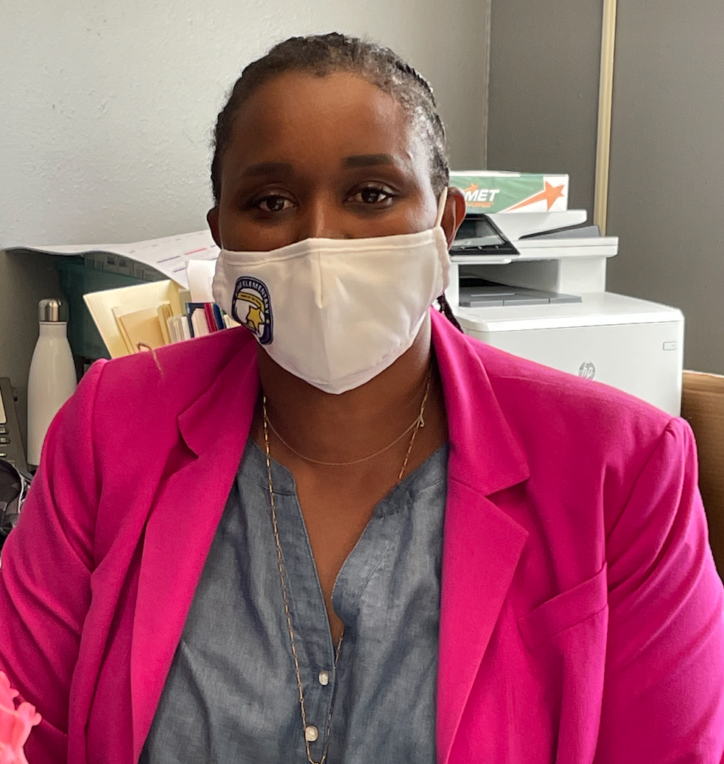
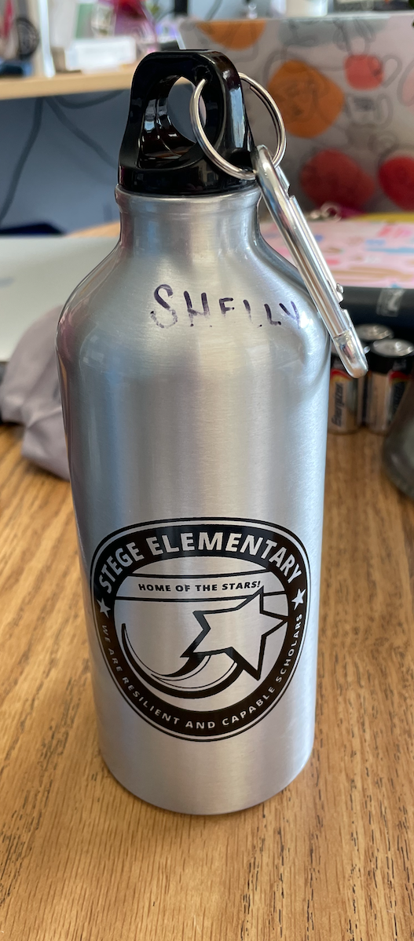
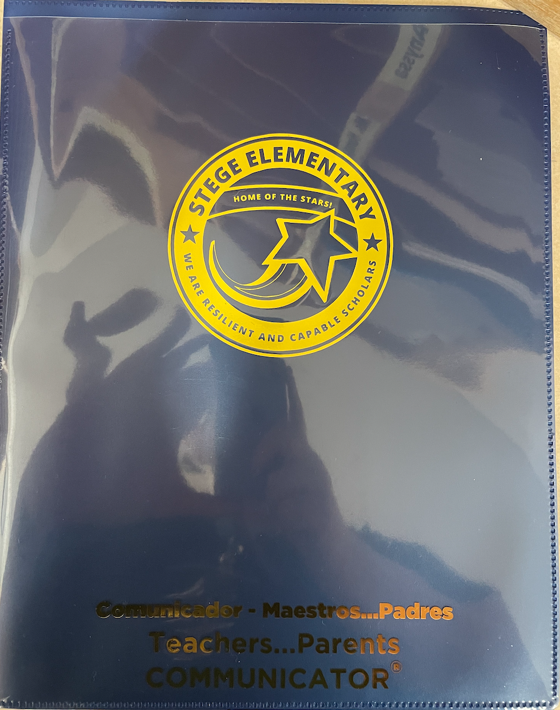
What to bring daily...
A mask that fits properly (covers nose)
Una mascarilla que le quede bien (cubre la nariz)
A refillable water bottle
Una botella de agua recargable
Backpack with blue Stege folder & pencils
Mochila con carpeta azul Stege y lápices
A STAR mindset

Slide 11
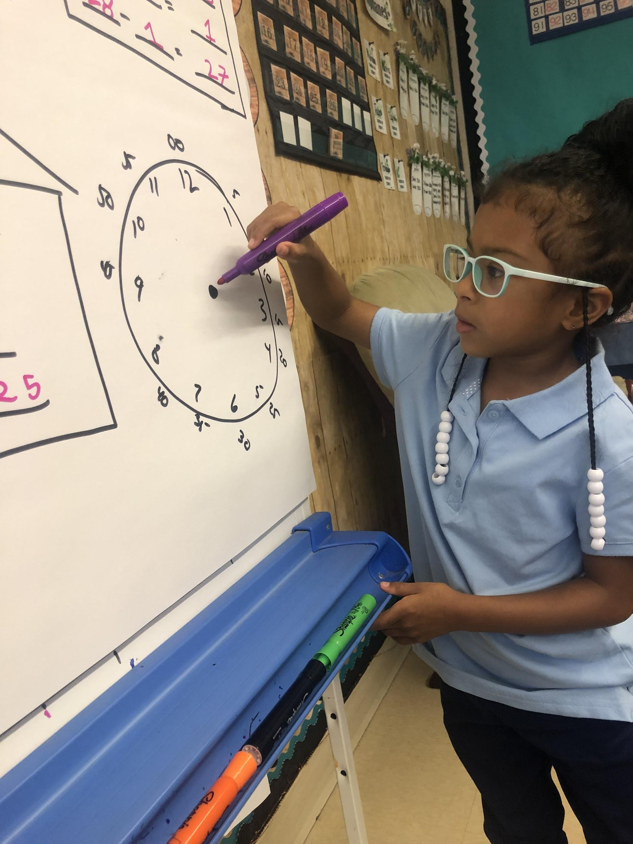
Dress Expectations: (page 34)
Uniforms are encouraged (navy blue, light blue or white collared shirt, khaki or navy blue pants)
To dress according to the dress code defined:
This means no garments exposing the torso; no strapless tube tops; no vests without shirts; no short shorts or short skirts (arms length); no garments with obscene or inappropriate words or pictures; no hats or other head coverings; no gang affiliated or related clothing; no see-through blouses or shirts; no low cut dresses; no sunglasses in class unless prescribed, etc.

Slide 12
Keep Electronic Devices at Home
Cell phones, ipads, tablets, cameras, smart watches, etc.
If they are at school, they must be turned off and stored in backpack.
1st time - warning, student must put it away in their backpack - parent contact by teacher.
2nd time - confiscated, parent contacted by office and we will return at end of day.
3rd time - will be returned to parent only after a meeting.

Slide 13
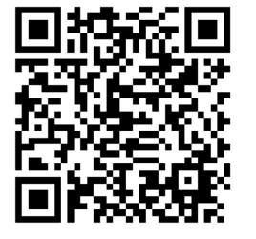
COVID testing
In order to register your child for COVID19 testing, please complete the registration form found by clicking here or visiting our website at wccusd.net/stege
Weekly testing Mondays at Stege
You no longer have to make weekly appointments.
The safety and health of students and staff is our top priority. During the Covid-19 pandemic, getting the vaccine and weekly testing for staff and students is key in helping to slow the spread of the virus. I want to thank you for your patience as we work to implement new testing protocols for students and staff in WCCUSD.

Slide 14
Save the date!
October 8th- School Picture Day
October 11- No School
Weekly on Mondays- COVID testing
¡Reserva!

Slide 15
Communication
Please be mindful of office hours when contacting your child’s teacher. Teachers are available to be called/texted M-F 8:30am-4pm. If you need something outside of those hours, please dojo them and they will reply within 24 hours.
If you need anything, please reach out to one of our front office staff!
Tangy Jules (Secretary) School phone: (510) 231-1425
Claudia Hernandez (Attendance Clerk-se habla espanol)
Jazmelina Ledesma (School Community Outreach Worker-se habla espanol)
Schedule an appointment or submit doctor’s notes (Click “Resources” upper right)
Tenga en cuenta el horario de oficina cuando se comunique con el maestro de su hijo. Los maestros están disponibles para recibir llamadas o mensajes de texto de lunes a viernes de 8:30 am a 4:00 pm. Si necesitas algo fuera de ese horario, hazlo y te responderán en un plazo de 24 horas.

