Slide 1

2014 demographic study
West Contra Costa Unified School District
June 10, 2015
Prepared by:

Slide 2

Scope of Work
Davis Demographics has assisted WCCUSD since 2007
Demographic Services
Researched relevant demographic data
Map 2014/15 student data by residence
Monitored development projects
Create student resident population projections by study area for 2015/16 to 2024/25
Alternate projection for charter school expansions
Produced report detailing methodology, maps, charts and findings

Slide 3
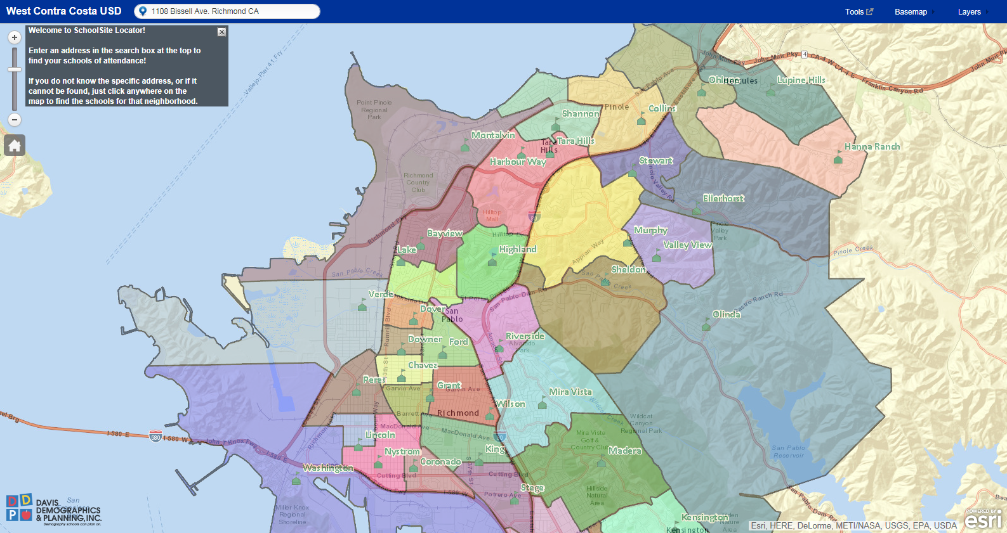
Software Solutions
SchoolSite Locator – Web application that allows the public to verify their resident school based on address
SchoolSite Desktop – Allows staff ability to analyze student and data for attendance boundary analysis

Slide 4
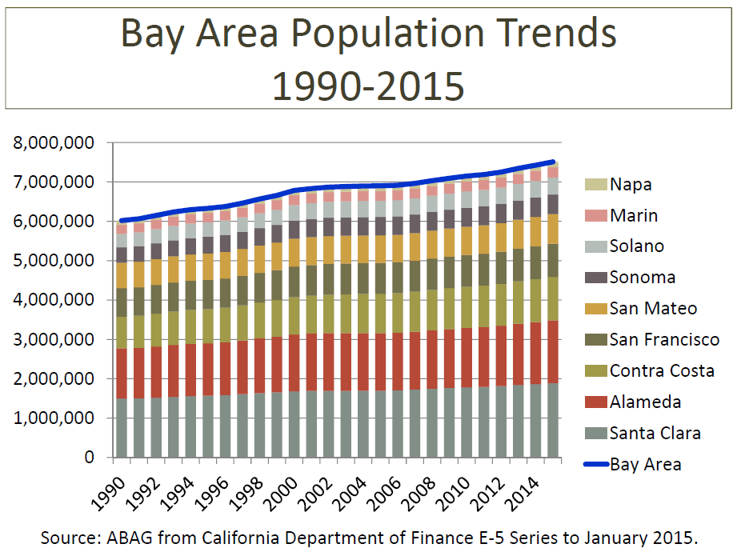
Slow steady growth across region

Slide 5
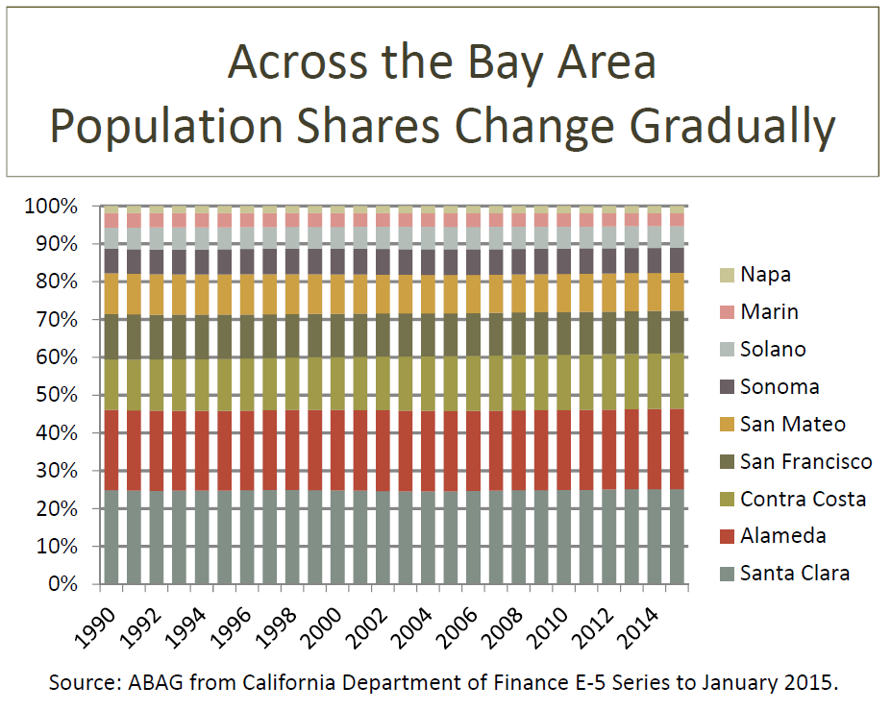

Slide 6
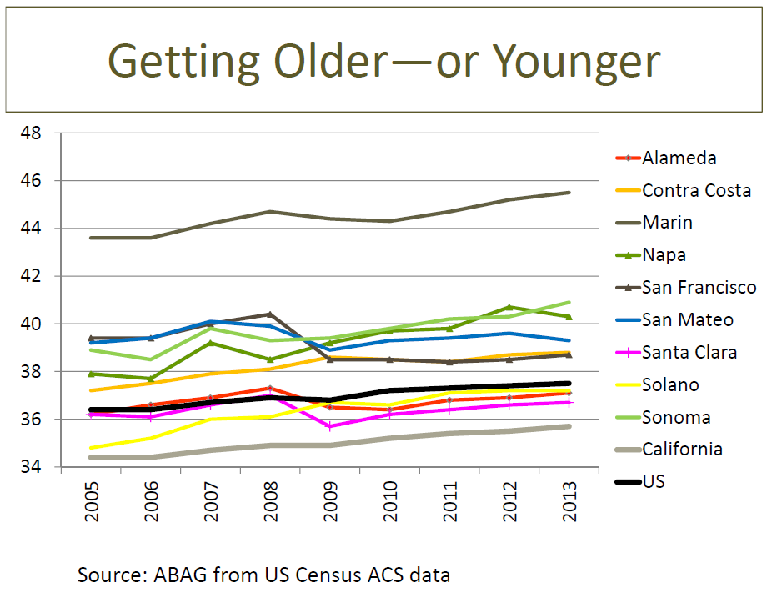

Slide 7
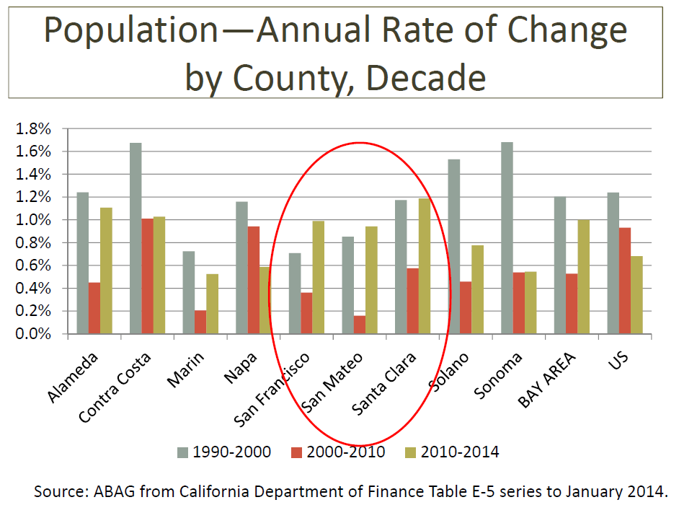
Growth in Job Creation Counties

Slide 8
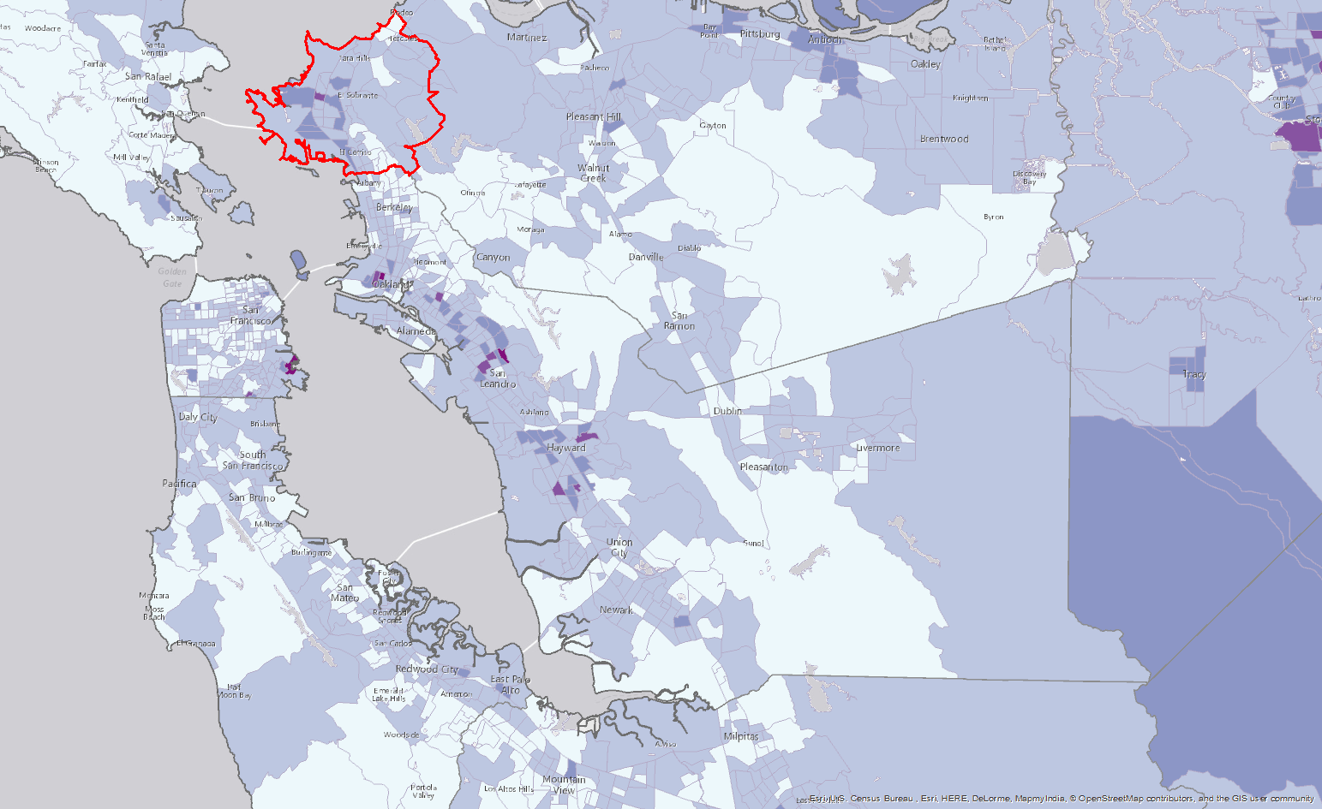
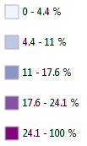
Jobs?
City of Richmond unemployment rate has remained
approx. 12% over the last five years.

Slide 9
Contra Costa County: Some Facts

Slide 10
Population Change
Contra Costa Cities
Source: DDP from Census ACS 2010-13

Slide 11
West Contra Costa USD
Lowest # births in last 20 years
Source: DDP from DOF Birth Data by Zip Code

Slide 12
City of Richmond
School Age Population
Source: DDP from Census ACS 2010-13

Slide 13
2014 Student Forecast

Slide 14

The DDP Philosophy
Projections: Residence vs. Actual Enrollment
Facilities should be located where the students live
Justification:
  Reduced District transportation cost
  Increased ability to conduct long term facility planning
  Increased access for walking students
  Accurately determine location of new facilities or consolidation of surplus facilities
  Increased ability to identify future population trends
  Attendance boundary adjustments are based upon student location
  Program locations can be better aligned to actual student population
Actual school enrollments do not necessary reflect area demographics
  There becomes a disconnect of true demographic trends and where students attend school
    Difficult to predict future students’ school of choice
  School consolidation should be based upon area student population
    Programs can be moved to other schools
  School enrollment is influenced by many non geographic variables
    Curriculum or special programs
    Intra-district transfers/open enrollment
    District policy
    Capacity relative to other schools (overflow)
    Etc…
Policies and programs can mask true demographic trends and area facility needs

Slide 15
Projection Calculations
Calculated for each of the district 401 Study Areas
  Ability to plan at a neighborhood level
Based upon student data October 2014/15 and historical student data from 2011/12 – 2013/14
Based upon actual student residence rather than current school of enrollment.
Graduate 12th grade; Move up other grades
Based upon three (4) factors that effect student population
  Incoming kindergarten class (partially determined from recent birth data by zip code)
  New residential development
  Mobility - Measures the migration of students in and out of the district. Including move ins, move outs, new students from infill housing, drop outs, private school movement, etc.
  Additional district-wide adjustments were made to
  account for charter school expansion

Slide 16
Multiple Years of Student Data

Slide 17
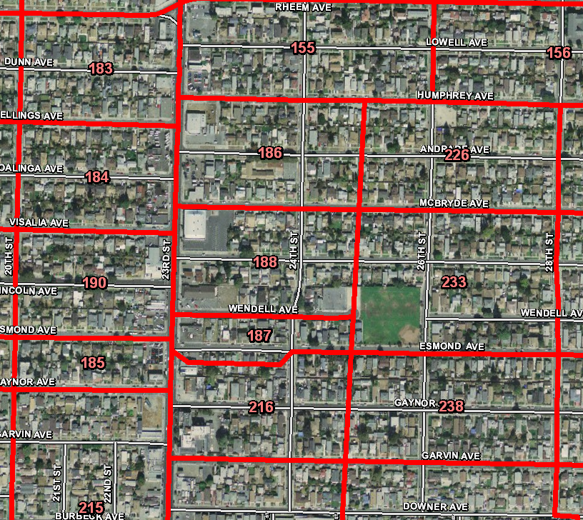
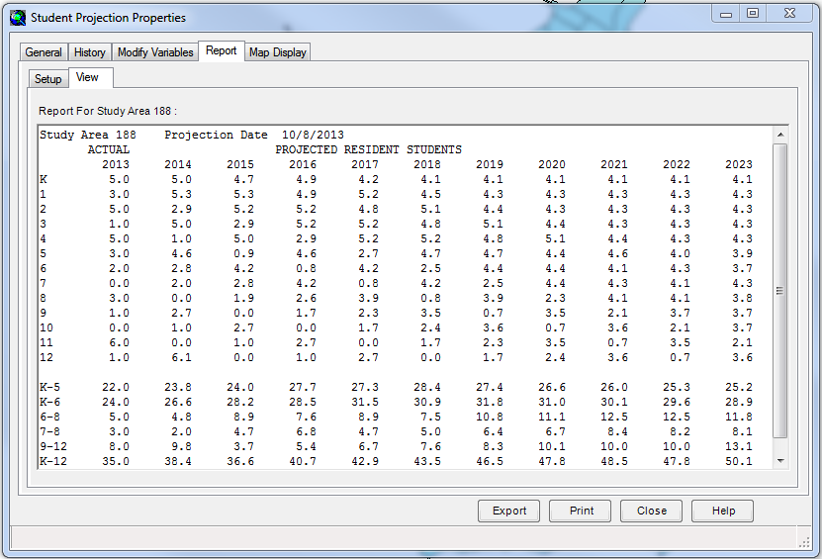
Projections Calculated for Each Study Area
Analysis is completed at the study area level, and summarized by attendance area and District-wide
Useful for boundary planning,
new site, and school consolidation analysis

Slide 18
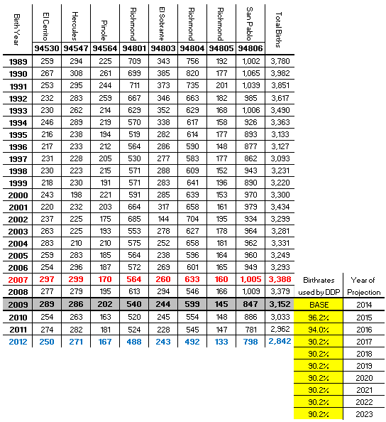
Births by Zip Code
Birth rates continue to fall from their 2007 peak
Lowest # births in the last
20+ years
Anticipated smaller incoming kindergarten classes will contribute to a lower student
forecast for the District
Sources:
Births by Zip Code -California Department of Health and Human Services
2012 Birth data was the most recent data available at the time of the study
*Zip Coe data does not correspond exactly with the W.C.C.U.S.D. boundary

Slide 19
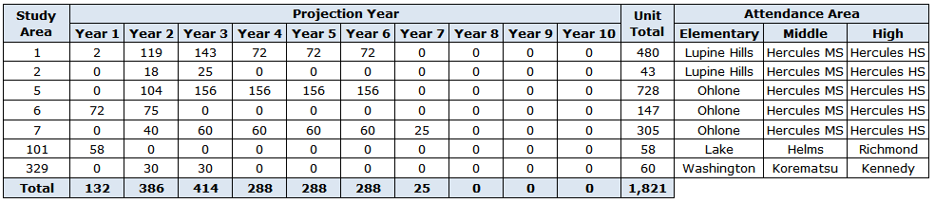
Residential Development
Much of the development planned within the District will be lower yielding Multifamily units
Student Yield Factors - District Wide*
 |  | K-6 |  | 7-8 |  | 9-12
Type |  | Students |  | Students |  | Students
SFD |  | 0.308 |  | 0.075 |  | 0.068
MFA |  | 0.058 |  | 0.004 |  | 0.017
Note: Student Yield Factors were calculated by Jack Schreder and Associates and provided to DDP by the W.C.C.U.S.D staff

Slide 20
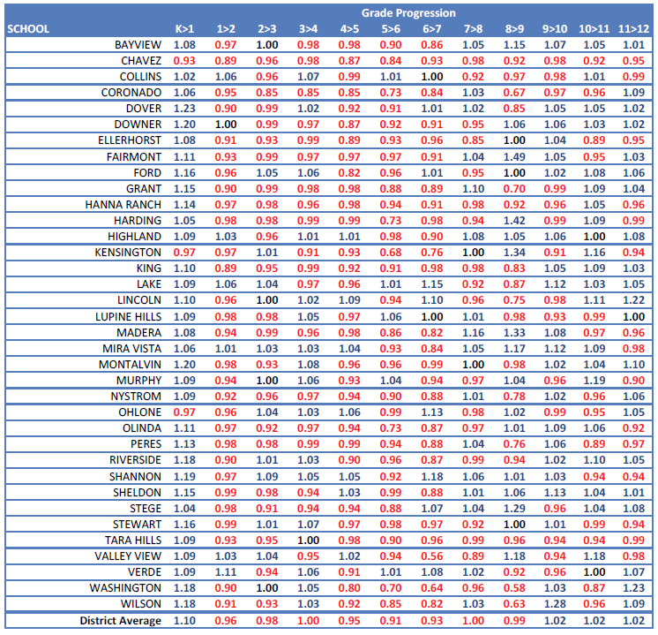
Mobility
Captures student migration in and out of the District
The District as a whole is seeing people leave the District between 1st and 9th grade
> 1.000 = positive migration < 1.000 = negative migration

Slide 21
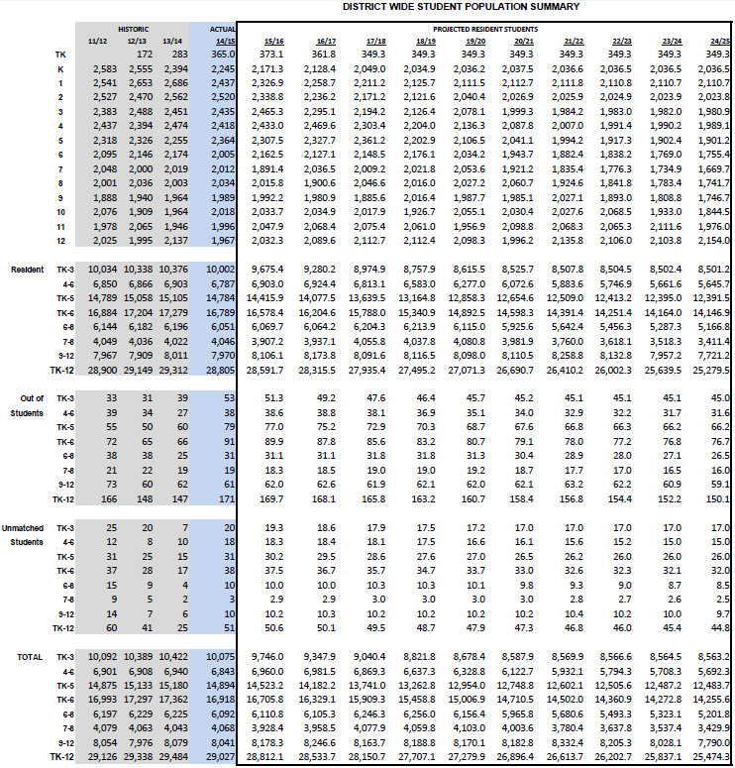
10 Year Forecast
10 Year Change
TK-6 -2,663 (-15.7%)
7-8 -639 (-15.7%)
9-12 -251 (-3.1%)
TK-12 -3,553 (-12.2%)

Slide 22
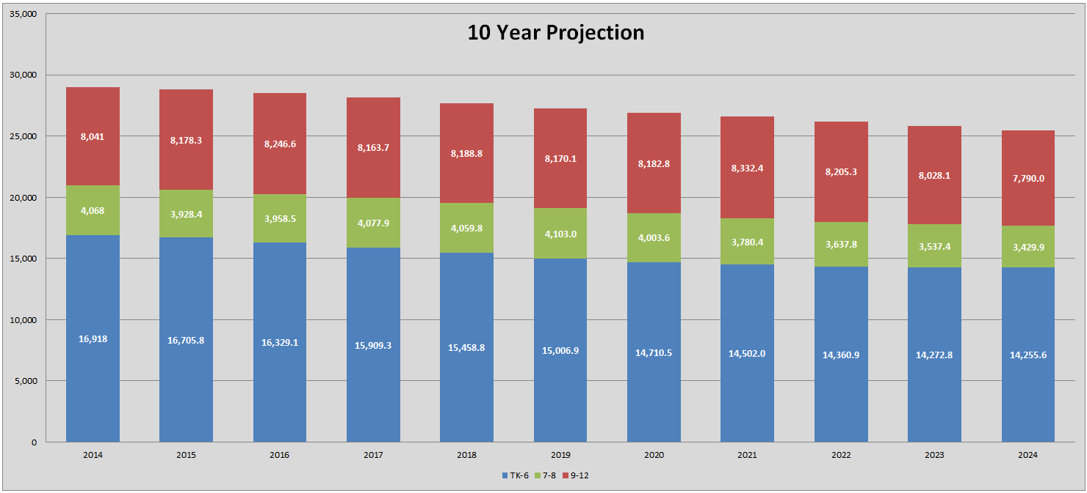

Slide 23
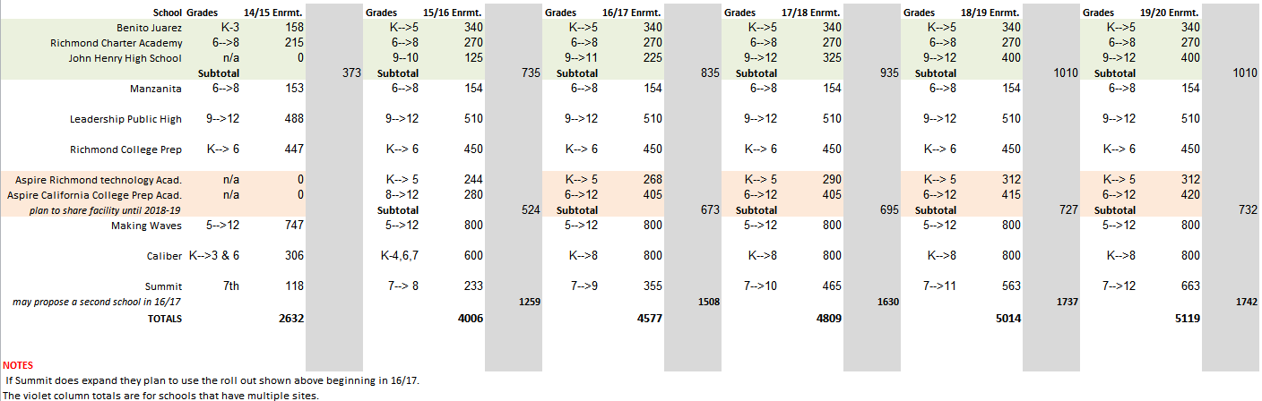
Charter School Adjustments
*Current (2014) Charter School Enrollment and Projections as Provided by WCCUSD Staff
Area Charter School enrollment is expected to increase by 2,487 or 96% by 2019
DDP Adjusted the Districtwide projections

Slide 24
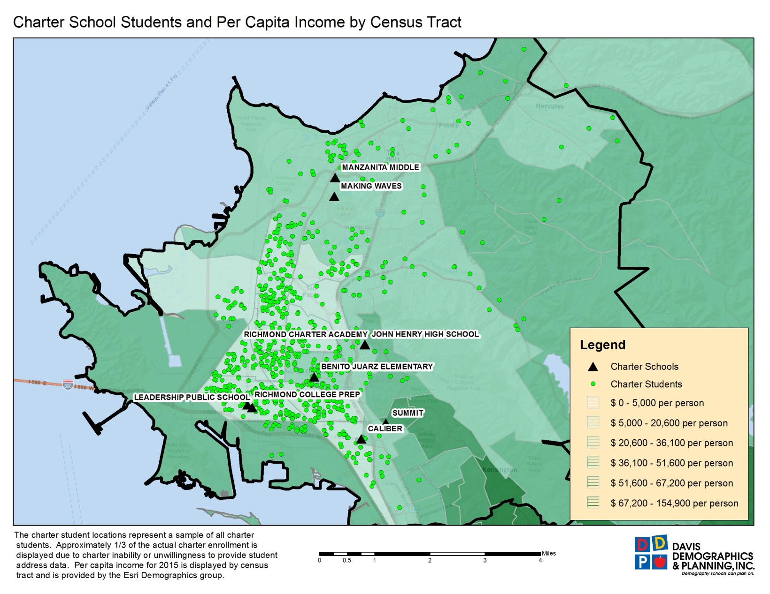
Charter School Analysis
Of the sampling, 99% of charter students reside within the WCCUSD boundary
Mapping of the sampling reveals that the students are concentrated in the lower income areas of the District

Slide 25
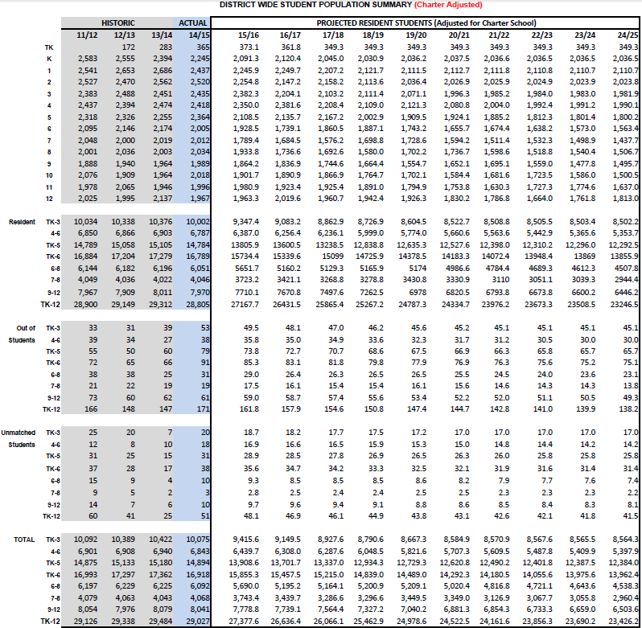
10 Year
Charter Adjusted Projections
10 Year Change
TK-6 -2,956 (-17.5%)
7-8 -1,108 (-27.2%)
9-12 -1,538 (-19.1%)
TK-12 -5,602 (-19.3%)

Slide 26
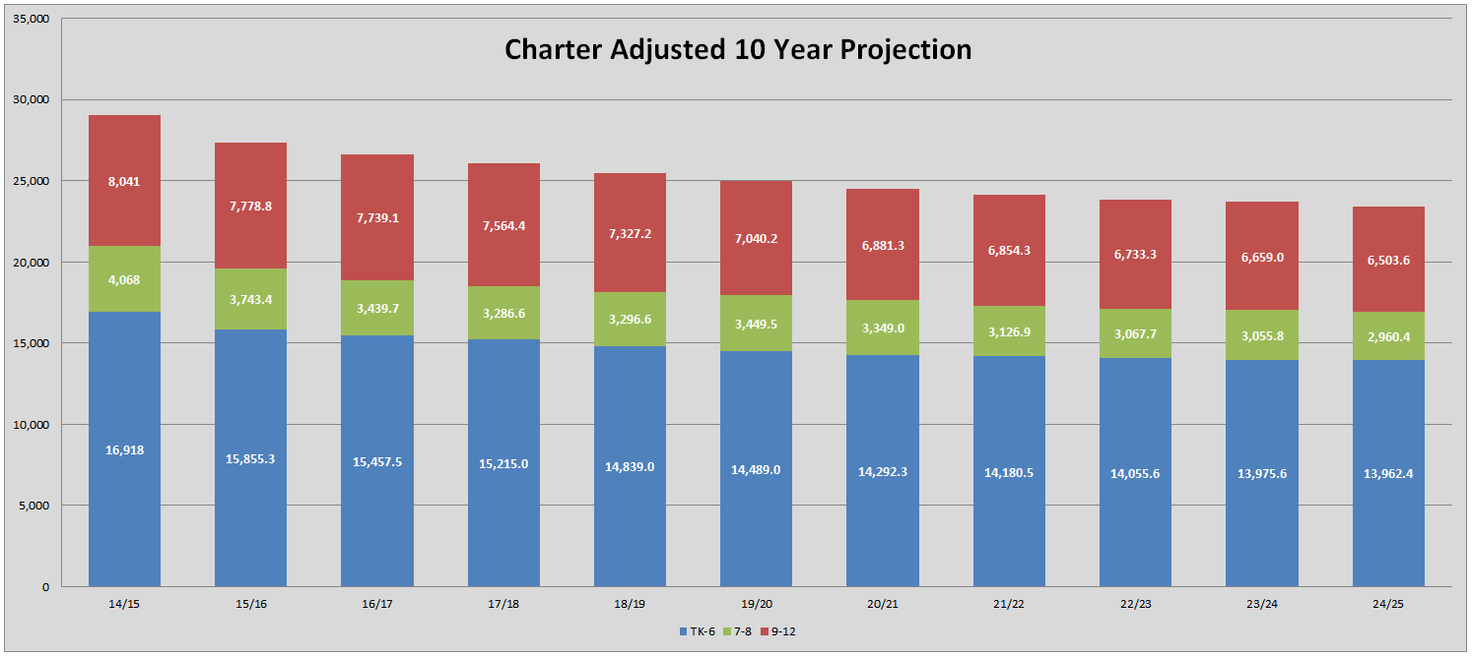

Slide 27
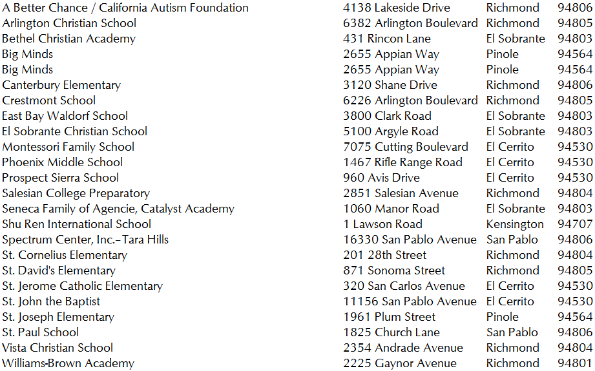
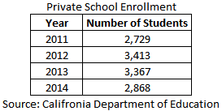
Private School Analysis
Private school enrollment has fallen since 2012

Slide 28
Charter School Analysis
Of the sampling, 99% of charter students reside within the WCCUSD boundary
Mapping of the sampling reveals that the students are concentrated in the lower income areas of the District

Slide 29
Summary
Historical slow growth across Bay Area
District area population is aging
Declining births
Local job situation- competition from other areas
Minimal development
Declining student population
Charter school impact
Overall economic climate hard to predict

