Slide 1
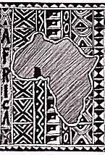
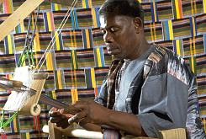
Weaving &
Kente Cloth

Slide 2
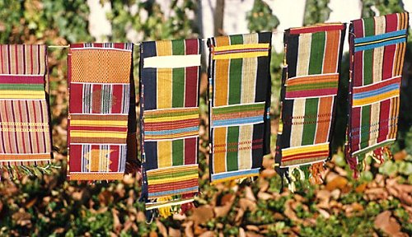
Kente Cloth, Ghana
Kente Cloth
Weaving done by men in West Africa
Woven in long narrow strips, then sewn together into large fabrics
Traditionally worn draped across the shoulders

Slide 3
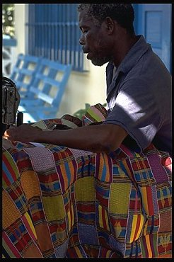
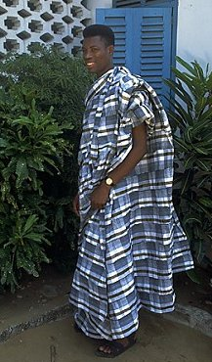
Bobbo sewing Kente cloth together
Bobbo’s eldest son

Slide 4
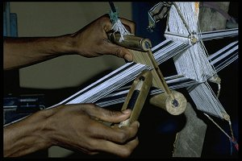
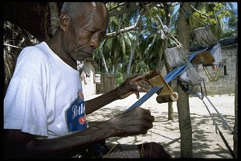
Weaving
Weaving
Process of interlacing threads to form cloth
Based on warp & weft threads

Slide 5
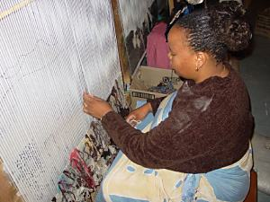
Weaving - Warp
Warp
Threads are strung vertically on a loom
Form the skeleton of the weaving

Slide 6
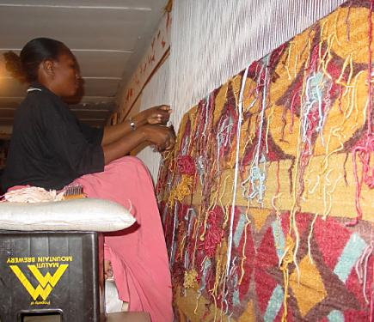
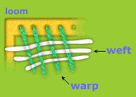
Weaving - Weft
Weft
Horizontal threads that pass over & under the skeleton
Form the body
of the weaving

Slide 7
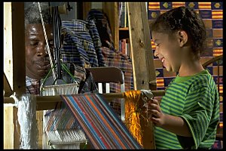
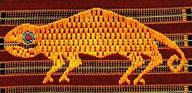
History of Kente Weaving
Kente weaving
Craft passes from father to son
Patterns given names
Example: “My ideas have run out”
Agama: The chameleon signifies patience and trickery
Notes:
Ator-tor
. Pineapple skin. The pineapple is sometimes given as a gift to a friend. It is not easy to peel -- like a friendship it requires work.
Agama The chameleon signifies patience and trickery

Slide 8
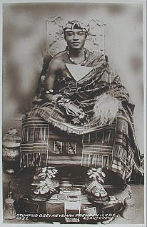
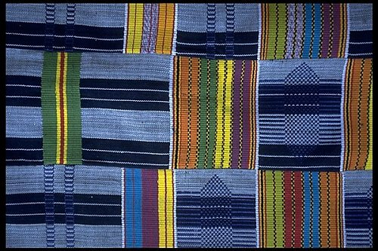
Use of Kente Cloth
Originally made for Kings & Queens
National dress of Ghana
Worn for holidays
Popular with tourists

Slide 9
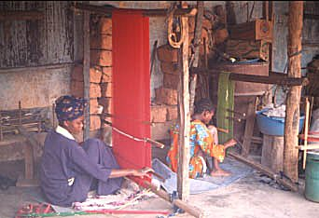
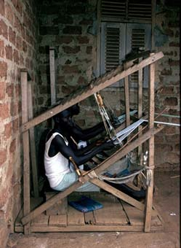
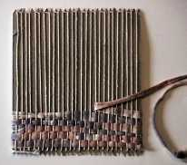
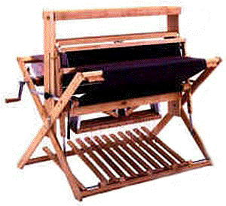
Weaving Terms
Loom
Structure that holds the weaving together
Strip loom
upright loom
Standing loom
cardboard loom
Strip loom
Notes:
Strip loom sometimes called the man’s loom. These looms are designed to accommodate long narrow strips of cloth.
Typically women use an upright loom
Standing looms are common
Students will be using a Cardboard loom, these are simple, rectangle pieces of heavyweight cardboard used as a weaving structure. They are inexpensive substitutes for a portable strip loom

Slide 10
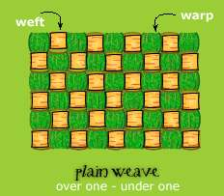
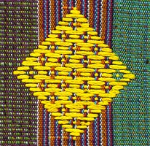
Weaving Terms
Tabby or plain weave
Going over, under the warp threads
(to) Beat in
To push the weft close to the previously woven weft
Selvedge edge
Woven sides of the piece

Slide 11
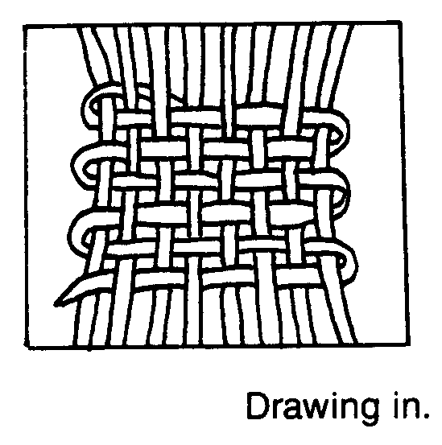
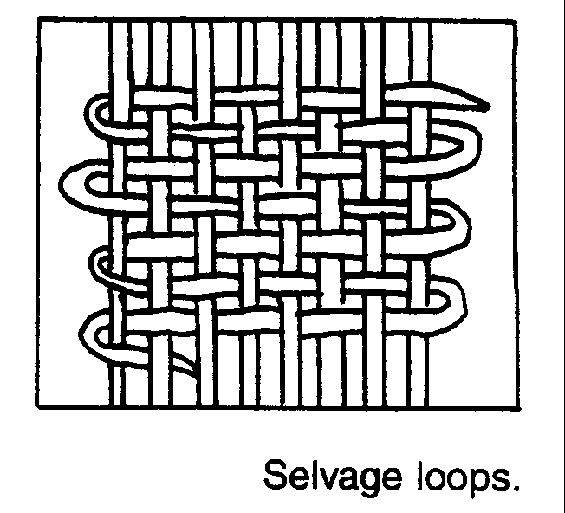
Weaving Problems
Drawing-in
Unwanted waist-line produced
if the thread is pulled to tight
Selvage loops
Uneven edges acquired if too
much thread is left at the edges
Notes:
Drawing in can only be fixed by taking the yarn out and redoing it
Selvage loops can be corrected by simply turning the weaving over and pull the uneven edges in line with the other threads.

Slide 12
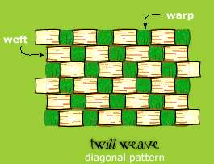
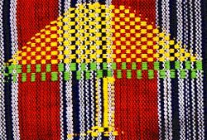
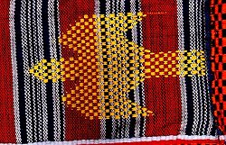
Kente Cloth Design Techniques
Use the tabby weave to develop different colored strips
Create interest with width differences
Create a checkerboard
Going over and under 2 threads
Add a brocade weave on top
Zigzags are common
Notes:
More weaving techniques in class packet

Slide 13
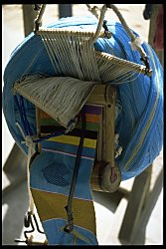
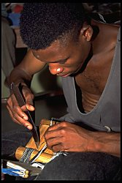
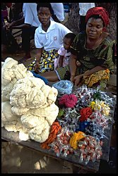
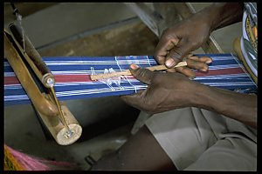
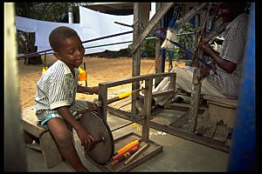
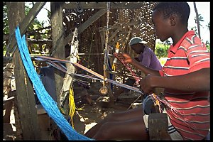
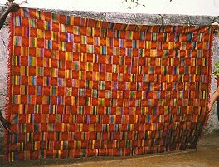
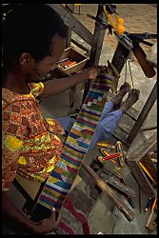
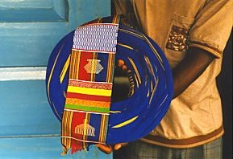
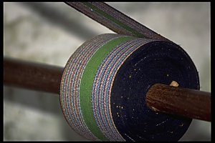
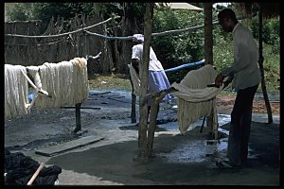
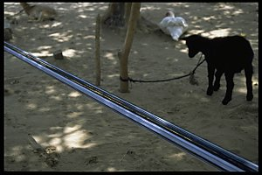
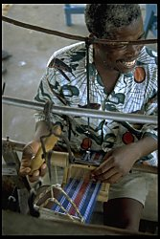
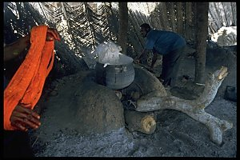
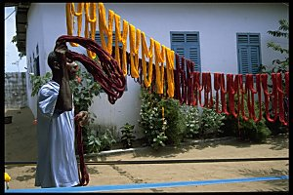
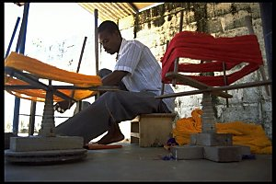
Master Kente Cloth Weaver, Gilbert “Bobbo” Ahiagble
Packed-up for the day. The warp is never left stretched out on a loom overnight. Here you can see the warp crown and its already woven end.
Two goats, a chicken and a warp
Bobbo weaving at his loom
A yet to be woven crown and the finished end of the strip
Bobbo at a weaving demonstration in the U.S. - with a young admirer.
One of Bobbo's youngest sons, Kweku, lending a hand winding thread onto a small bobbin
Measuring the beat of a strip with a notched stick
Kente Cloth
A couple of young weavers helping out on school break
Washing yarns
An elder weaver from Agbozume
A weaver showing a finished strip - this pattern is called worgagba, or "corn power".
A woman selling yarns and dyes on market day in Denu
Boiling the yarns in a large kettle on a fire pit, adding starch, and dyeing.
A weaver winding the yarns onto bobbins
Hanging a multitude of different colored dyed skeins out to dry. Sunny days are not scarce in Denu
Adding threads to the loom
A woven strip of cloth winding up on the loom's cloth beam
Bobbo at his loom
Passing the weft threads through the shed.
Notes:
Gilbert "Bobbo" Ahiagble, of the Ewe ethnic group is a Master Kente Cloth Weaver from the VGilbert "Bobbo" Ahiagble, of the Ewe ethnic group is a Master Kente Cloth Weaver from the Volta Region of Ghana.
He began assisting his father by winding bobbins at the age of three and moved onto the West African loom as soon as his legs could reach the treadles, at around the age of nine. He obtained a solid formal education also and his academic abilities opened doors for him and he soon received a diploma as a secondary school teacher, which obliged him to make a choice at the age of 21, to become a teacher or to remain a weaver. Influenced by words he heard from his Peace Corps math teacher, he combined the two and became a teacher of Kente cloth weaving.
Bobbo was first invited to the USA in 1975 as an Artist-In-Residence at the Museum of African Art, then a small, private museum which became part of the Smithsonian Institution several years later. His skills as a communicator soon gave him the title of "Cultural Ambassador of Kente Cloth" and continuous invitations to work abroad came from Switzerland, Canada and the USA. Most recently he taught American fiber artists the fine art of Kente weaving in a workshop held in Atlanta at the prestigeous conference of the Handweavers Guild of America, "Convergence".
Bobbo's weaving business employs many weavers in the Denu and Agbozume areas.
Bobbo has had a major influence on traditional West African strip cloth weavers beyond the borders of Ghana. He serves as a spokesperson for the power in the language of Kente cloth, filled with symbolic proverbs present to enrich the lives of everyone ready to listen and learn.
Just recently he has co-authored a children's book, titled Master Weaver from Ghana, with Louise S. Meyer, with outstanding photographs of his home town taken by Nestor Hernandez, a Washington, DC based documentary photographer. And he has built a school and dormitory in Denu, called the Craft Institute of Kente Weaving, where student groups can stay and learn traditional Kente cloth weaving.

Slide 14
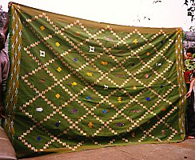
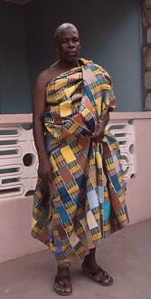
Kente Cloth

Slide 15
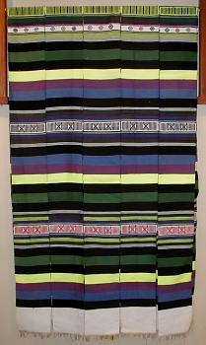
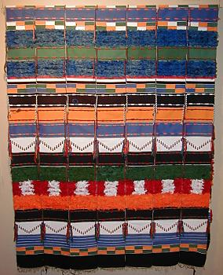

Slide 16
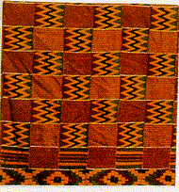
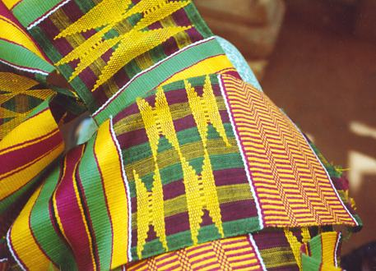
Kente Cloth

Slide 17
Credits
Created by Jerilynn Packer
Resources:
Kente Cloth story and slides http://members.aol.com/davilojo/p1.htm
www.africancrafts.com African Crafts
http://www.marshall.edu/akanart/cloth_kente.html AKAN KENTE CLOTHS
http://mywebpages.comcast.net/kboahene02001480/kente.htm
http://www.ghana.com/republic/kente/index.html KENTE
http://kente.midwesttradegroup.com/history.html Symbolic Meanings of Colors
http://www.adire.clara.net/africantextilesintro.htm looms of Africa
www.handsoncrafts.org Hands on Crafts

